Slide 1

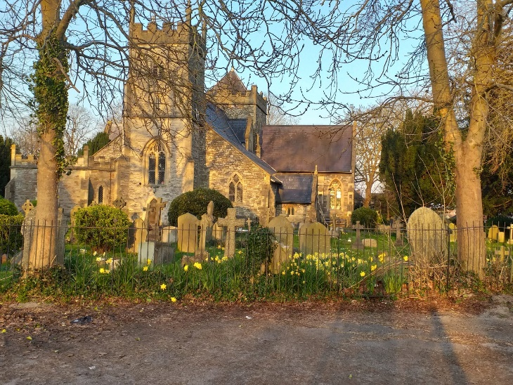
Introducing
At Holy Trinity, Horfield

Slide 2
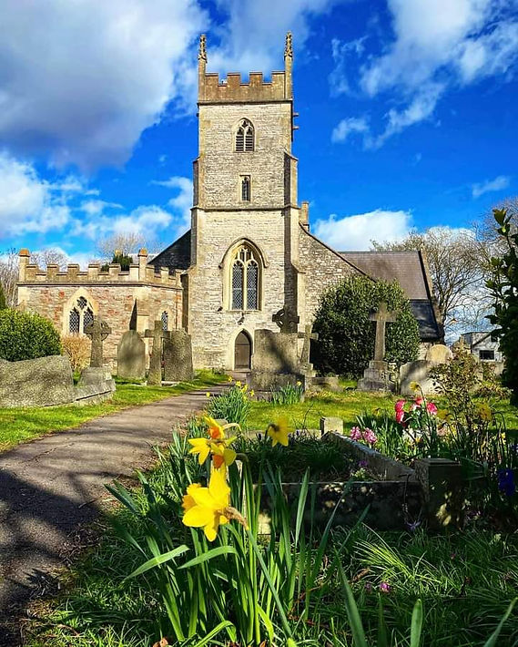
Outline
Context
Demo
Tips
Reflections

Slide 3

Sharesy in the Diocese of Bristol
Currently: 11 churches in the Diocese are live on Sharesy - 7 in Bristol and 4 in Swindon.
In preparation: A further 6 have signed terms and are in the process of going live, all in Bristol.
Photo by Susan Holt Simpson on Unsplash

Slide 4
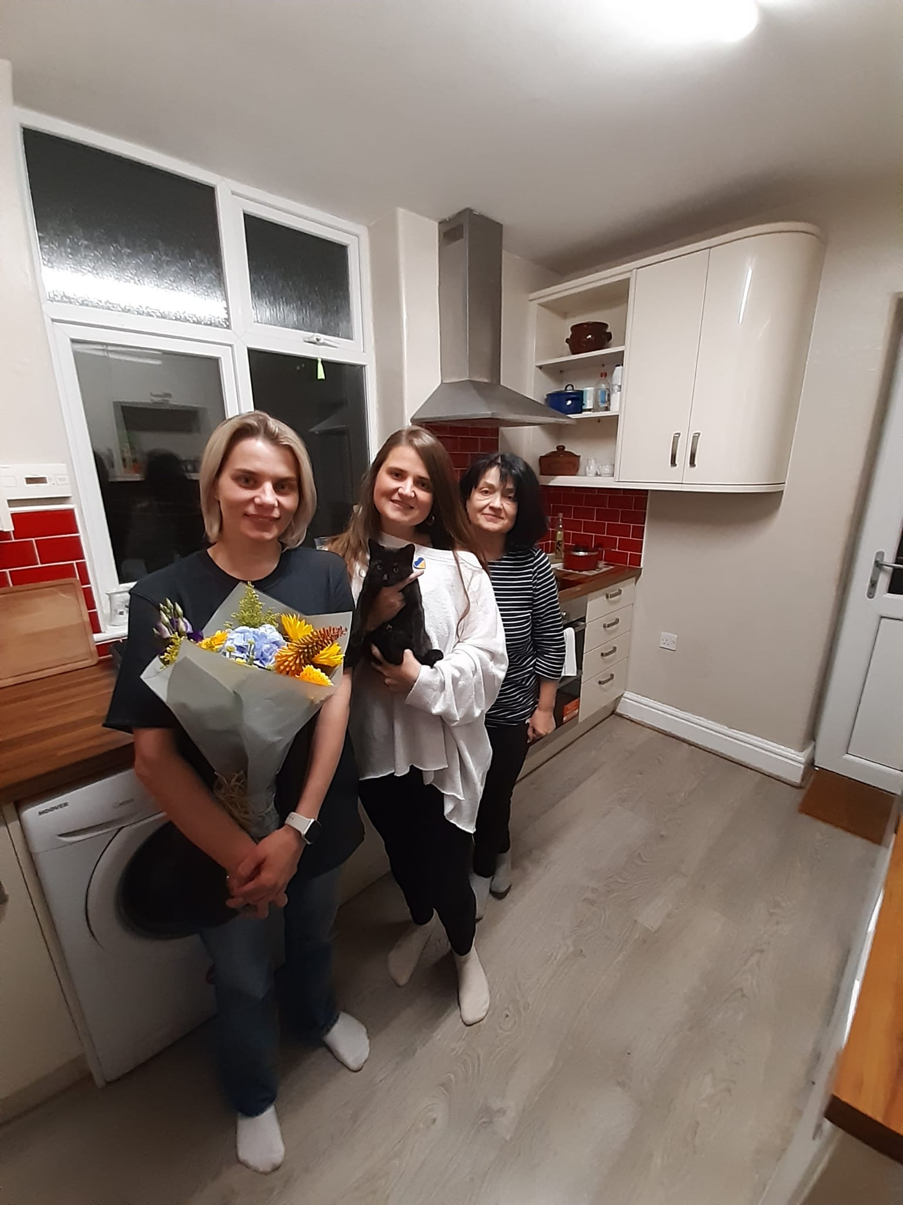


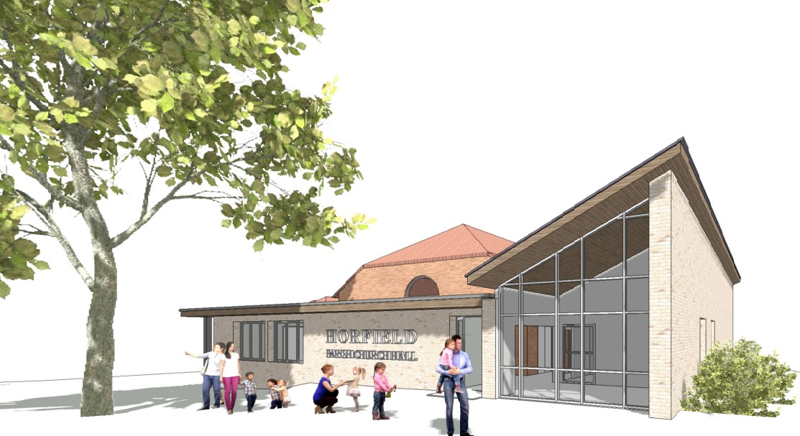
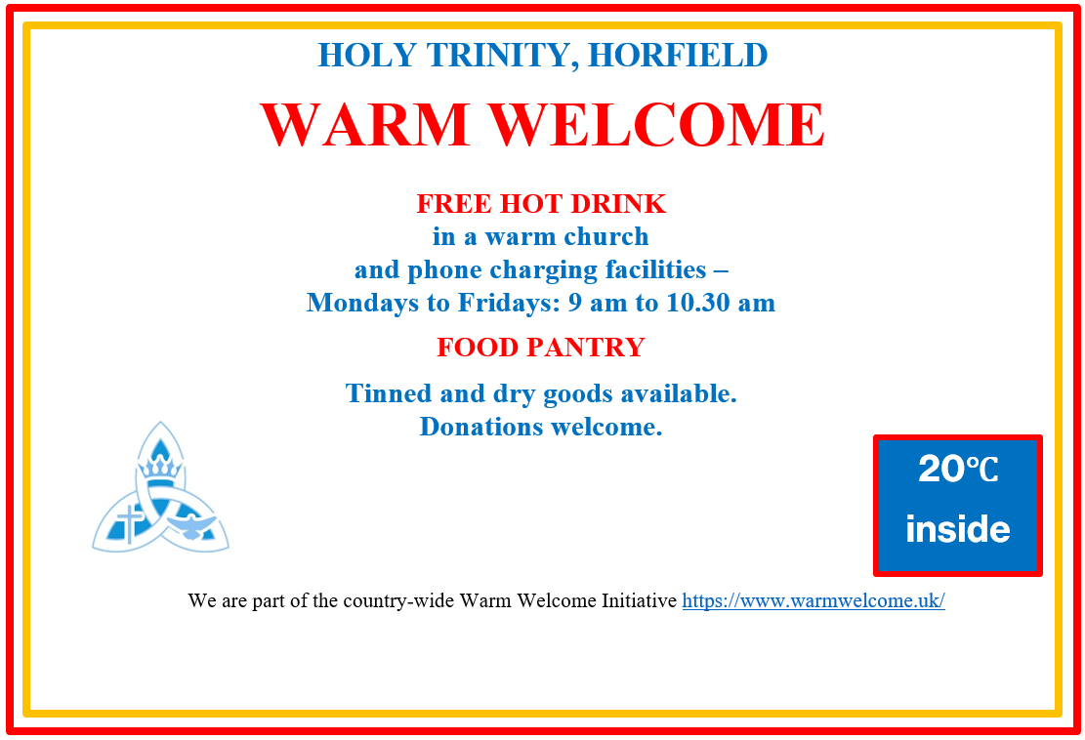
Holy Trinity
Transition of Parish support role.
Current system:
Cumbersome booking process
Securing Bookings
Lack of data

Slide 5
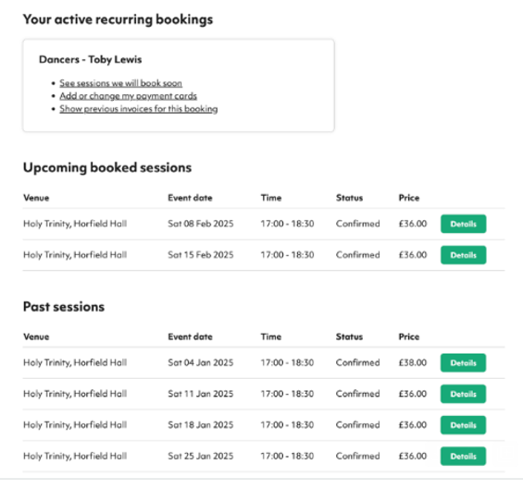
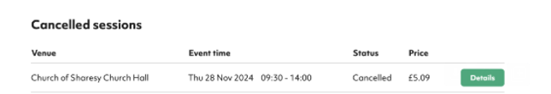
Hirer dashboard
Welcome to Sharesy

Slide 6

Tips
Preparation
Engagement
Review

Slide 7

Reflections
Photo by Tim Marshall on Unsplash

Slide 8

Questions
Photo by Evan Dennis on Unsplash

