Slide 1
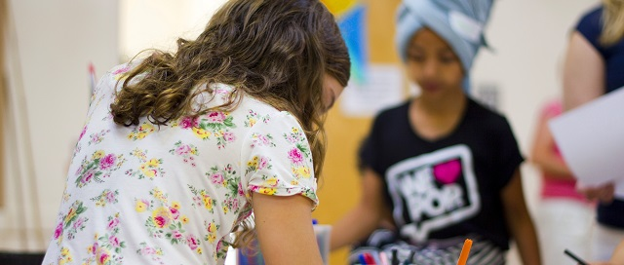
TC.T update - Diocesan Synod
Diocese of Bristol
RANSFORMING CHURCH.
OGETHER.
Following Jesus
Serving Others
Transforming Communities

Slide 2
Contents
TC.T Progress so far
Good News Stories

Slide 3
Contents
TC.T Progress so far
Good News Stories

Slide 4
Missional
progress
Following
Jesus
Deep lived out pathways
to faith
Serving
Others
Supporting Volunteers
Release Ministers to
Flourish
Developing
& mobilising
U18s
Max impact of Church buildings
Right forms of
Church, right places
Transform Communities
Develop & sustain Partnerships
Priority
Communities
Sustainable Diocese
Inclusion
Racial Justice
Capability
Build income
People & Systems

Slide 5
Programme Board Summary (Sept 24)
Overall progress is Amber / Green for the first time since the start, and real impact is being felt.
Major areas of current risk:
- Budget: - Parish Share / Income Generation
- Parish Engagement (though activity is increasingly more visible)
- Partnerships, Volunteers, Inclusion need intensive focus to create momentum

Slide 6
Contents
TC.T Progress so far
Good News Stories

Slide 7
Good News Stories
(NB not just TC.T funded!)

Slide 8
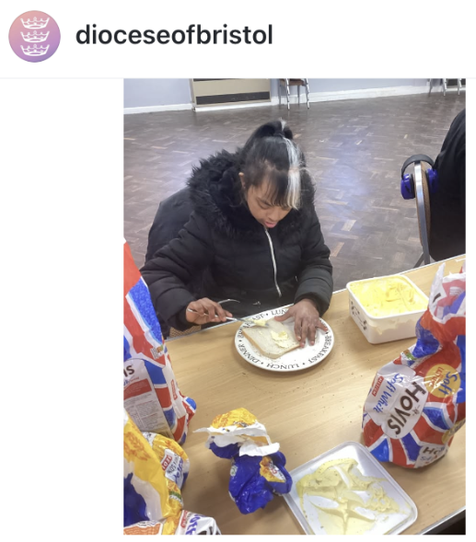
Good News
St Peter's Church Penhill
St Peter's teamed up with Uplands School students to make 18 loaves worth of sandwiches
These were donated to the Filling Station, a Swindon charity supporting the homeless
A good example of church engaging in local partnerships!

Slide 9
Good News
Priority Communities
First 3 Ops Hub Managers have now started and are able to give practical support to Clergy (first feedback is that they are 'a huge blessing'!), 4 more in the pipeline
3 Lay positions have also been filled in line with Parish needs
We are meeting with SWYM & Mullers to discuss mutually supportive Youth & Children's workers pipeline (key issue for whole TC.T programme)

Slide 10
Good News
Sharesy
55 churches in the pipeline (6 signed terms), 11 are live on Sharesy
Holy Trinity Horfield have earned enough to refurbish their Parish office, and enough time to repaint it, all within the first two months

Slide 11
Good News
Seed funding applications now available for Fresh Expressions of Church
Pioneering Parishes launched this year, with good interest so far (50 people attended the Bristol event, 70 came to the one in Swindon)
23 Churches signed up to participate in the Contested Heritage Monument Audit so far

Slide 12
Good News
65 clergy now in the Coaching programme, with 78% positive expectations so far
LLM Coaching programme in development
Lay worship leaders / Benefice worship leaders course to be rolled out shortly
First Young Preacher to be affirmed in March

Slide 13
Good News
3 new Small Groups have started as a result of the 'small group essential' materials
160 people signed up to receive the Rhythm of Life email resources every month
Phase 2 for Growing Faith Chaplains now starting discussion
CNZ – 4 VA School solar panel installations underway, 10 heat pumps planned for Clergy homes

Slide 14
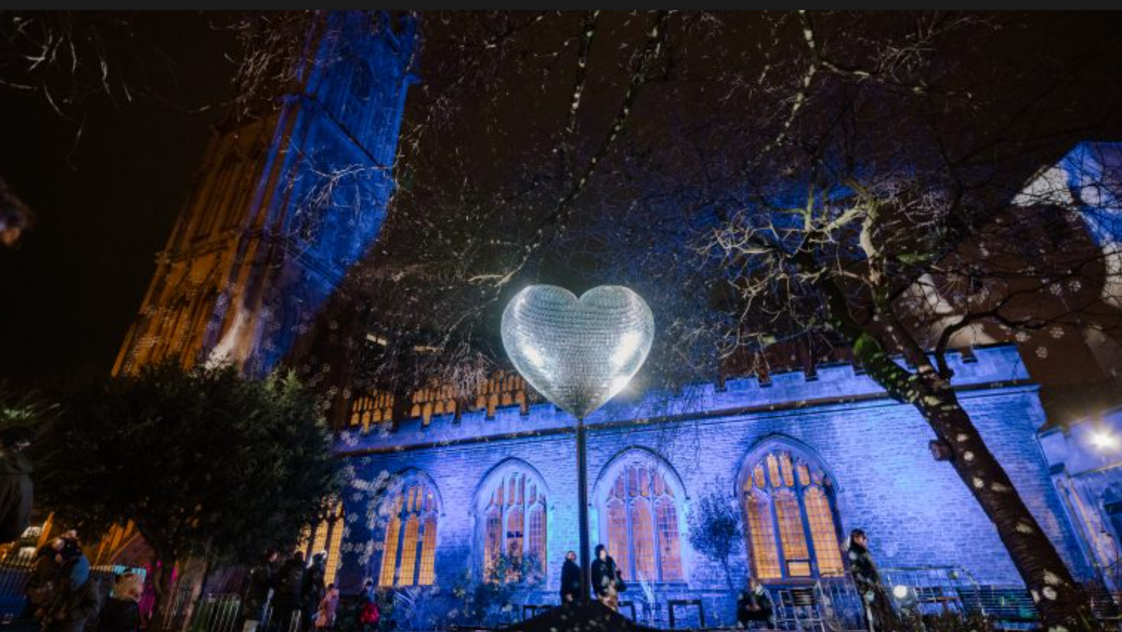
St Stephen's Church
'Our Beating Heart' was inspired by the idea of shared love and togetherness which transformed the gardens of St Stephen’s Church
Made up of more than 11,000 mirrored tiles and set to a soundtrack of iconic dance hits, 'Our Beating Heart' painted the churchyard in dapples of light, as part of Bristol Light Festival 2025

