Slide 1
Mission looks like Pioneer Experiments
Niall Briggs, Flourish Framework

Slide 2
Agenda
A quick history
Values and Methods
Everything is an experiment
Examples and stories

Slide 3
Flourish Mission Statement
Flourish enables, encourages, and nurtures the growing and releasing of innovative and new ministries through communities that create opportunities for all to encounter, journey with and experience God's love.

Slide 4
Flourish Values
In this community we value:
being genuinely bothered about people we meet
the gifts and uniqueness each person bring to this community and their place in it
making time to be with people and sharing life
vulnerability and genuineness
supporting each other on the wanderings and wonderings of life

Slide 5
Flourish Strategy
Find and be in spaces
Establish relationships
Uncover good news and help it be revealed
Explore spiritual connections together
Communities of discipleship
Identify and share lessons learned
Identify, develop and release leaders
Explore potential spaces
Being present in spaces
Establish relationships
Uncover good news in/with community
Enable good news to be revealed
Explore spiritual connections together
Work out, nurture and grow communities of discipleship based on shared values
Identify, develop and release leaders
Identify and share lessons learned

Slide 6
What is the Flourish Framework?

Slide 8
The Haven
Some Community Reflections

Slide 10
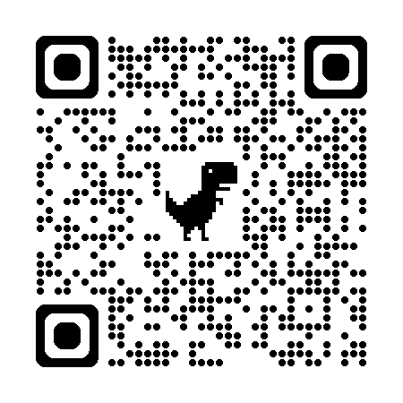
Thank you
Niall Briggs
niall@flourishbsgc.org.uk
flourishbsgc.org.uk
https://bit.ly/m/FlourishFramework

