Slide 1
Hope Aspiration and Courageous Advocacy in the Primary School
Laura Harris – Diocesan Schools’ Adviser
Laura.harris@bristoldiocese.org

Slide 2
What does the Bible have to say?
Take a look at the Bible quotations. Which one do you find resonates with your work in school? Why?

Slide 3
Christian Values
Can you match the Bible verses, with a value which is reflected in their words?
What do these words mean to you in terms of Courageous Advocacy in schools?

Slide 4
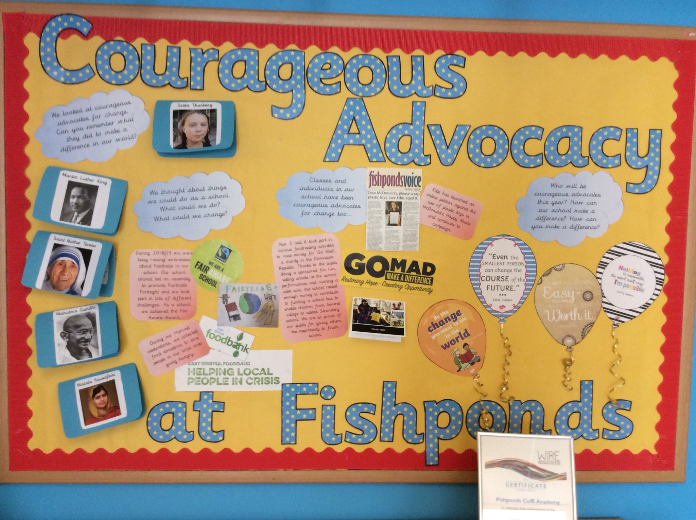
School Vision
Do these Bible passages or values link with your own school’s Christian vision in any way?

Slide 5
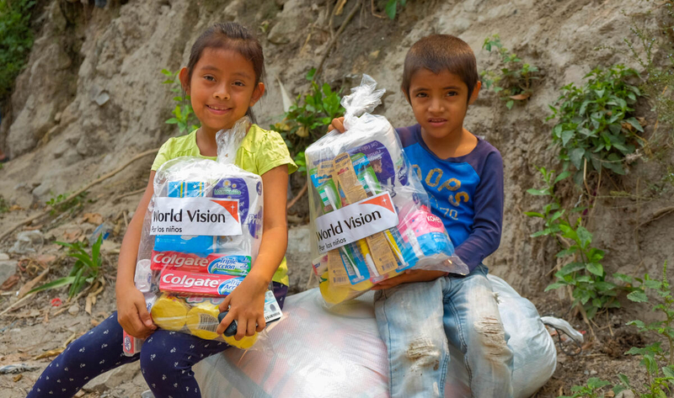
What SIAMS has to say currently:

Slide 6
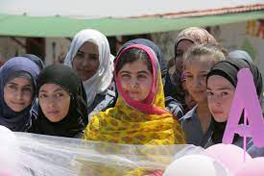
What SIAMS may have to say in the future:
justice
courageous advocacy
ethical choices
agents of change
partnerships
impact
freedom
rights
responsibility

Slide 7
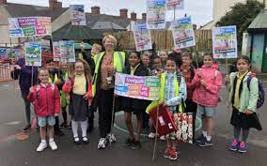
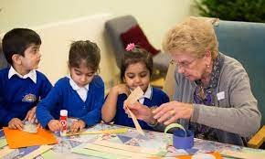
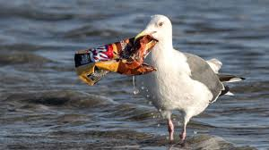
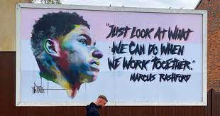
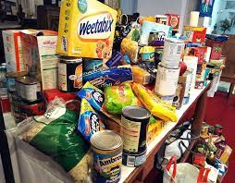
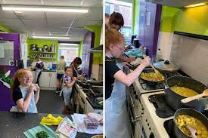
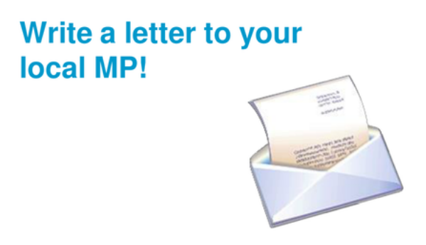
So, what can pupils actually do?
Love
Walk
Act
Protect
Follow
Speak
Share

Slide 8
So, what can pupils actually do?
Exhibit
Write
Raise awareness
Plan
Change
Suggest
Sing
Learn

Slide 9
lucy.swift@childofhopeuganda.org
Do you want to demonstrate how effectively your school’s distinctive Christian vision enables pupils and adults to flourish?
Through a meaningful, global, charitable partnership with Child of Hope, nursery, primary and secondary schools in Uganda, you could help develop your children’s understanding of faith in action, of disadvantage, deprivation and how to become courageous advocates for change in a global community.
Everything is Christ-centred. Child of Hope education, pastoral and medical staff work with children and their families to beat poverty through education. The schools provide free education for 600 children aged 3-18 from the Namatala slum and surrounding areas.
https://youtu.be/zSGUKW7he30 https://youtu.be/k1Wzz_xFStg.

Slide 10
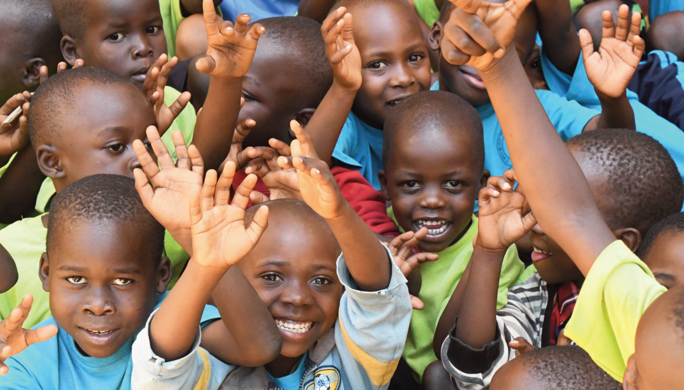
https://www.childofhopeuganda.org/what-we-do/education/our-school
lucy.swift@childofhopeuganda.org

