Slide 1


Breaking the Jar

Slide 2
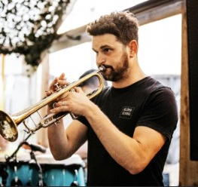


ANNA
PICTURE
PICTURE
PICTURE
DAVE
MATTI

Slide 3

Breaking the jar

Slide 4
about every
500 years the Church feels compelled to hold a giant rummage sale
“
“
Phylis Tickle “The Great Emergence: How Christianity Is Changing and Why” quoting The Right Reverend Mark Dyer

Slide 5
Jar-breaking moments
70 AD
500 AD
1054 AD
1521 AD
2025
Early Church
Monasticism
Great Schism
Reformation
Post-Christendom

Slide 6
Peregrinati (OR GYROVAGI)
At the Hertford Synod in 672 it was stated:
'MONKS SHALL NOT WANDER FROM PLACE TO PLACE....EXCEPT WITH A LETTER DISSMISSORY FROM THEIR OWN ABBOT'
LITTLE CHURCHES WITHIN THE CHURCH (ecclesiolae in ecclesia)

Slide 7
Is the God of Luke 10 still out There?
Am I releasinG ALL the gifts of the people + building THE BODY? (Ephesians 4)

Slide 8
Am I making disciples of Jesus or LOYAL MEMBERS OF my church?
Am I keeping people in a state of adolescence?

Slide 9

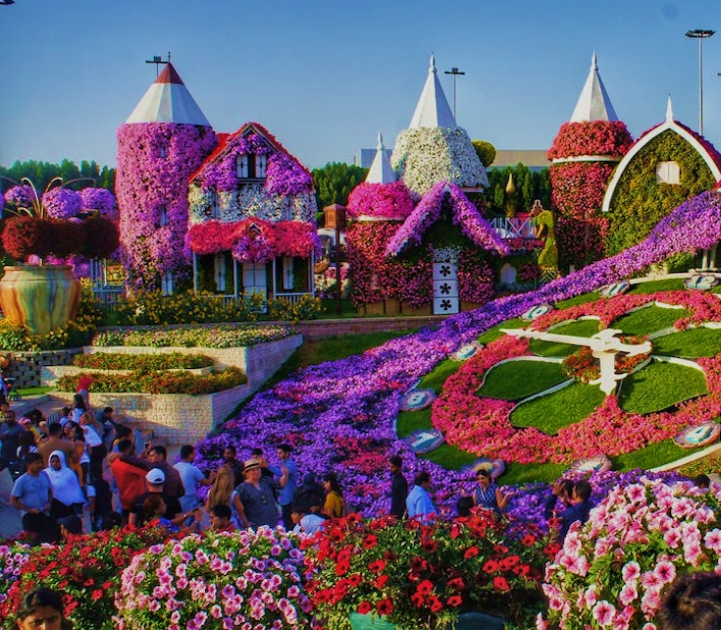
TWO GARDENS.
DESERT OR DUBAI?

Slide 10
WHAT IS
THE GARDEN?

Slide 11
15 lay led
simple, sustainable, sociable
Missional communities across Norfolk.

Slide 12
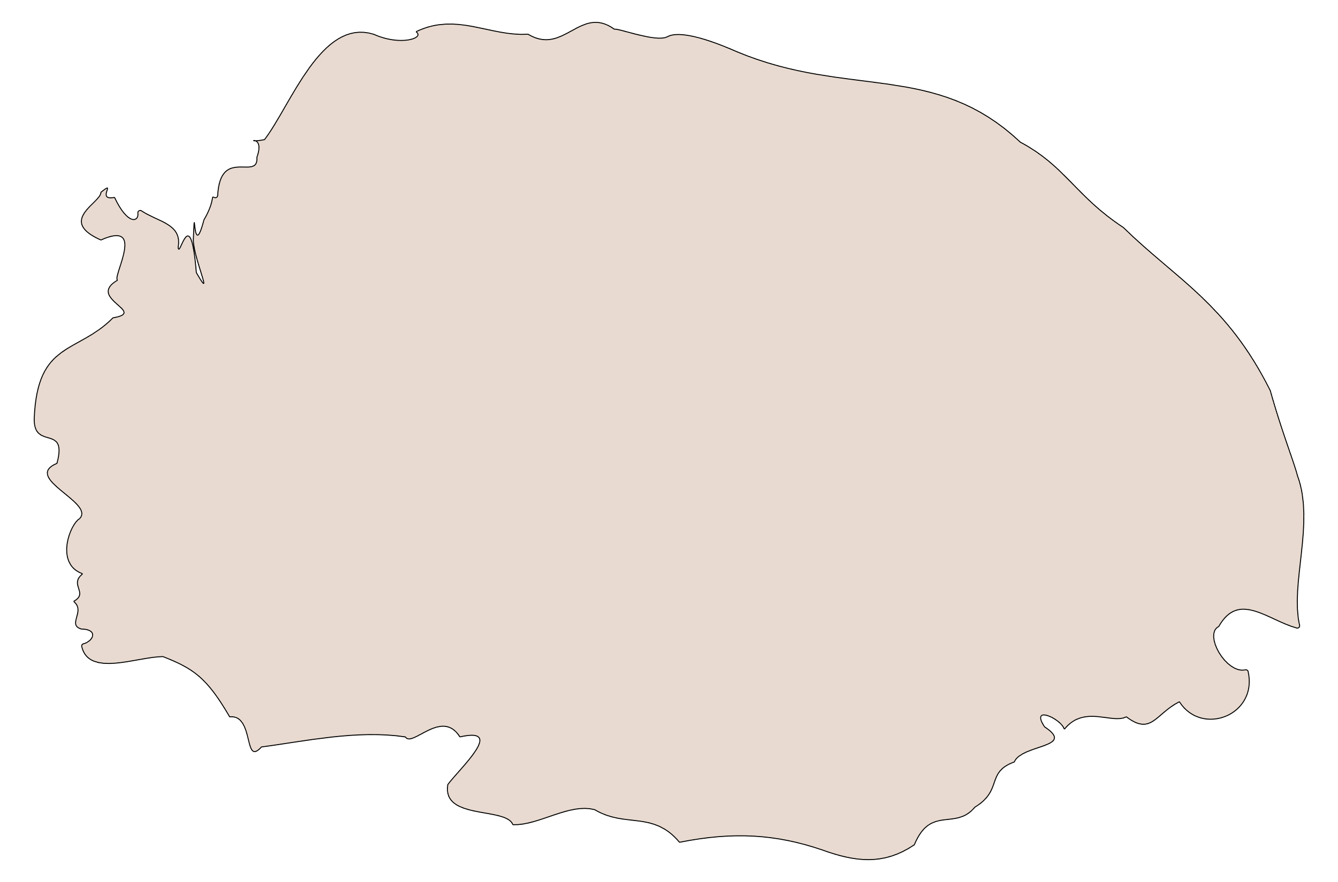
Fakenham
Swanton Novers
Reepham
Upper Nar Villages
Attlebridge
Statton Strawless
Ringland
Sprowston
Costessey
NORWICH
Hethersett
Shotesham
Dereham
Raveningham
Breckland South
Thetford

Slide 13
D.
L.
E.
S.
S.
DEVOTED. LOVING. EQUIPPED. SPIRIT-FILLED. SUFFERING

Slide 14

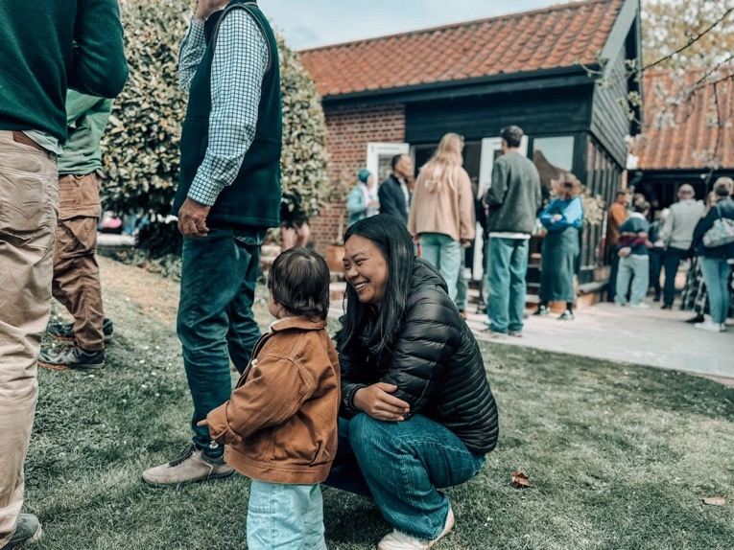
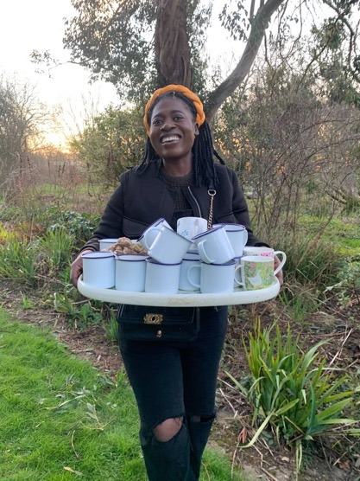
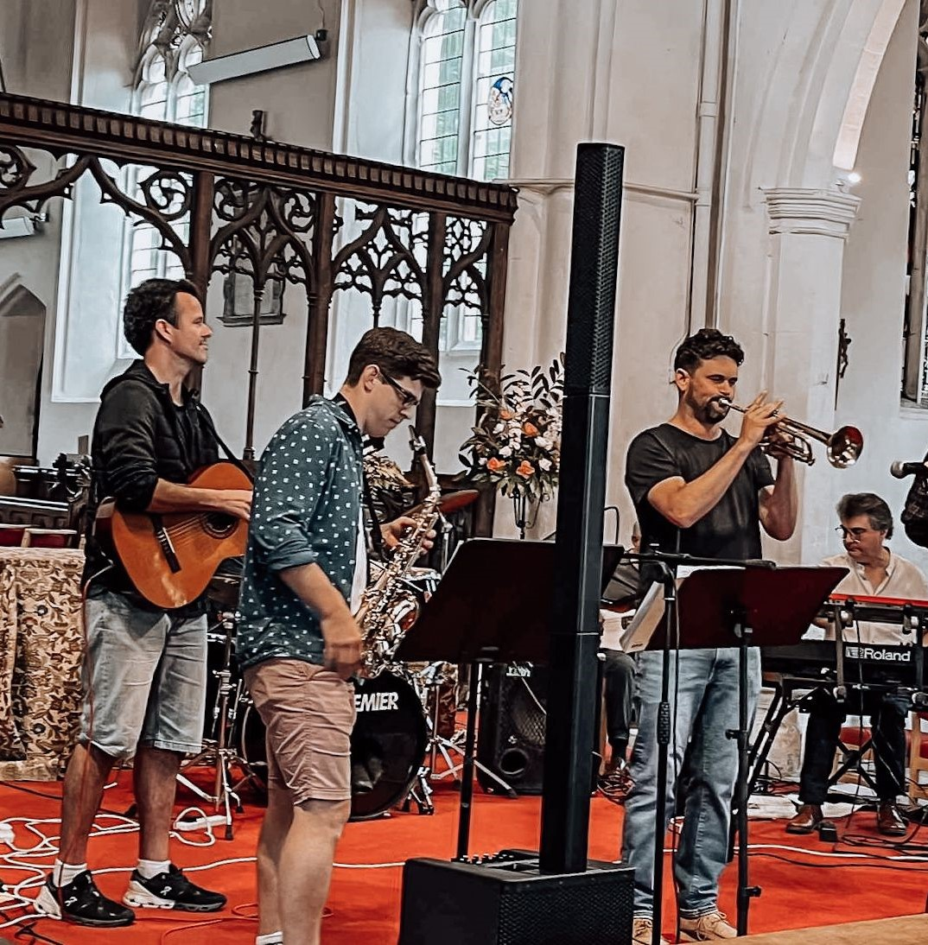
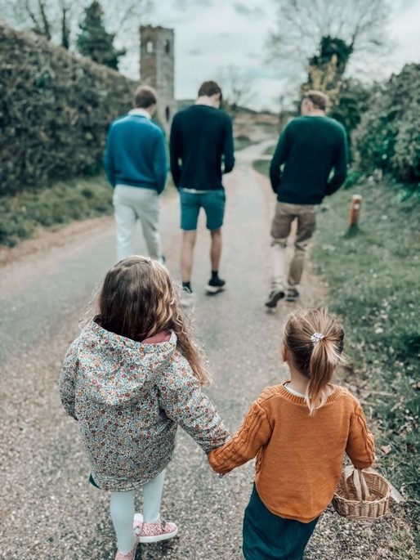
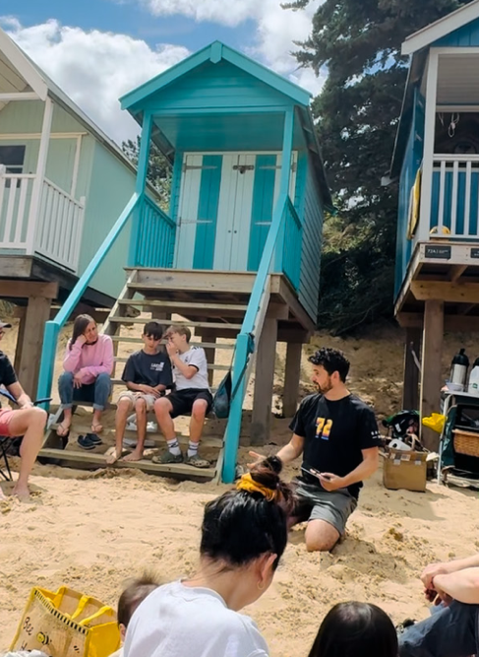
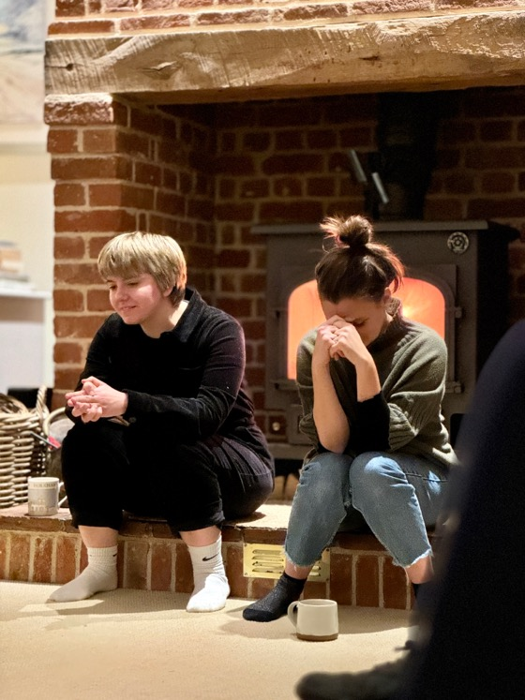
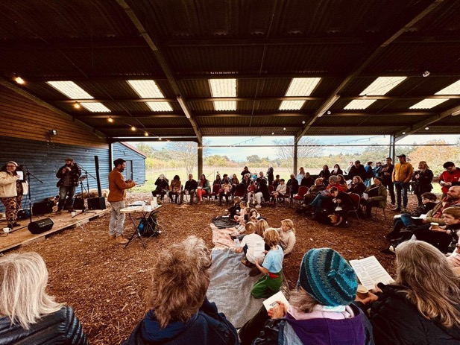
WEEKLY
MONTHLY
MISSIONAL COLLABs

Slide 15
PAUSE + REFLECT
What environment are you growing disciples in?
What limitations + opportunities do you see?

Slide 16

PRINCIPLE 1.
Loving Families

Slide 17
Family + mission trinity - Father son and Holy Spirit
Abraham - father of nations ex 15.13 –‘a family champion’ (go-el)
Jesus mark 3 –new family
Acts- koinonia
Oikos –Christian household

Slide 18
PRINCIPLE 2.
Communitas and Liminality

Slide 19
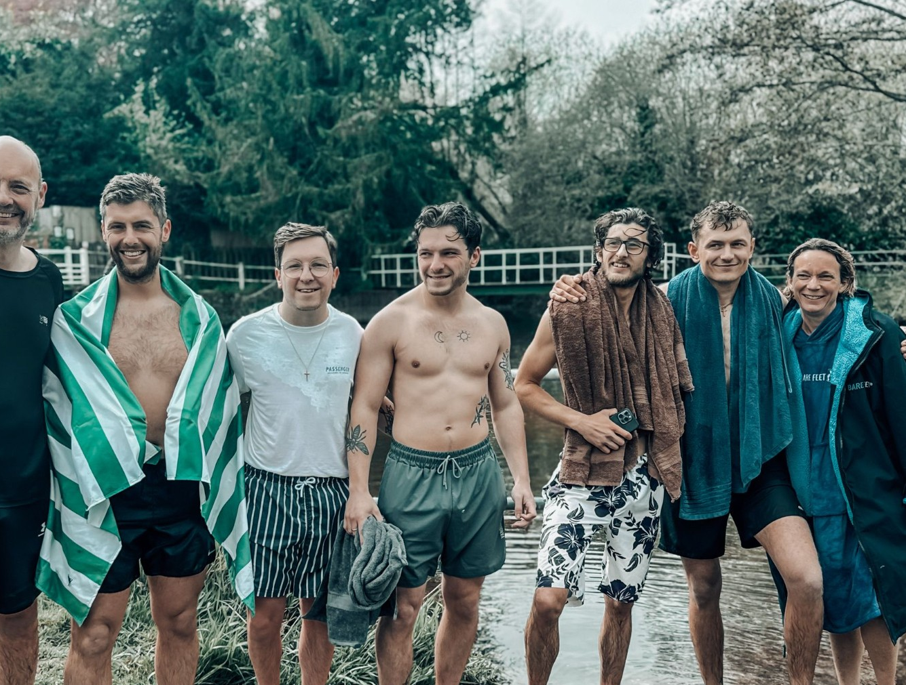
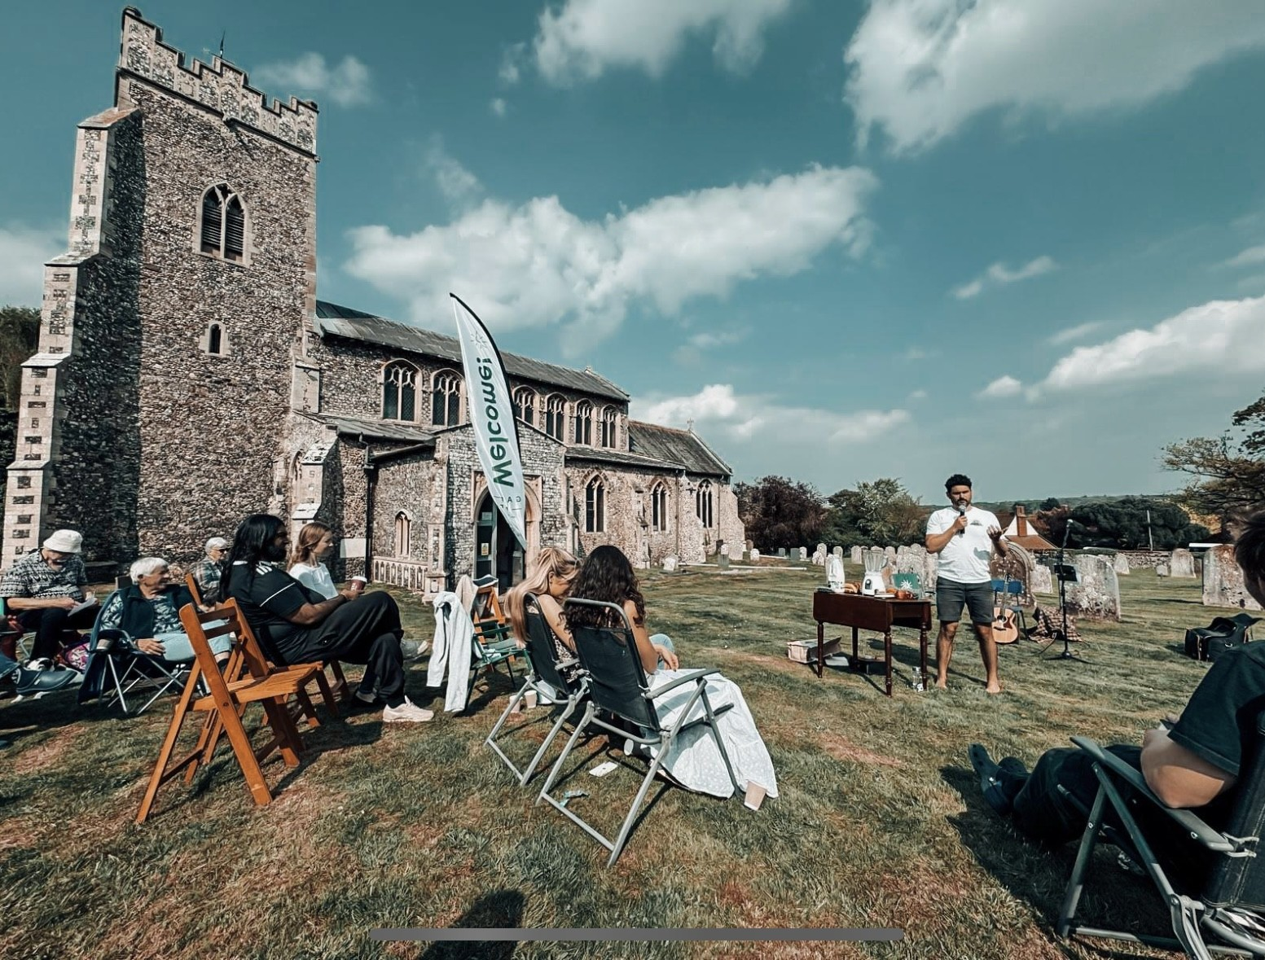
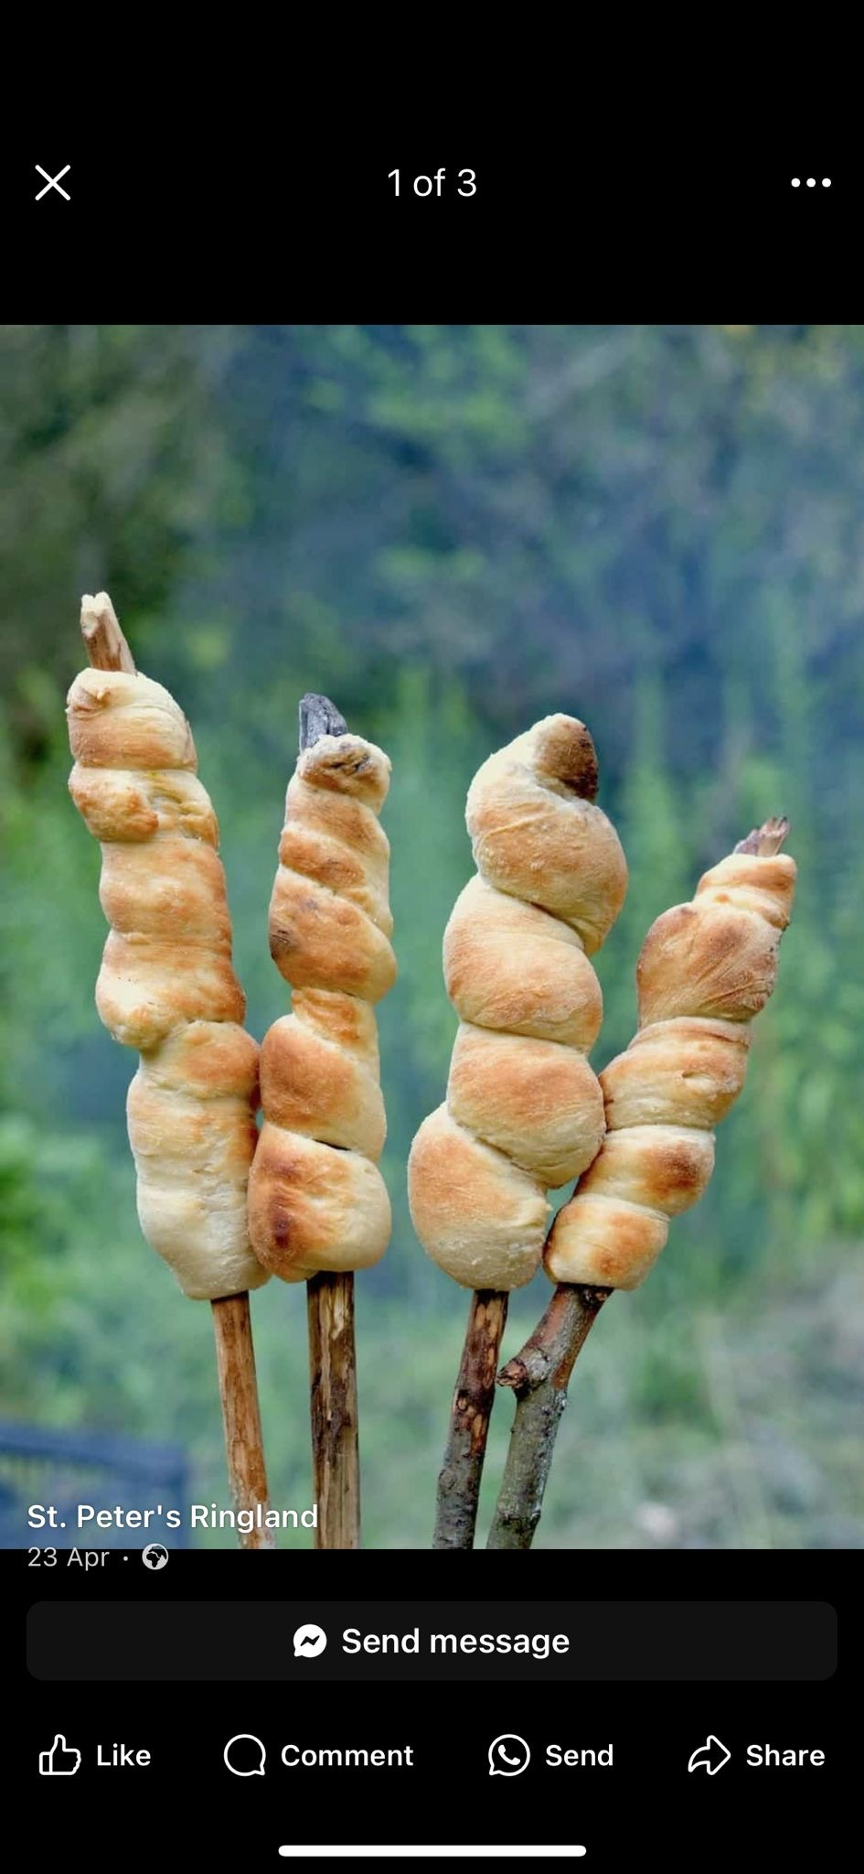
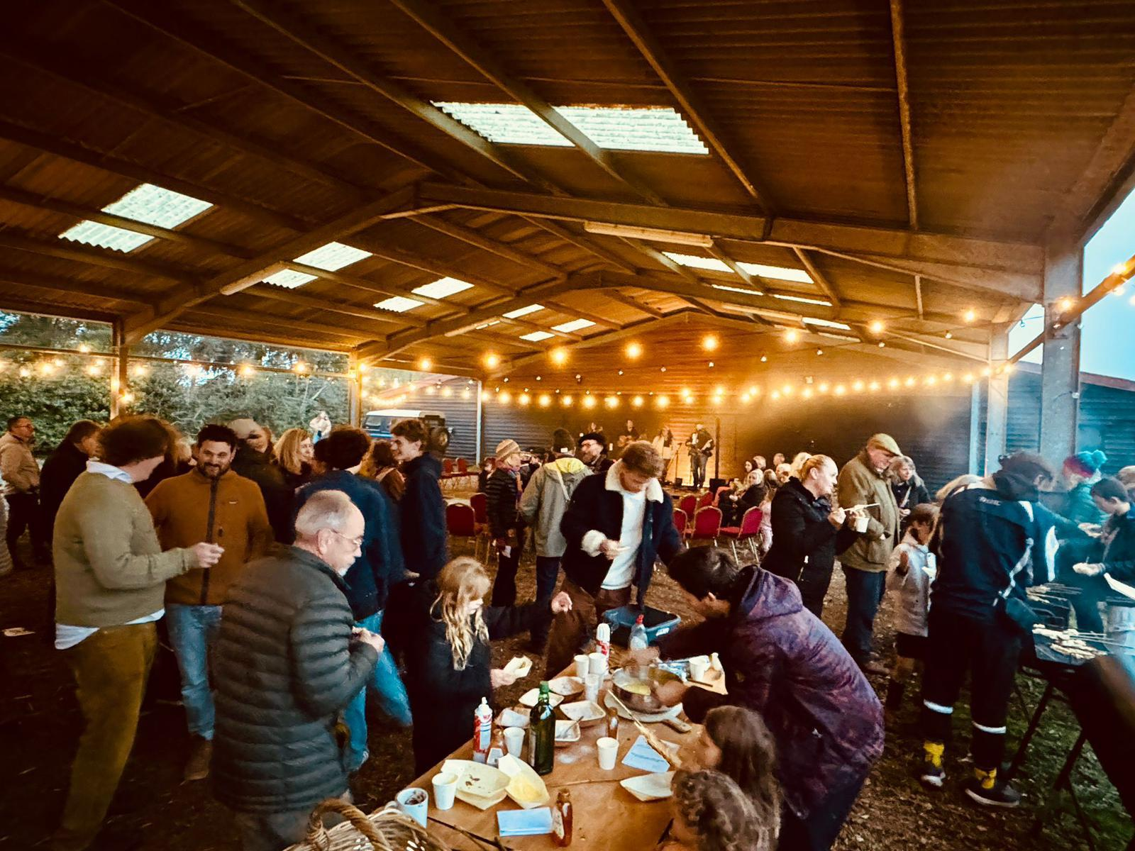
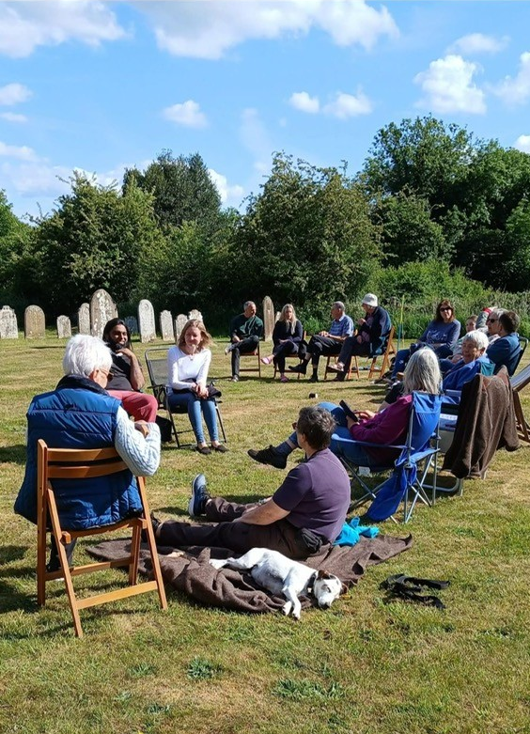
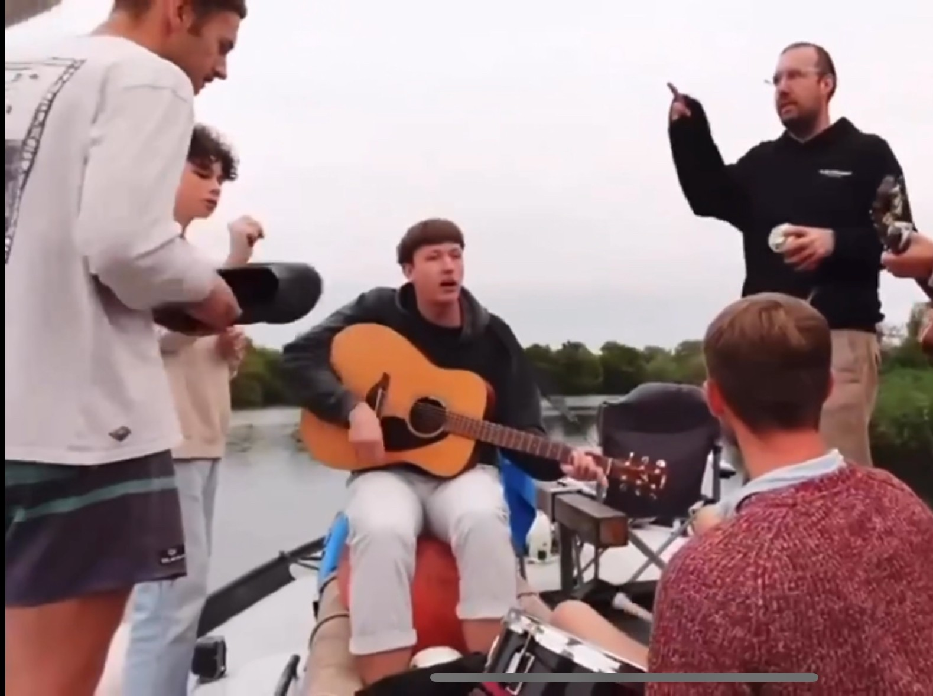
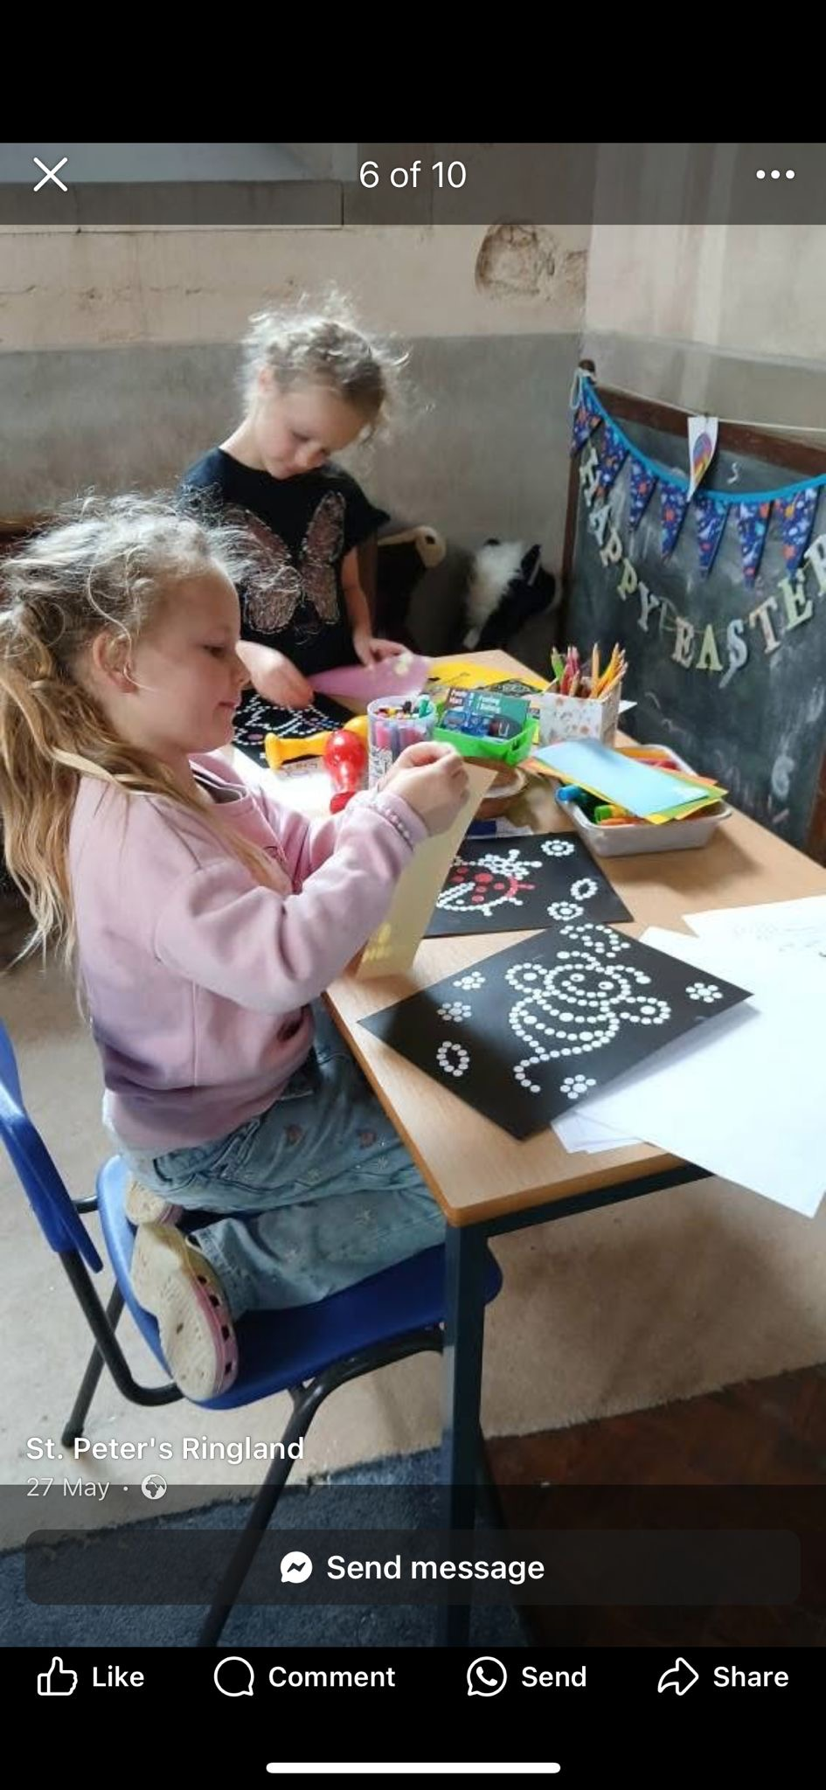

Slide 20

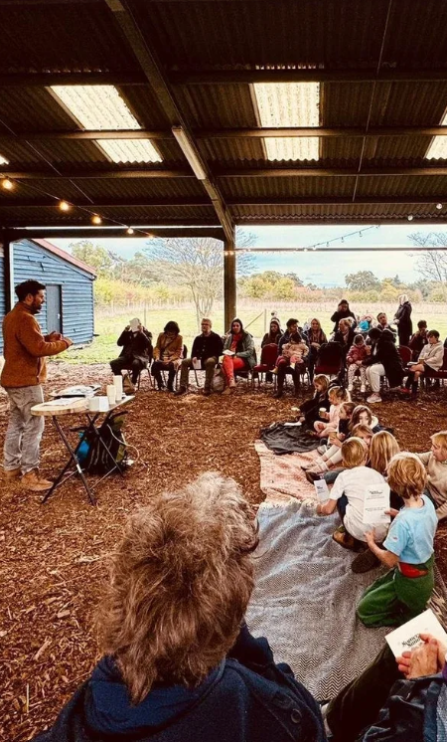
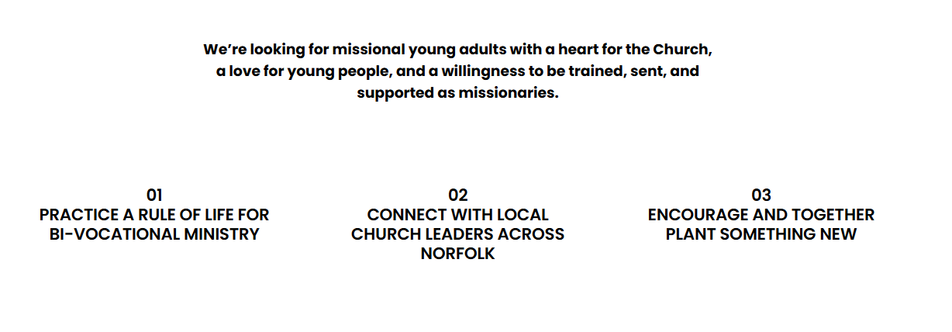

Slide 21
PAUSE + REFLECT
HOW IS YOUR BLEND OF
DEPTH + BREADTH + CHALLENGE?
LOVE
COMMUNITAS
LIMINALITY

Slide 22
PRINCIPLE 3.
CHURCHY? OR CHURCHLY? DISCIPLES
Mission + ECCLESIOLOGY
“An unmissionary church and an unchurchly mission are both a gospel absurdity” (Newbigin)

Slide 23
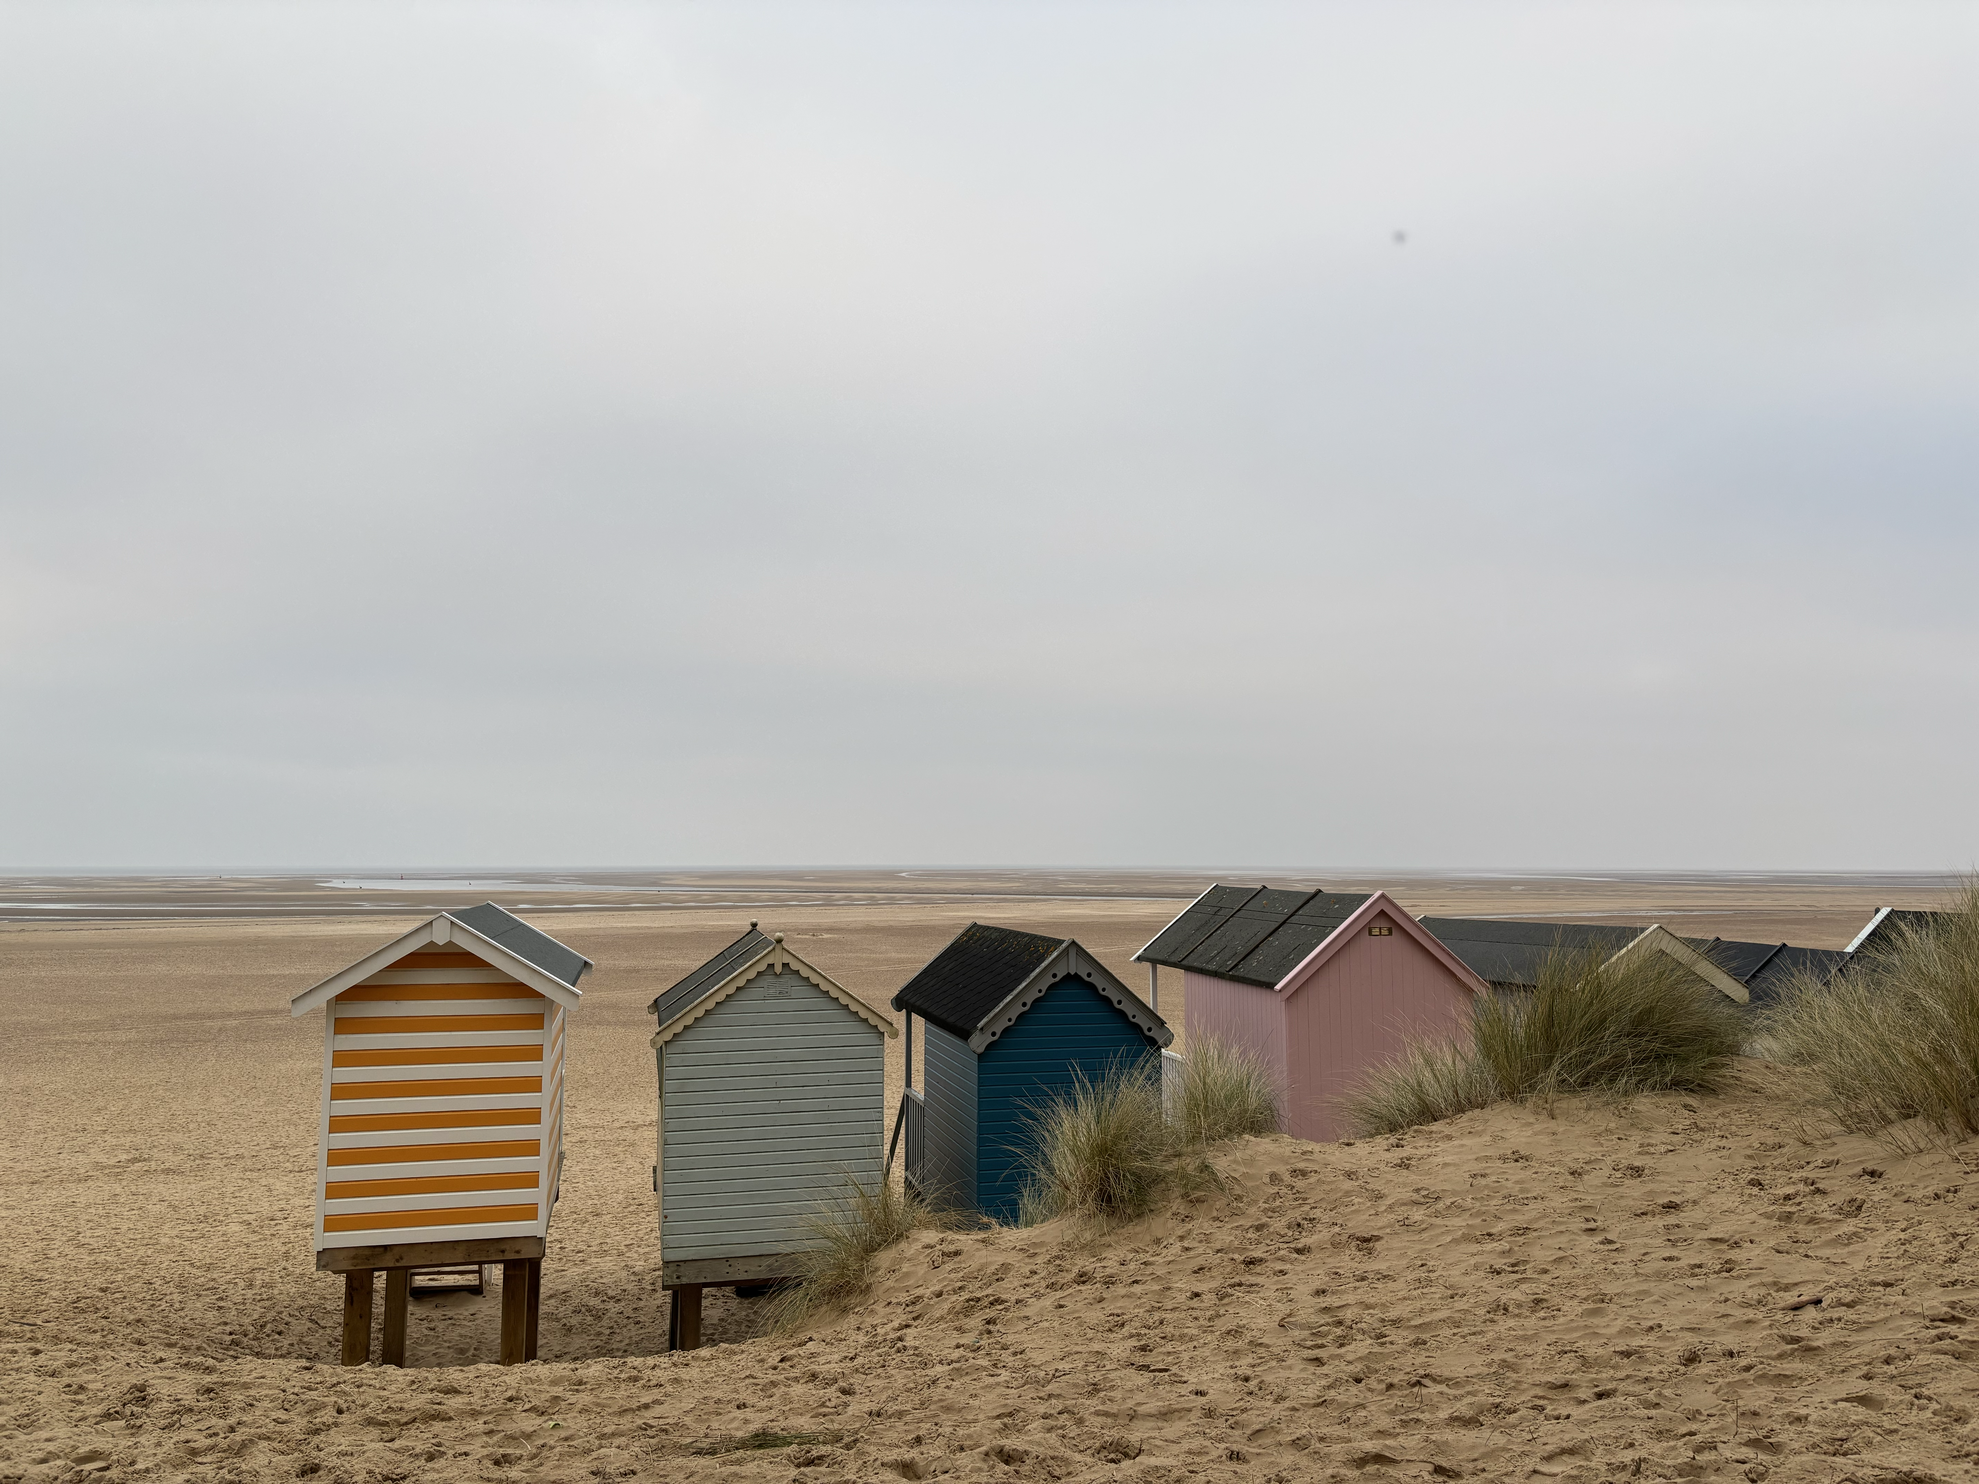
BEACHHEADS
“Jesus did not send his students out to start governments or even
churches as we know them today……They were to establish
BEACHHEADS of his person word and power”
Dallas Willard

Slide 24
CULTIVATE SEEDS IF WE WANT FRUIT?
D.
L.
E.
S.
S.
DEVOTED. LOVING. EQUIPPED. SPIRIT-FILLED. SUFFERING

Slide 25

BUZZ THE BASICS
MODEL IT YOURSELF
2 Peter 1:Godly Character = Fruitfulness

Slide 26
BE THE FLEA GOD MADE you TO BE

