Slide 1
Diocese of Bristol Academies Trust (DBAT) Update
Liz Townend
Director of Education
Rt Revd Neil Warwick
DBE Chair

Slide 2
Transfers complete
Carefully chosen for ethos and capacity
Track record of school improvement
Robust central capacity, business and operations
Children and young people learning well
Good relationships with new trusts
Expertise into DBE trust infrastructure
Notes:
, Deanery Secondary and Kingfisher Primary

Slide 3
Transfers
2 Swindon schools to The Park Academies Trust - 1st Sept 2024
10 Wiltshire and Swindon primaries to Blue Kite Academy Trust - 1st Jan 2025
3 Bristol schools to Lighthouse Schools Partnership - 1st Jan 2025
Notes:
, Deanery Secondary and Kingfisher Primary

Slide 4
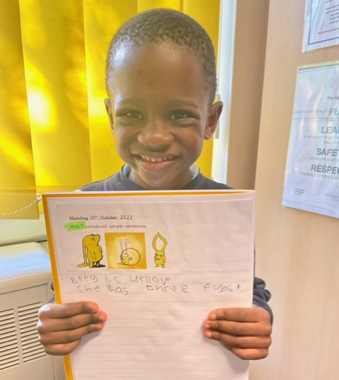
Christian Distinctiveness (character)
Equality Articles of Association
Foundation governance
Memoranda of Understanding
Good relationships
Regular reviews
Ongoing training partnership
Ongoing church links
MAT Chaplaincy
Notes:
Equality Articles to protect church school foundation in law
Foundation Governance at trustee, member and local Board level
MoU sets out relationship and partnership
Ongoing reviews between DDE, CEO and DBE Trust Adviser

Slide 5
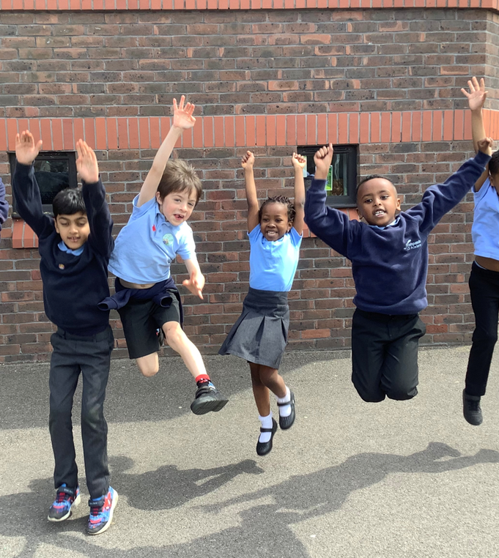
School Improvement
All schools remain DBE schools and subject to inspection
DBE support for Christian character
Notes:
(Statutory Inspection of Anglican and Methodist schools - SIAMS)
Support - SIAMS, RE, Collective Worship, Spirituality, Leadership, Church – School – Home partnership continues

Slide 6
Diocese of Bristol School Partnership Programme (DBSP)
Co-constructed with Trusts To launch Sept 2025 4 strands:
Church School Flourishing Leader | Church School Governance Leader | Religion and Worldview Leader | Collective Worship and Spirituality Leader
Notes:
Regular reviews between DDE, CEO a

Slide 7
DBAT Lessons Learnt Report
Good progress on actions from the report specific to the DBAT context and wider education landscape well underway.
DBAT executive report
Notes:
Our final members of staff, Rachel and Anne, CEO & CFO respectively, finish tomorrow, 28.2.25. I am delighted to confirm that all our Central Staff who were made redundant and who wish have found new jobs.
The final Pensions figure which is required to obtain further funding from the ESFA (c£400k) will not be received until late March/early April.
Whilst the aim is to sign-off the accounts by the end of April this may be deferred into May, but should not affect the final striking off of DBAT.
A General Meeting will

Slide 8
Company closedown
Sign off of accounts Apr/May 25
DBAT company closes by Aug 2025
DBAT Trustees and Company Secretary remain to closure
Notes:
Exec report for other trusts, DBAT Trustees and members, DfEOur final members of staff, Rachel and Anne, CEO & CFO respectively, finish tomorrow, 28.2.25. I am delighted to confirm that all our Central Staff who were made redundant and who wish have found new jobs.
The final Pensions figure which is required to obtain further funding from the ESFA (c£400k) will not be received until late March/early April.
Whilst the aim is to sign-off the accounts by the end of April this may be deferred into May, but should not affect the final striking off of DBAT.
A General Meeting will be required to Receive the final accounts and I will call this once these are approved.
At the AGM in December, I mentioned that we were preparing a "Lessons Learned" document and a copy is attached. This covers the period since the receipt of the Special Measures Ofsted Judgement on the Deanery in September 2023; it does not address the reasons for which led to this which were covered by the DBE review. Please feel free to share this - it is intended to be used and help any other Trusts which face similar situations.

Slide 9
Where Now?
School staff settled and positive
Children learning well
DBE now working with 7 trusts with CE schools
Notes:
Audit

Slide 10
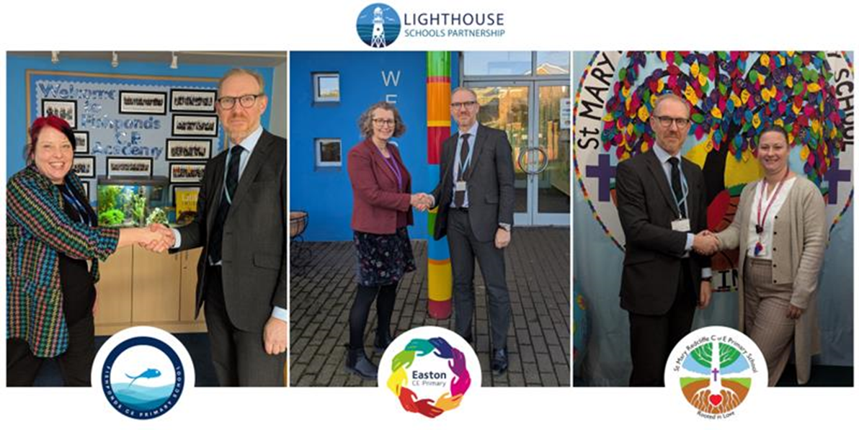
LSP Chief Executive Dr Gary Lewis, commented: “We are delighted to welcome these three schools to our Trust. I am very excited and optimistic about the future as we take on our new responsibilities in Bristol. It is a privilege to be part of the very successful work that the schools are already doing and we are looking forward to working together to help them continue to flourish.”

Slide 11
Click to add final
page message
Add.your.email@bristoldiocese.org
Add.your.email@bristoldiocese.org

