Slide 1





Slide 2

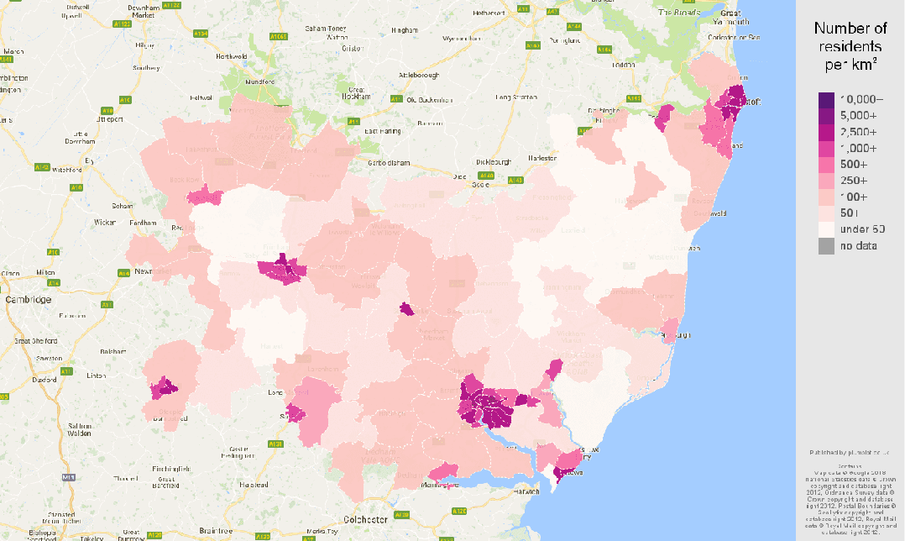
WHERE DO YOU COME FROM?
Sunny Suffolk
lots of multi parish benefices (445 parishes 229 benefices)
lowest attendance per church building of any diocese (13800 in 478 buildings)
lots of clergy in the countryside but but most serving churches of a similar type not reaching younger demographic
Encouragement of mixed ecology – locally based innovation catalysed and supported by a Suffolk-wide Bishop’s Missio Order

Slide 3
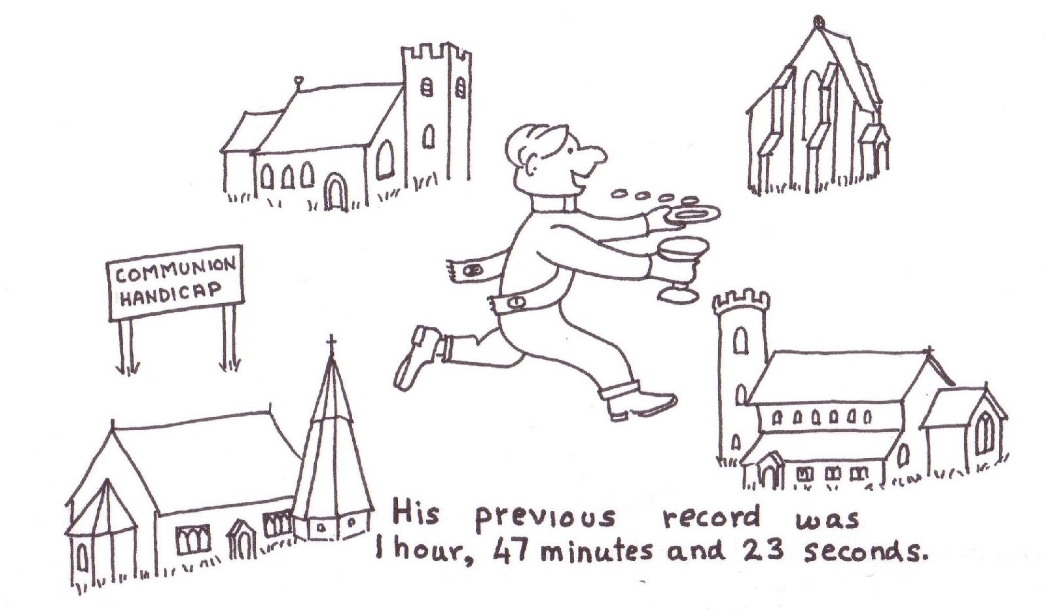
What are the challenges we feel?

Slide 4
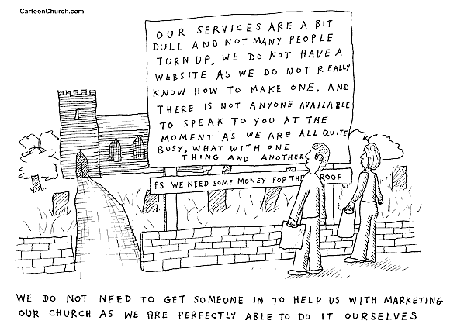
What are the challenges we feel?

Slide 5
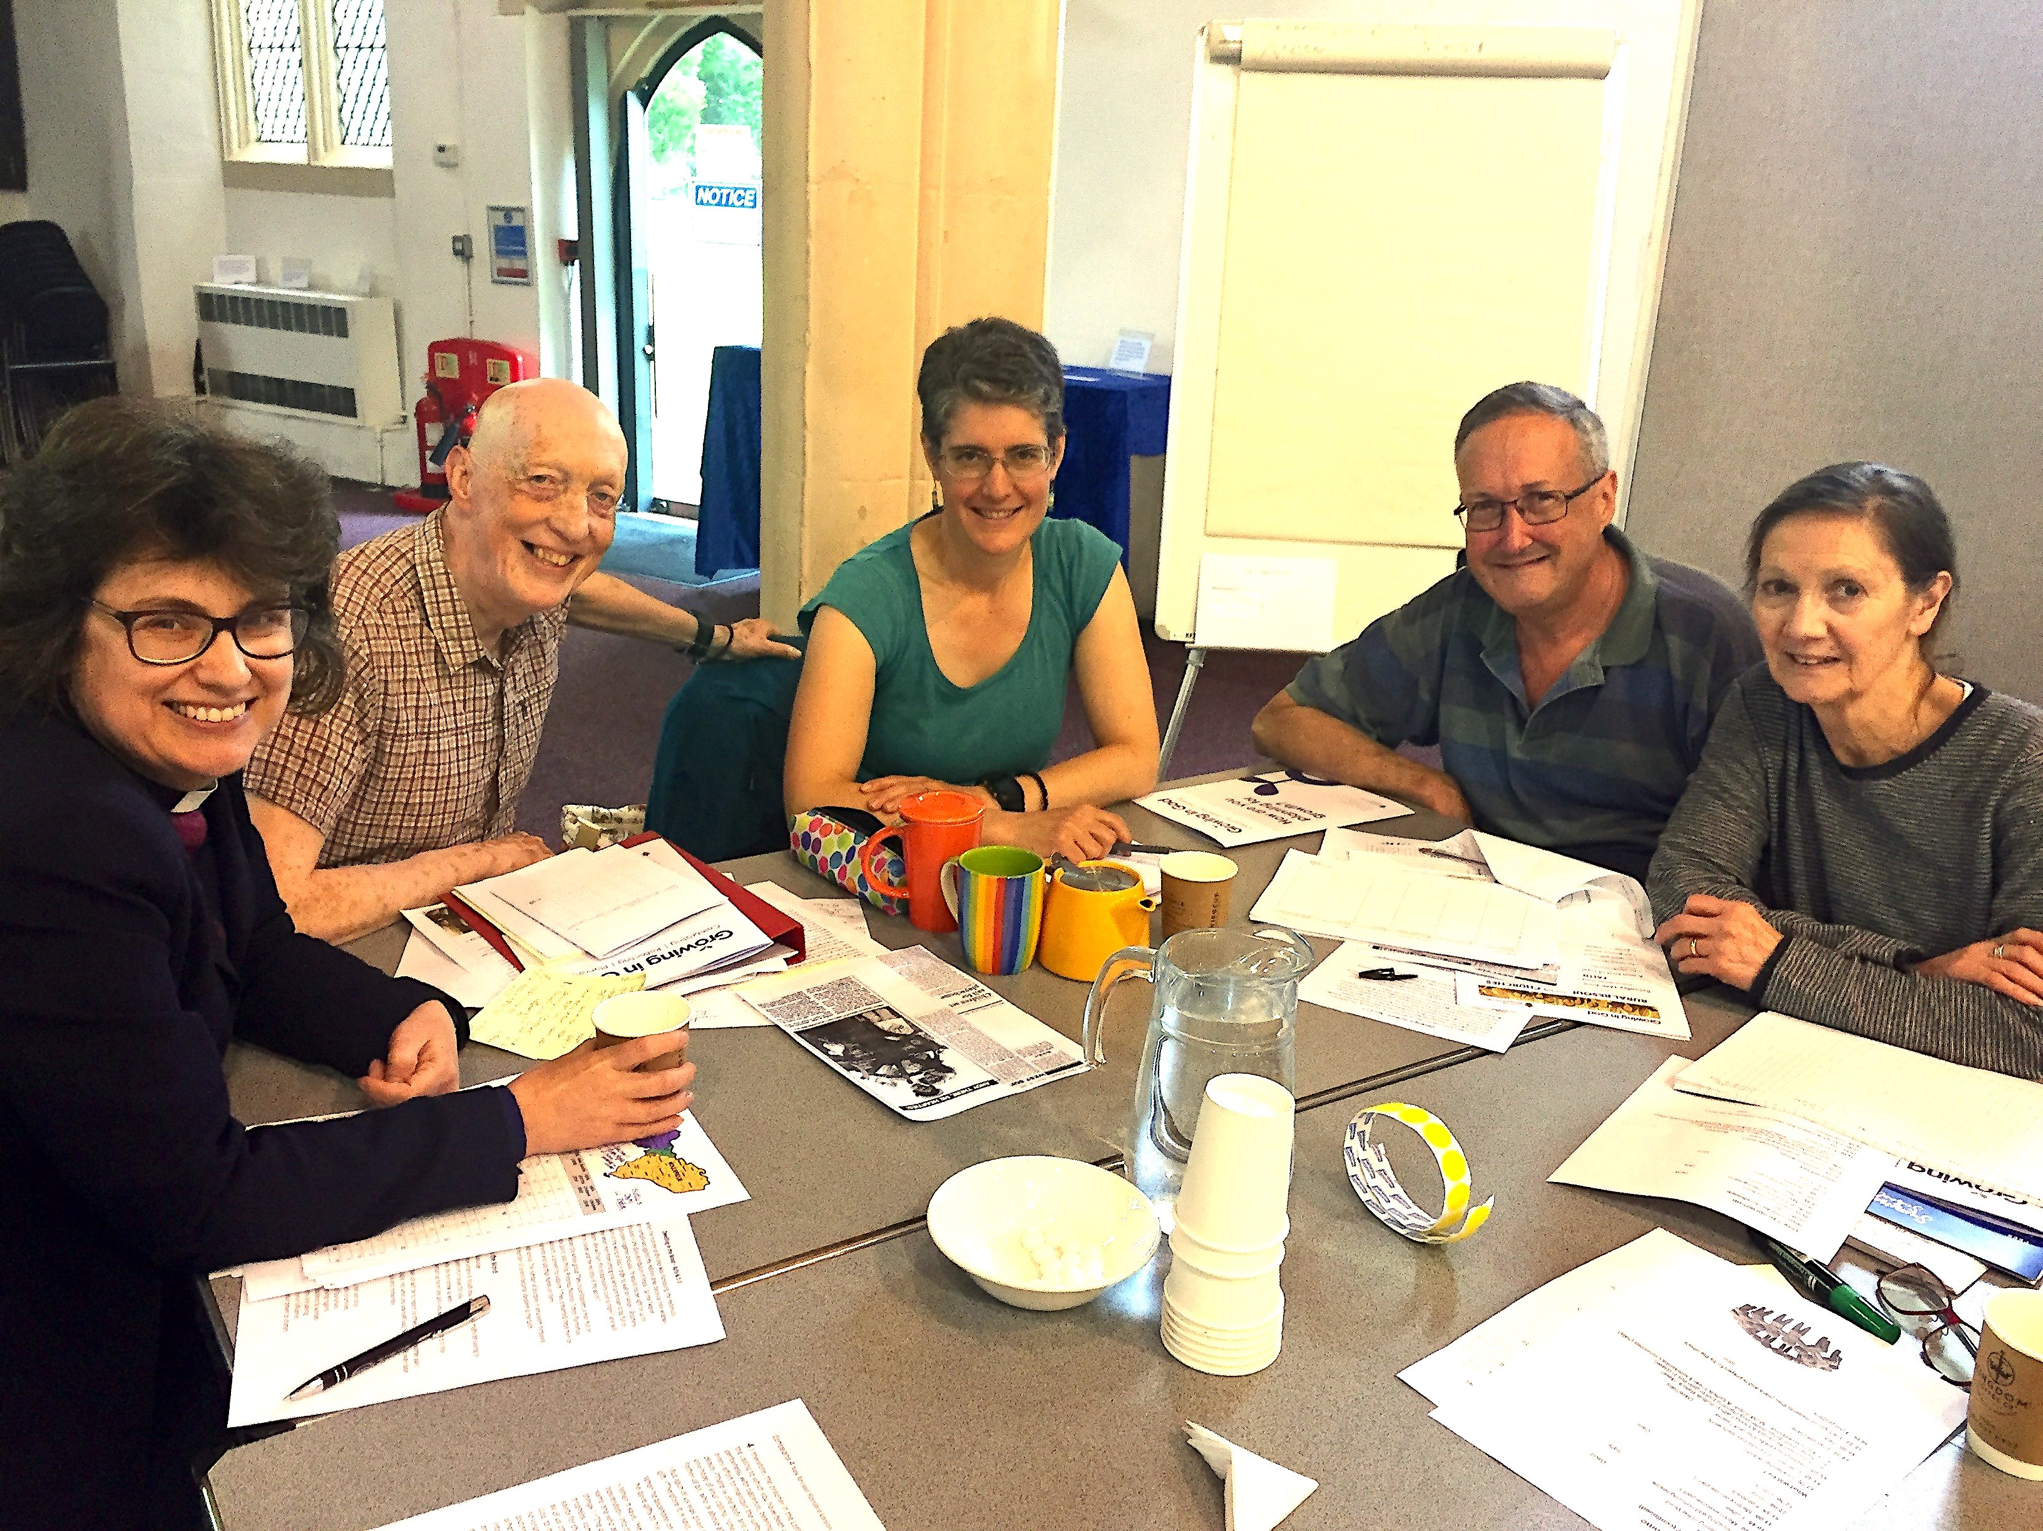
What SPECIAL CHALLENGES affect CHURCH in rural areas?
Smaller numbers (but higher proportion of population attend church)
Different socio-economic backgrounds and worship style preferences supported in one congregation
Traditional outlooks (from who?)
Lack of resources/ facilities in area
Lots of church buildings located in small communities
Closer community but getting less so… “It never used to be like this” (fast change in size and make up of rural villages)
Low proportion of young adults in population

Slide 6
What does God see in us?
HE LOVES US!
“God’s chosen people, holy and dearly loved”
Colossians 3.12
HE LOVES TO WORK WITH US
“God chose things that are powerless…”
1 Corinthians 1.27

Slide 7
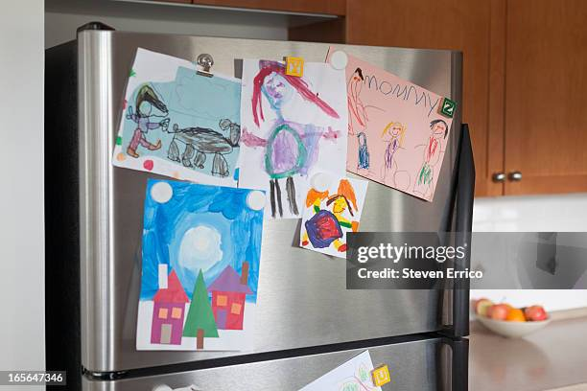
What does God see in us?
God’s Fridge

Slide 8
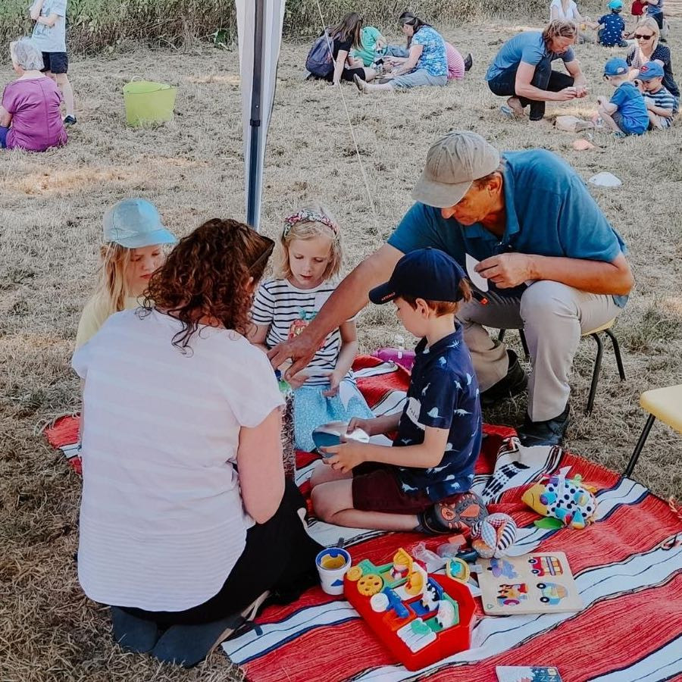
God’s Family

Slide 9
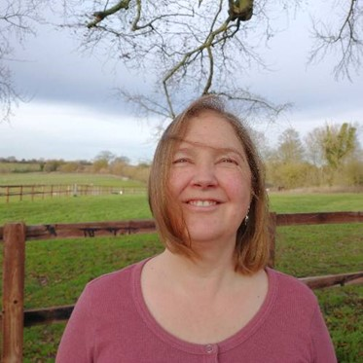
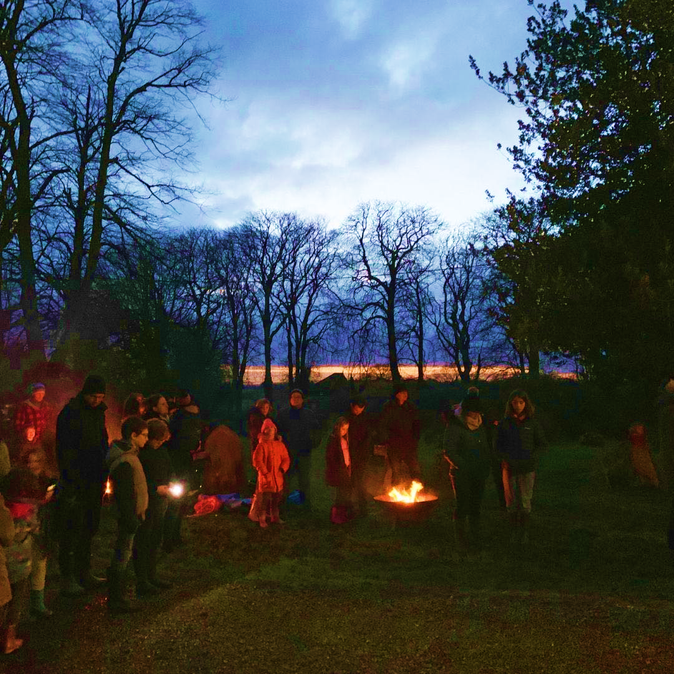
God’s Field

Slide 10
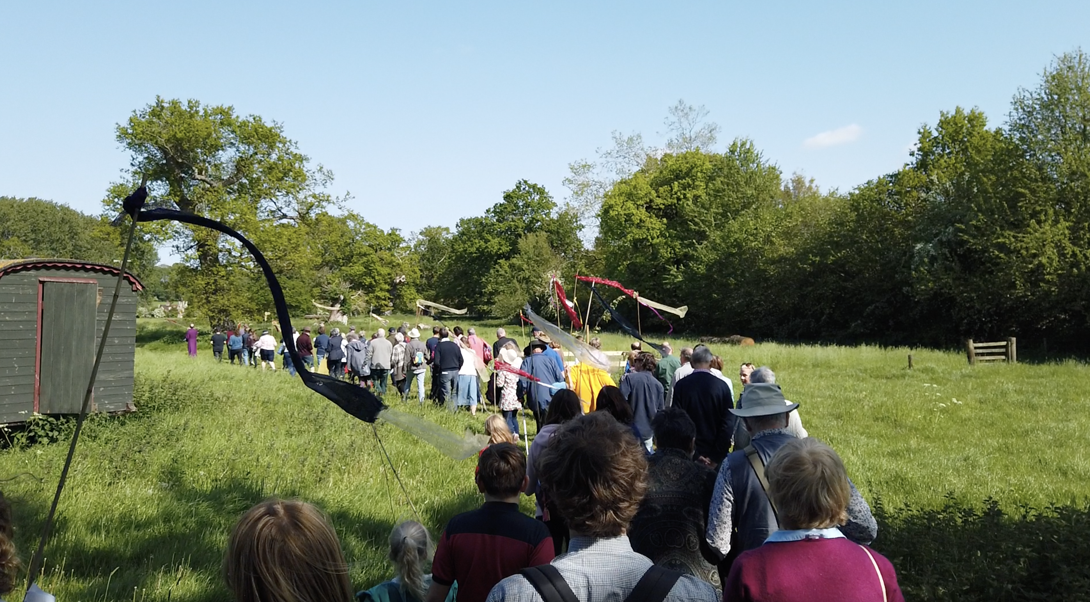


Pray faithfully

Slide 11
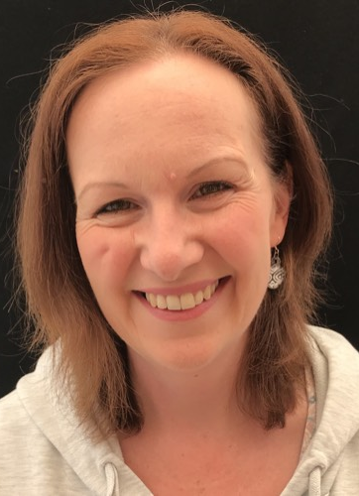
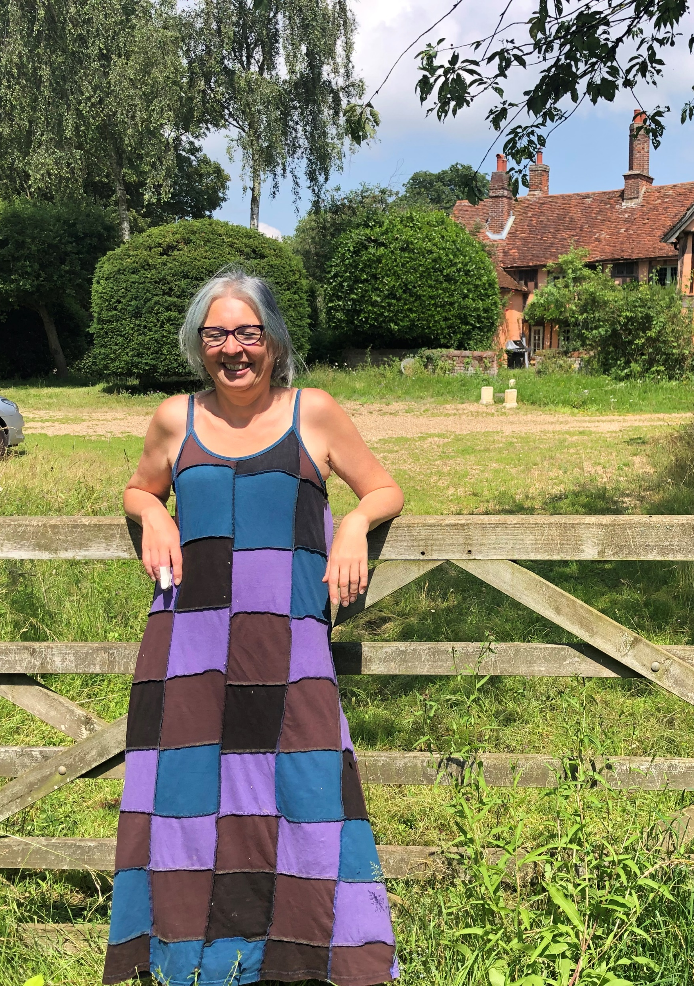
Where are we seeing God at work?
Vocation and growing leaders
Public worship becoming more public
Young people growing in spirituality
Life in the field margins

Slide 12
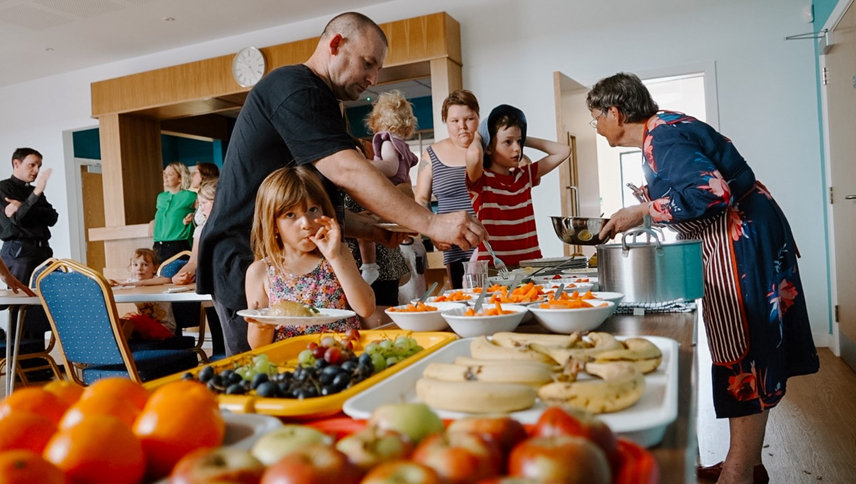
Love Practically

Slide 13
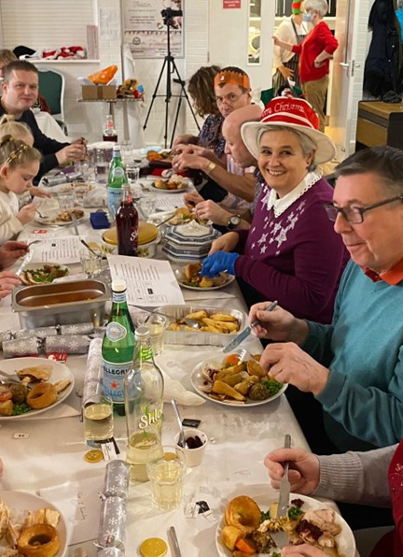
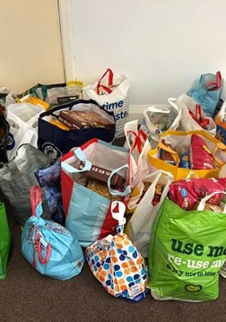
Where are we seeing God at work?
Loving service with (not for) people in poverty
Healing
Weekly rhythms to make church accessible

Slide 14

How Big is your Heart?

Slide 15
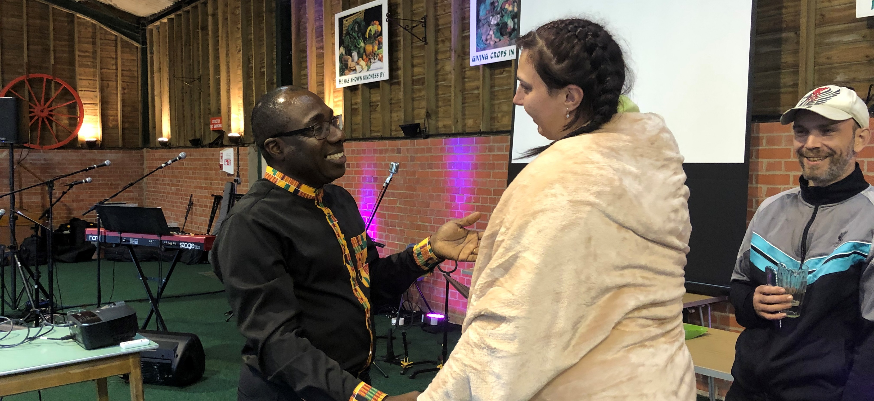
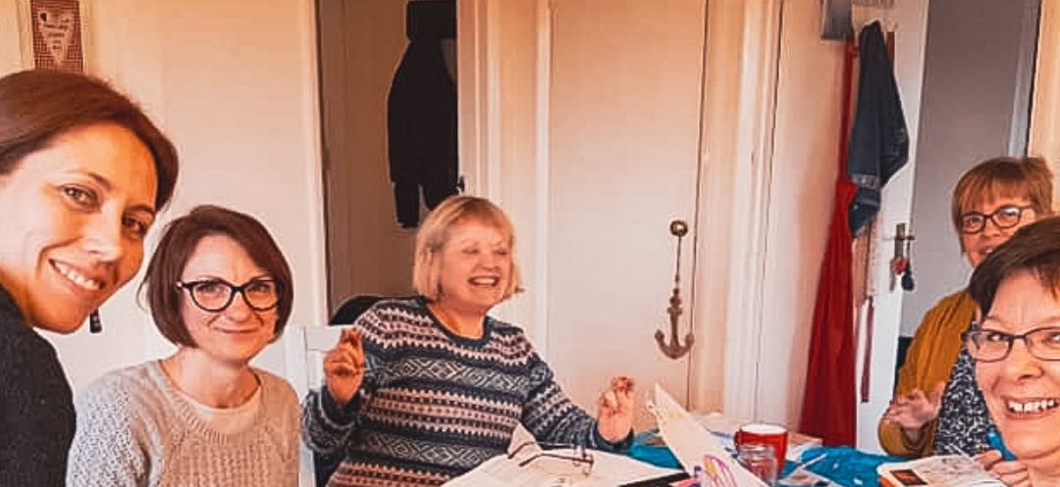
Where are we seeing God at work?
Togetherness and connection
Community Partnerships and churches working together
Journeying with people on their discipleship pathway

Slide 16





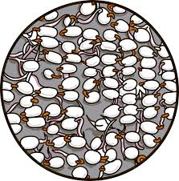

Suffolk
Discipleship Pathway
Sowing
Nurturing
Fruit
Flowering
www.lightwave.community
Based on Sowing, Reaping, Keeping model. (Lawrence Sunglehurst’s acclaimed book of the same name and developed by Fresh Expressions in MSM course.
Notes:
“Sowing Reaping Keeping” had just 3 stages.
Sowing – which was simple service activities
Reaping which was coming to faith
Keeping which was staying in the church.
Lawrence characterises the aim of the sowing as relational engagement with as many not-yet-Christians as possible, as helping them to re-think their misconceptions and so recognise that ‘God is good and we are OK!’ Then as folk move down at their own pace you get to the ‘fewest number of people and maximum Gospel content.’ Obviously the whole process should be covered by prayer.
In Suffolk we have added the stage of nurturing to more fully represent the rowing in spiritual interest before someone is ready to make a faith commitment. We have renamed the stage of commitment flowering, representing the flowering of faith and instead of “Keeping” we talk about “fruit” because of the way Christians continue to grow and be fruitful throughout their lives.
Any of these stages can occur either in a planned, prepared program/event or they can flow spontaneously in a developing relationship, with one-to-one opportunities and conversations.

Slide 17
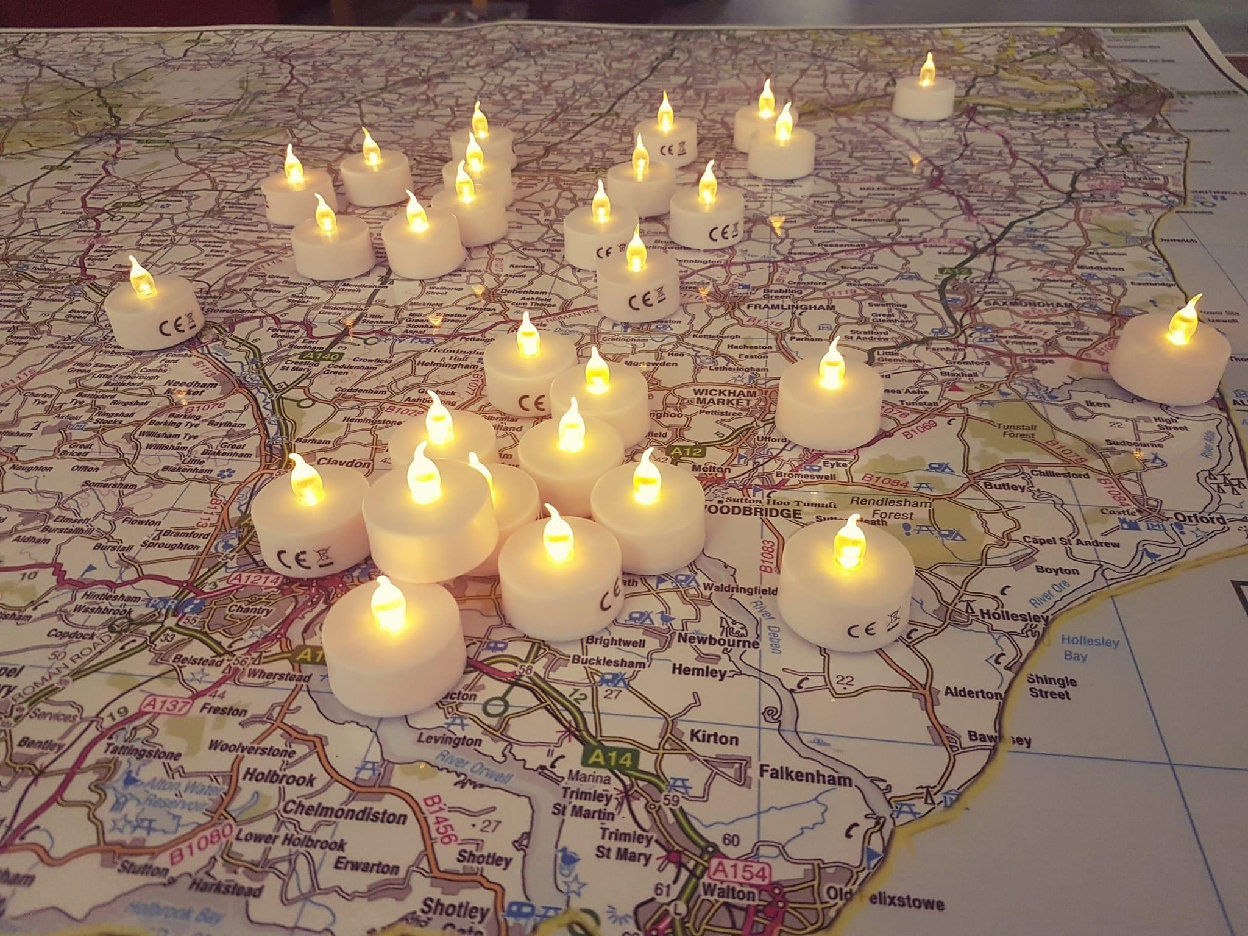
Where are we seeing God at work in the countryside?
Lots of small initiatives
Bible focus (Digging deep)
Public worship becoming more public
Connecting with Creation
Vocation and growing leaders
Loving service with people in poverty
Intergenerational work
Community Partnerships & People of Peace
Healing
Young people growing in spirituality
Weekly rhythms

Slide 18
Take Aways
Remember what God sees in you
Attend more to enlarging our hearts than enlarging our congregations
Pray Faithfully
Love Practically
Journey Together

Slide 19
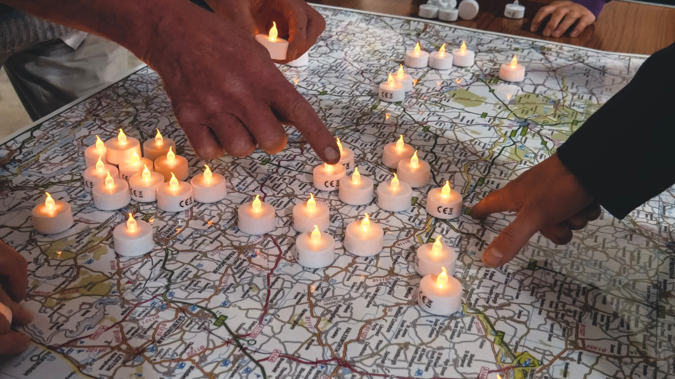
Dream Small
Pray Faithfully
Love Practically
Journey Together
www.lightwave.community

