Slide 1
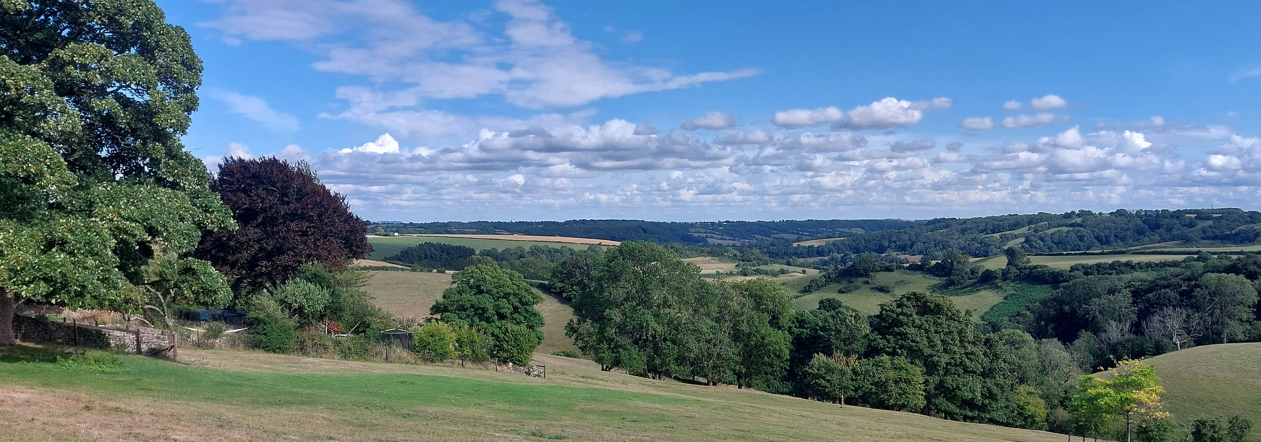
Multi-Parish/Church Benefice Identity and Mission
Revd Sharon Roberts
s.roberts5454@outlook.com
www.marshfieldchurches.org

Slide 2
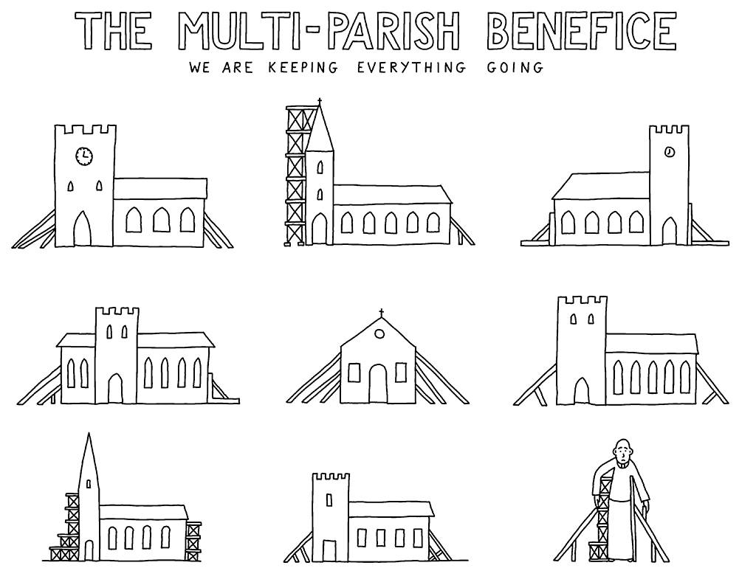

Slide 3
Features of Rural MCBs
Fragility: The six features are:
Financial pressure on the church and congregational anxiety about dwindling resources.
An actual or feared inability to replace churchwardens and other officers or volunteers.
The relentless nature of keeping going, that saps energy and thwarts new initiatives.
A lack of critical mass of children and volunteers to work with them.
Congregations of a dozen or less people, with an increasing age profile.
The demands of maintaining historic buildings. (Lawson A., Rural Theology 21.1, pp.40 - 51).
Complexity
Fragility
Commitment to Mission

Slide 4
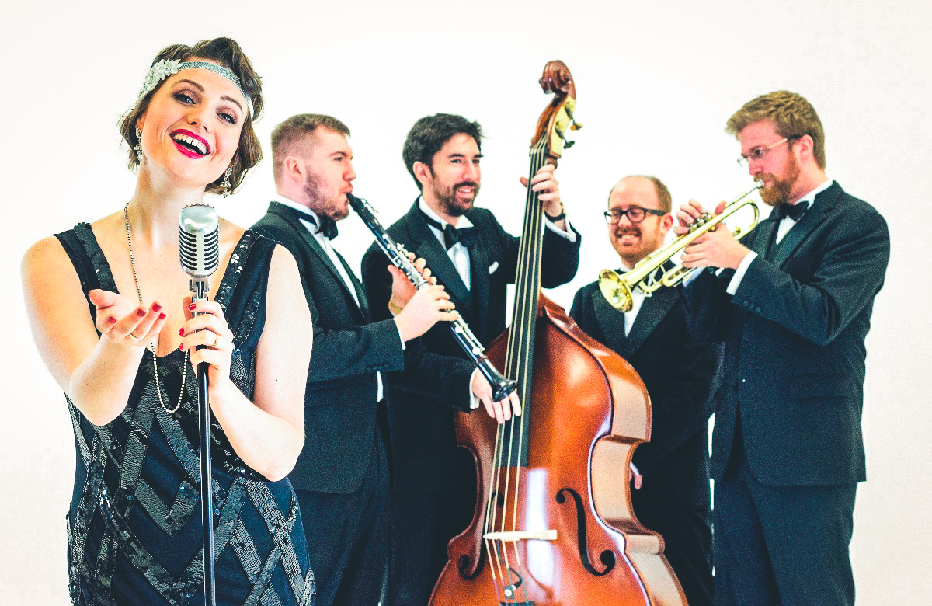

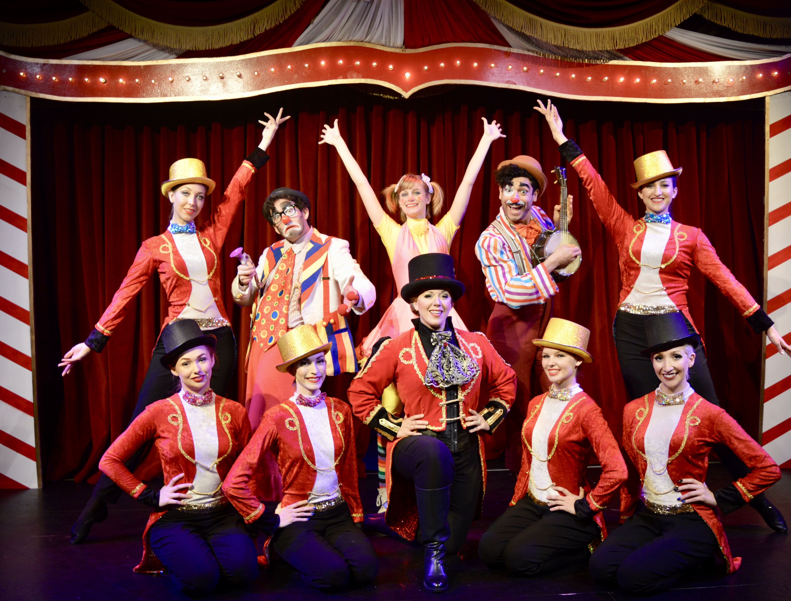
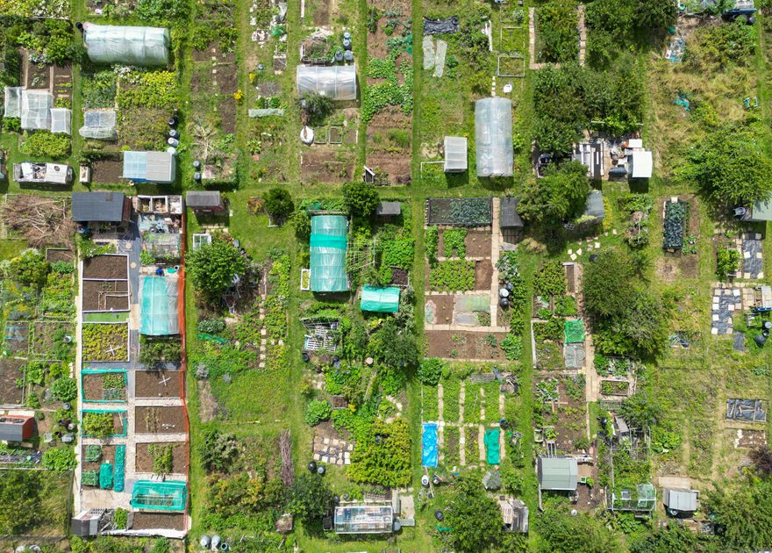
Which metaphor describes your MCB?
Jazz Band
Children Playing in a Circle
Circus Performers
Independent Allotment Growers
MacNaughton Thrive p. 31-33

Slide 5
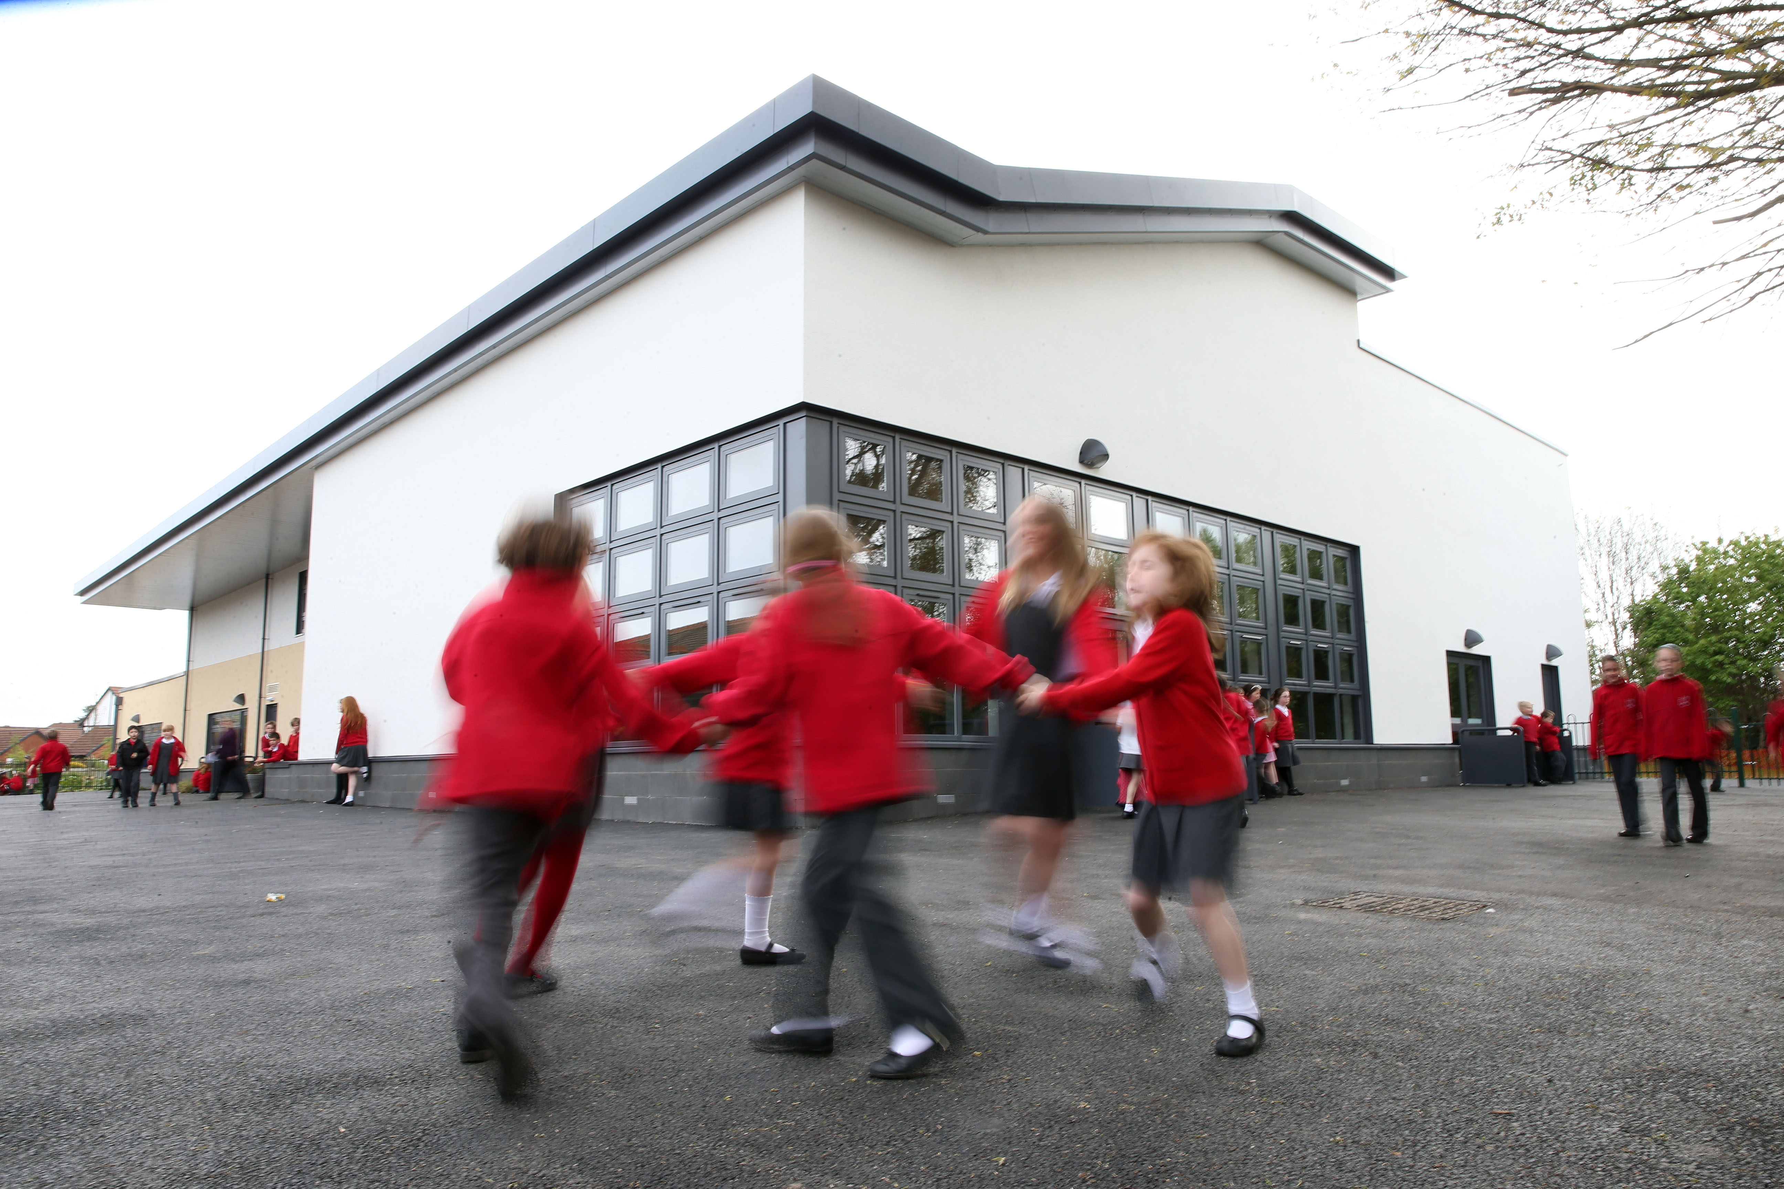
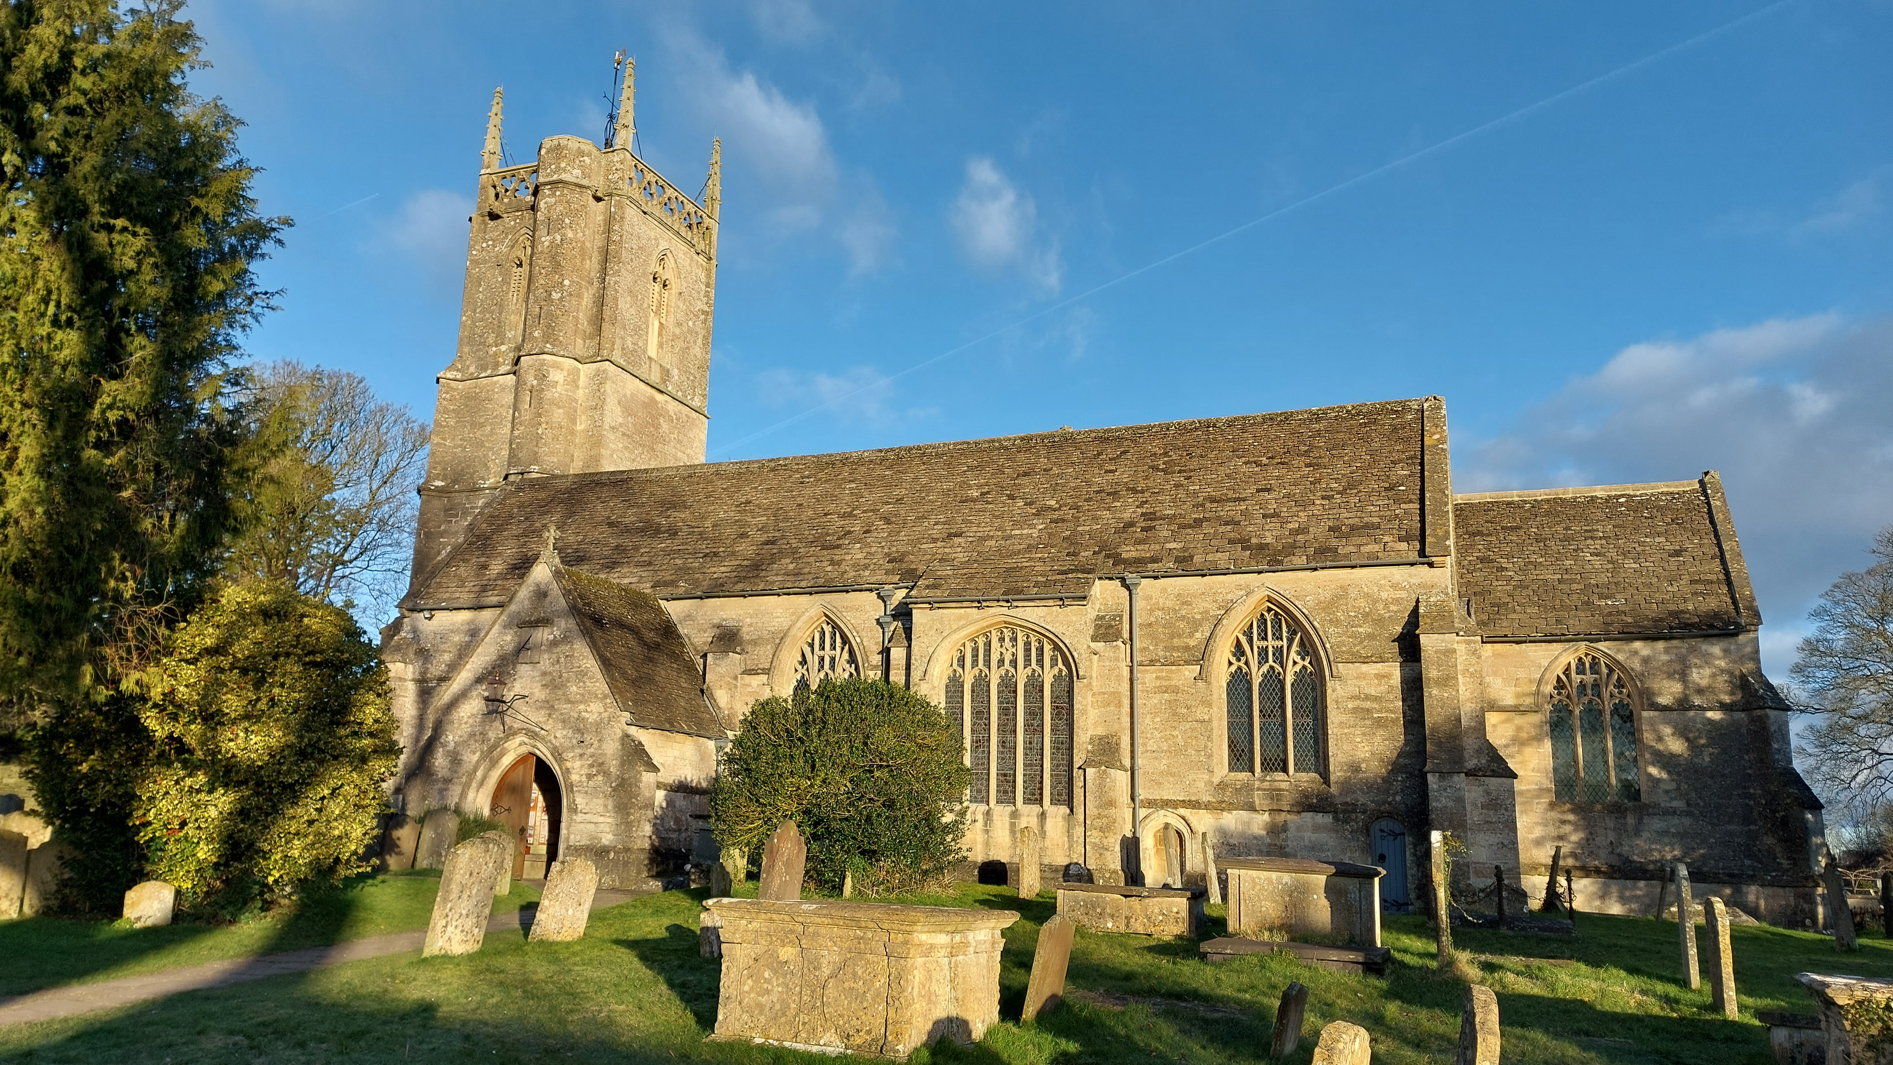
We all start somewhere… my story
Multi Academy Trust
MCB/MPB
Individual Autonomy or Shared Identity?

Slide 6
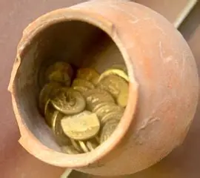


‘The ability of an organisation to inspire … the perception of oneness or belonging can strengthen in-group co-operation within that organisation.’
Resource
Lens
Work

Slide 7
Key Finding – Brendan Research
Richard Tiplady – What is in our hands?
…in many cases, the ability to help parishes to overcome their sense of independence and to recognise their interdependence with other parishes in their benefice helped to create a critical mass that allowed them to feel that they could do something new. The ability of parishes to work to a common vision and to feel part of something bigger, even while retaining their own distinct identity, was noted by several dioceses as one of the healthy outcomes of the projects being evaluated. (Page 5)

Slide 8
Questions about the MCB
How long had the benefice been established and size (Festival/Closed)?
Ministry team make up
How fragile were the churches?
Age profile of Sunday worshippers
Service pattern
Occasional offices
Mission activities

Slide 9
Questions about MCB Identity
What is in a name? Geography and Identity.
Group, Team or Benefice?
Perceptions of the Benefice – Lay and Clergy
Identity and Strapline
Identity and Vision Statement or Action Plan
Identity as Strategic Tool
Identity in Shared Worship
Identity in Shared Governance
Identity in Shared Mission
Training and Support for Leading Benefices
Impact of Diocese on the MCB – in terms of Strategy and Training

Slide 10

Identity: What’s in a name and a picture?
Link to geographical area
Benefice
Group
Team
Family
Mission Community

Slide 11
Perceptions of the MCB
Option 1 | Option 2 | Option 3 | Option 4 | Option 5
It is a way of sharing clergy. | It is a way of keeping our church going. | We are beginning to work together more closely but it is sometimes hard work. | It is a missional partnership which enables us to work together to serve the area. | It is a missional partnership and we make prayerful decisions about the focus of the work. We put this work above the needs of our individual churches.

Slide 12

Other Questions about Benefice Identity
Identity and Vision Statement or Action Plan
Identity as Strategic Tool
Identity in Shared Worship
Identity in Shared Governance
Identity in Shared Mission
Training and Support for Leading Benefices
Diocesan Support not strong enough for benefices

Slide 13

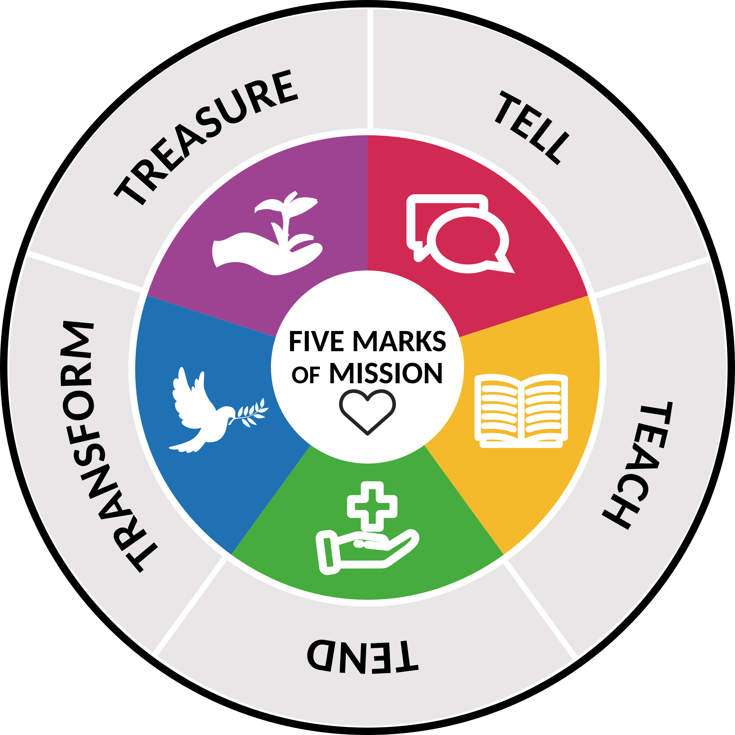
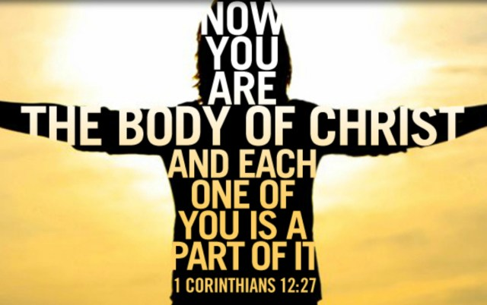
Nurturing a Shared Identity in a MCB
Expanding the view of parish and place
Finding a communal calling
A shared commitment to mission

Slide 14
A Shared Identity: Reimagining and Expanding ‘Parish’ and ‘Place’ and ‘Building’
Parish Not a feature of worldwide Anglicanism
Move from Parish to Local
Needs to be open to negotiation – empowered deaneries
Specialism within collaboration
Place Already expanded in people’s minds and needs to be intelligible
Building Re-opened to the Secular. Pruning or returning to a Community responsibility?

Slide 15
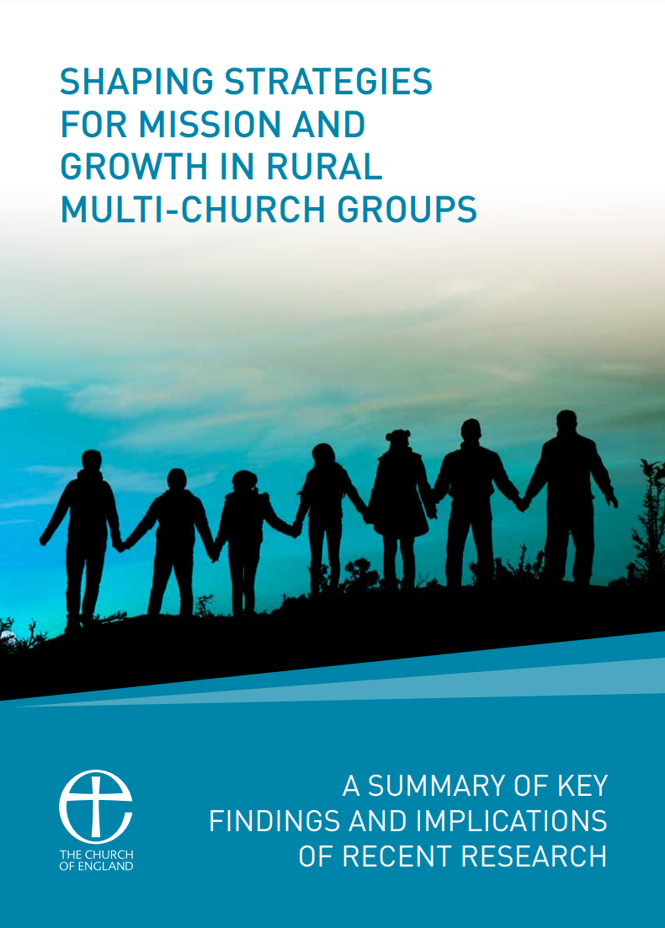
A Shared Identity: A Community Calling
The Body of Christ
Kingdom of God
Blessing
Place for a loving encounter with God and Neighbour
Sharing Christ’s Presence

Slide 16
A Shared Identity: A Commitment to Mission
What would bring us life?.... 1 thing well?
Intentionality – releasing people to focus.
Set individual churches free from doing everything.
Think congregations and not churches – parity of esteem and knowledge and appreciation of each other.
Where might we meet?
Growth can be slow…Maintenance is to be seen as growth. Five years to get something established.
  .

Slide 17
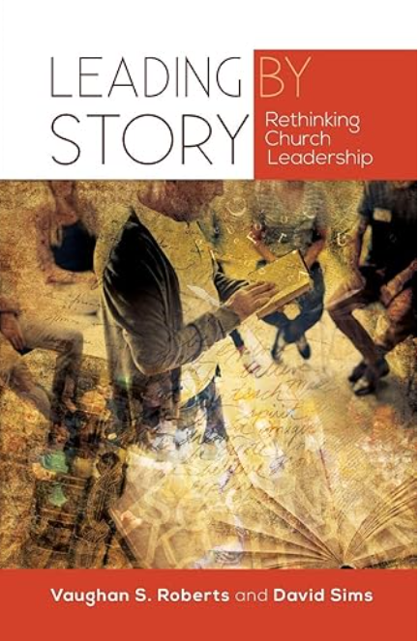

Nurturing a Shared Identity: Practical Processes
It is possible to ‘live long in a weak story’ (p. 54) the ‘central task of leadership is to give people a better story to live by’ and ‘one that is a springboard to a better future’ (p. 55).

Slide 18
Bibliography
Bell, J., & Hopkinson, J. (2017). Shaping Strategies for Mission and Growth in Rural Multi-Church Groups. The Church of England: Archbishops’ Council.
Grundy, M. (2015). Multi-Congregation Ministry. Norwich: Canterbury Press.
Lawson, S.A. (2023). Revising the Marks of the Fragile Rural Church in Rural Theology, 21.1 pp. 40-51.
MacNaughton, P. (2023). Thrive. Helping your multi-parish benefice to grow. London: Church House Publishing/CPAS.
Olsworth-Peter, E. (2024). Mixed Ecology: Inhabiting an Integrated Church. London: SPCK.
Roberts, V.S., & Sims, D. (2017). Leading by Story: Rethinking Church Leadership. London: SCM.
Tiplady, R. (2025) What is in our Hands? Rural Mission Learning Review. Access at https://churchsupporthub.org/all-resources/whats-in-our-hands-rural-mission-learning-review/
A full copy of my dissertation can be found at Churches Together in England Mission Research Library at www.cte.org.uk
Published article: The Challenge of Leading Large Rural Benefices: A Different Approach? Rural Theology Vol 23 Issue 2. (Please email me for a free link to this article.)

