Slide 1
Learning to dream BIG
A (partial) vision of the future
Date
October 2022

Slide 2
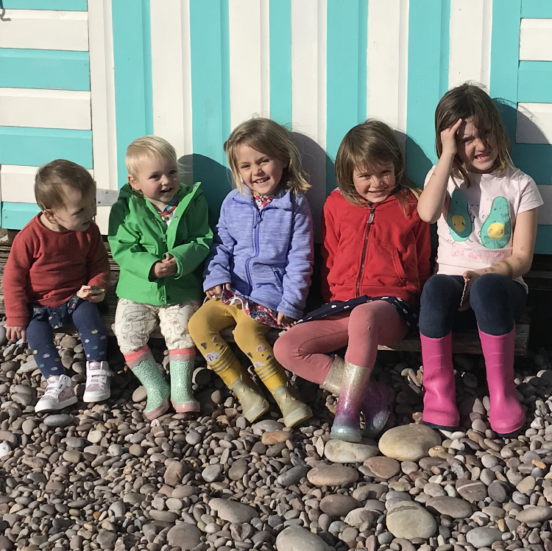
A single vision? Or one that grows and changes?
Notes:
Finally, using the example of my own grandchildren.
We can be overwhelmed by the pressures and experiences we think young people face. We can see evil and confusion and struggle in all aspects of their lives, we can urgently want to protect them or be protected from them.
We should hope for their present as well as their future. We are focused on the well being of young people as much as their well becoming. It is in the here and now that we value them and recognize them.
My grandchildren know they are significant to me because I tell them, often. They know they are seen, heard and valued. It is the foundation we can give for young people to navigate through situations and pressures we don’t even know about yet.
Always hope, love always, even if you don’t fully understand

Slide 3
What they achieve and attain now will set their course for life
The problem we have here is the low aspiration of young people
  What adults and schools often say about young people
We want young people to look beyond this area and its reputation
We don’t accept that poverty and family background determine the future of young people

Slide 4
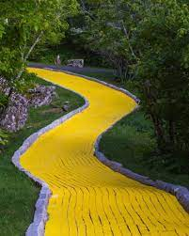
The focus is on the road ahead and the journey to come

Slide 5
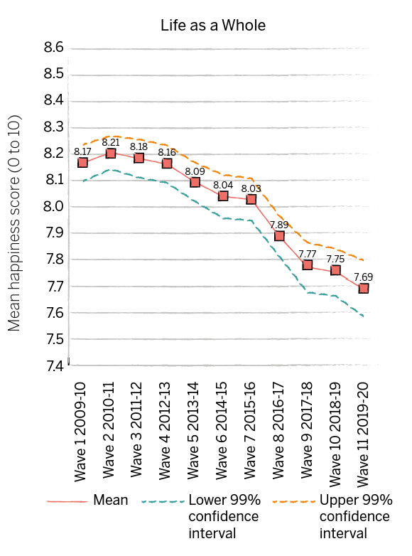


Trends in children’s well-being 2019-20
Trends in children’s (aged 10 to 15) happiness with life as a whole, UK, 2009-10 to 2019-20
In the latest wave of the survey (2019-20):
      Mean happiness scores for life as a whole, friends, appearance, and school were significantly lower than when the survey began (2009-10). This was in spite of a slight upturn (not statistically significant) in the mean scores for friends, appearance, and school in 2019-20.
      There was no significant difference in mean happiness scores for family or schoolwork (in spite of a decline in the latter in recent years) compared with 2009-10.
Source: University of Essex, Institute for Social and Economic Research. (2022). Understanding Society: Waves 1-11, 2009-2020 and Harmonised BHPS: Waves 1-18, 1991-2009. [data collection]. 15th Edition. UK Data Service. SN: 6614, DOI: 10.5255/UKDA-SN-6614-16.
Presentational note: All graphs use the same size range of values (1.2) so that they can be visually compared. Data are weighted (confidence intervals take account of design effects).
Notes:
As ever, this year’s good childhood report starts with the latest trends in children’s well-being from the annual Understanding Society survey, which looks at happiness among children aged 10 to 15 in the UK. As I mentioned earlier, the latest data are for 2019-20 and so include responses collected at the start of the pandemic for the first time.
The chart on the screen shows that children’s overall happiness with life as a whole has declined since the survey began in 2009-10.
Children’s happiness with specific areas of life that we know are important to their overall happiness, including their happiness with friends, appearance and school, are also significantly lower than when the survey started. This is in spite of a slight upturn in friends, appearance and school in 2019-20
Luckily, there have been no significant changes in children’s happiness with family or schoolwork (there has been a decline in the latter over the last few years, however, which we are keeping a close eye on).
Show slides with other trends on?

Slide 6
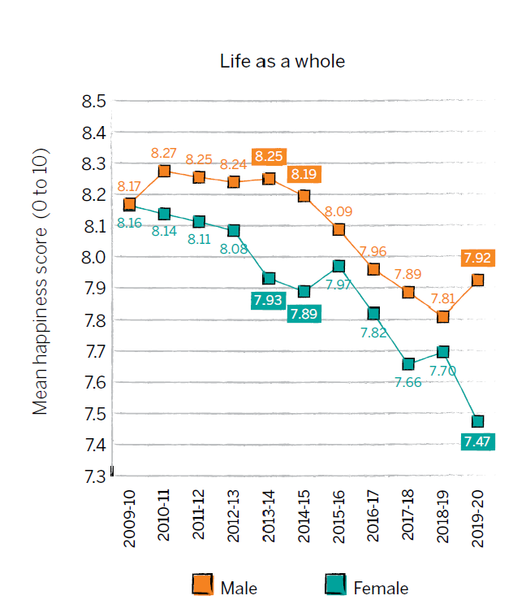
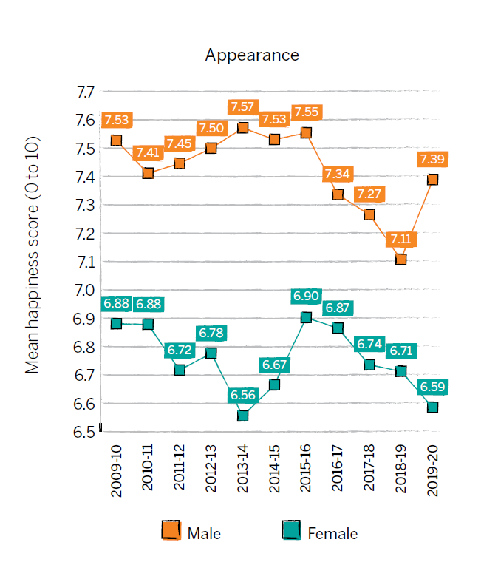
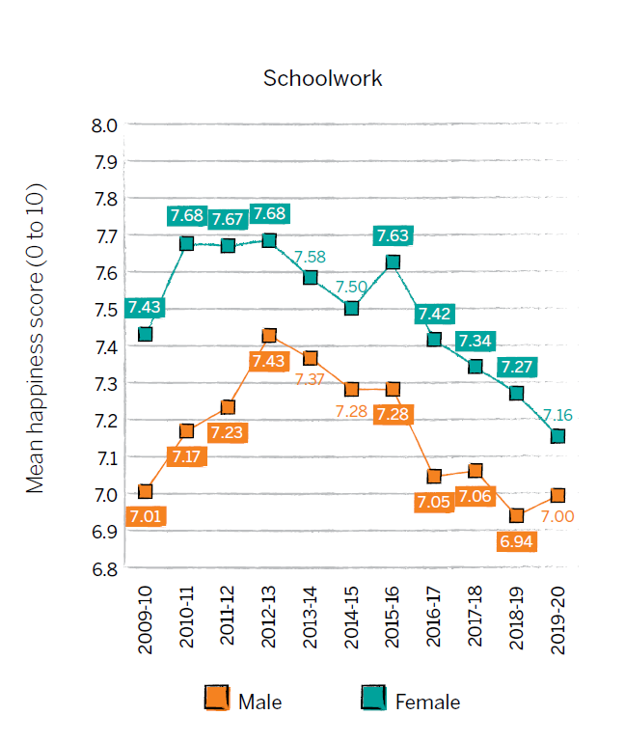
Gender differences in children’s well-being 2019-20
Trends in children’s happiness with different aspects of life by gender, UK, 2009-10 to 2019-20
Source: University of Essex, Institute for Social and Economic Research. (2022). Understanding Society: Waves 1-11, 2009-2020 and Harmonised BHPS: Waves 1-18, 1991-2009. [data collection]. 15th Edition. UK Data Service. SN: 6614, DOI: 10.5255/UKDA-SN-6614-16.
Presentational note: All graphs use the same size range of values (1.2) so that they can be visually compared. Data are weighted (confidence intervals take account of design effects).
Differences by gender:
Males were significantly happier with their appearance across surveys, and females with their schoolwork in 8 of the 11 surveys conducted to date (but not in 2019-20).
Notes:
Important gender differences :
-boys are significantly happier with their appearance than girls across surveys
-girls are significantly happier than boys with their schoolwork in 8 out of 11 survey waves (but not the most recent one in 2019-20).
I have included the chart for life as a whole as often of interest. This isn’t an ongoing trend, and further illustrates some of the interesting patterns/quirks in the most recent data, which we’ll be keen to monitor/ revisit next year.

Slide 7
The push and pull for young people
The future and all possibilities
The here and now and what matters most

Slide 8
I feel that as teenagers we think a lot about the future especially having a new house. But we don’t actually get taught about buying a house or mortgages so we are not educated on this aspect of our future
When I am older, I am nervous of moving to an area that doesn’t accept my religion and identity.
I feel like I’m not going to make GCSE’s and just fail
I’ve learnt to care more about family than wealth.

Slide 9
A vision of the present
The value and pressure of now
Date
October 2022

Slide 10
The daily and ever present
How do I look?
Scrutiny from peers, scrutiny from school staff, scrutiny from men and boys
Is it safe?
The journey home, the shops, the parks and places I want to go to
Am I liked?
Belonging and feeling part of, being complimented and approved, liking myself

Slide 11
An adult vision of the present
Giving hope and opportunities to grow into
An awareness and respect of current feelings and experiences

Slide 12
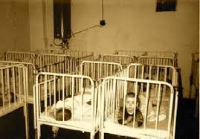
When the future looks lost

Slide 13
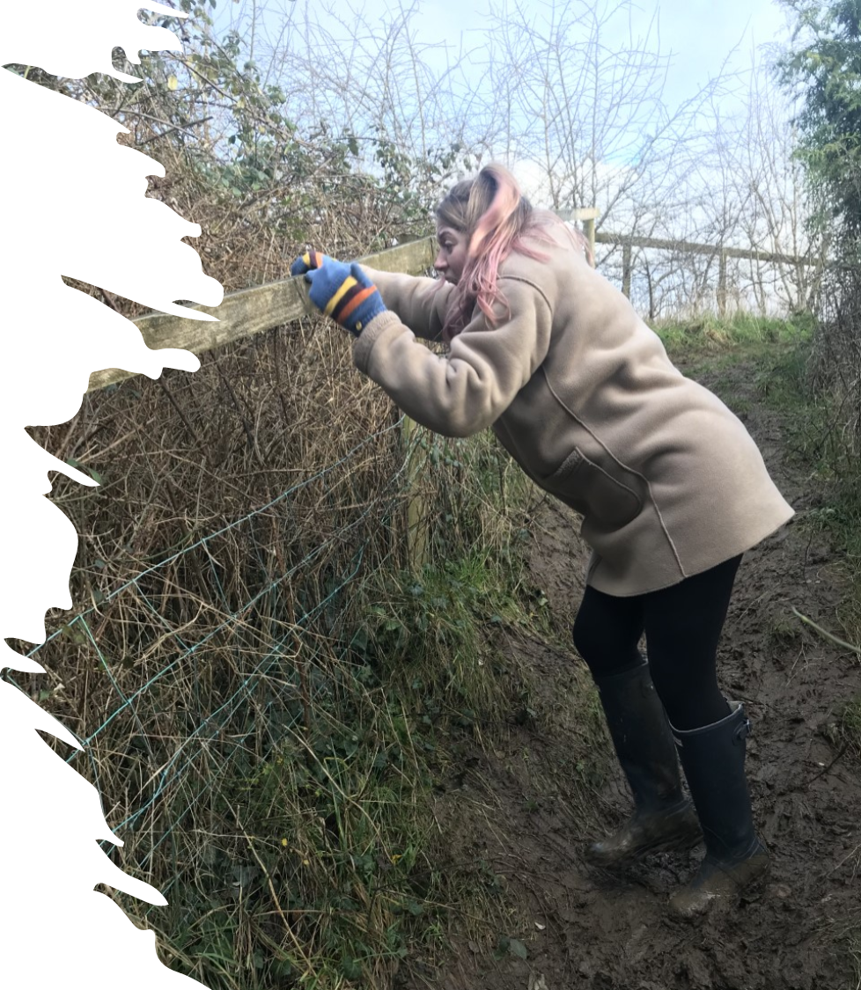
Born of desperation, moving forward in hope

