Slide 1
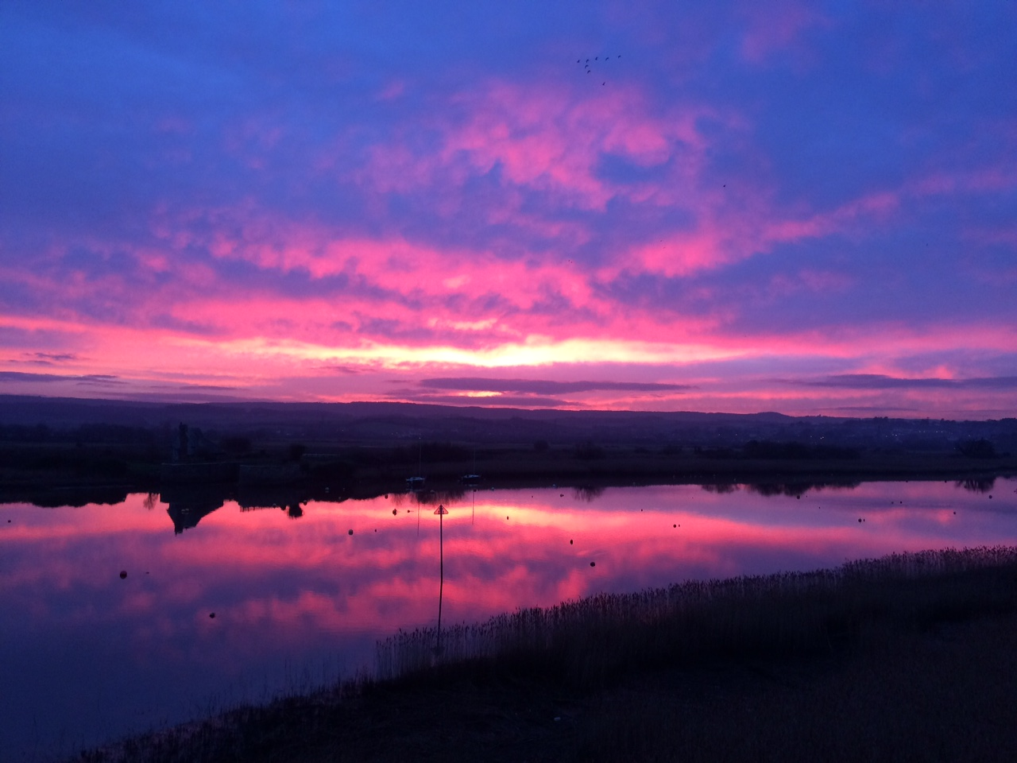
The Church and the Environment: Getting Real about Creation Care
Bristol 14th April 2018

Slide 2
Living together as if the Earth mattered to God

Slide 3
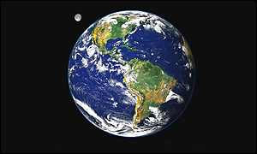
And God saw that it was good… and it was very good!

Slide 4
Planet in Crisis Declining natural resources Water loss Pollution Loss of biodiversity Poverty Global Consumerism Climate Change

Slide 5
What is the Gospel of Creation? God creates life out of nothing The inhospitable becomes home God breathes life into the world and humanity God enfolds the Earth with love God rescues the lost and heals brokenness God is lived in community The Lord rejoices in all his works God so loved the world… I have come that you may have life…

Slide 6
Biblical Emphases
Co-Creators in a Creatio Continua (Partnership)
Earth reveals the glory of God (Revelation)
Shabbat tradition of natural cycles (Sabbath Rest/Limited Resources)
Prophetic voice for most vulnerable (Justice)
Love as deepest expression of Grace (Love)
Healing of brokenness of world (Tikkun olam)
Struggle for peace and wholeness (Shalom)
Importance of right relationships (Common Good)
Custodians for future generations (Stewardship)

Slide 7
Call for reflection and action: * Challenge assumptions * Deepen perceptions * Campaign humbly * Live out alternatives * Build communities * Respect and enhance diversity * Love compassionately * Think holistically * Celebrate together * Have fun!

Slide 8
Exeter Eco Diocese 5 areas of activity: * Land and Buildings * Procurement of Resources * Transport and Travel * Personal and Community Lifestyle * Theology, Worship and Spirituality

Slide 9
The Good News is that which affirms that the purpose of God is ‘Togetherness’, and our role is to love one another into becoming as complete as we can be….

Slide 10
3 questions:
How can we reconnect with God through
the Earth and with one another?
How can we use our gifts, skills and
resources to live as if the Earth
mattered to God?
How do we sustain ourselves in the
struggle for transitioning to a
low carbon economy?

Slide 11
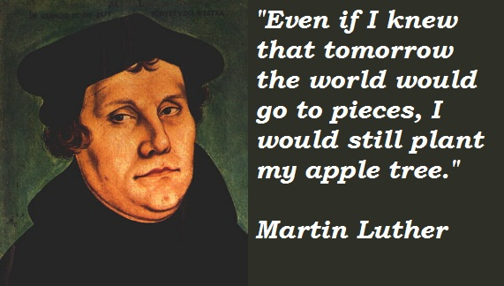

Slide 12
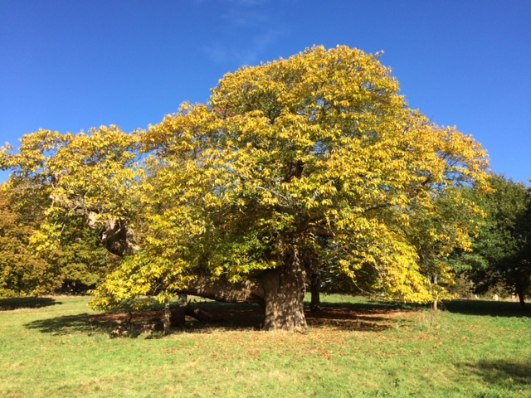
‘We need to create the life that we aspire to discover’

Slide 13
The Church and the Environment: Getting Real about Creation Care
Bristol 14th April 2018

