Slide 1
The Church and the Environment
Sustainability and mission:
Why should we care?

Slide 2
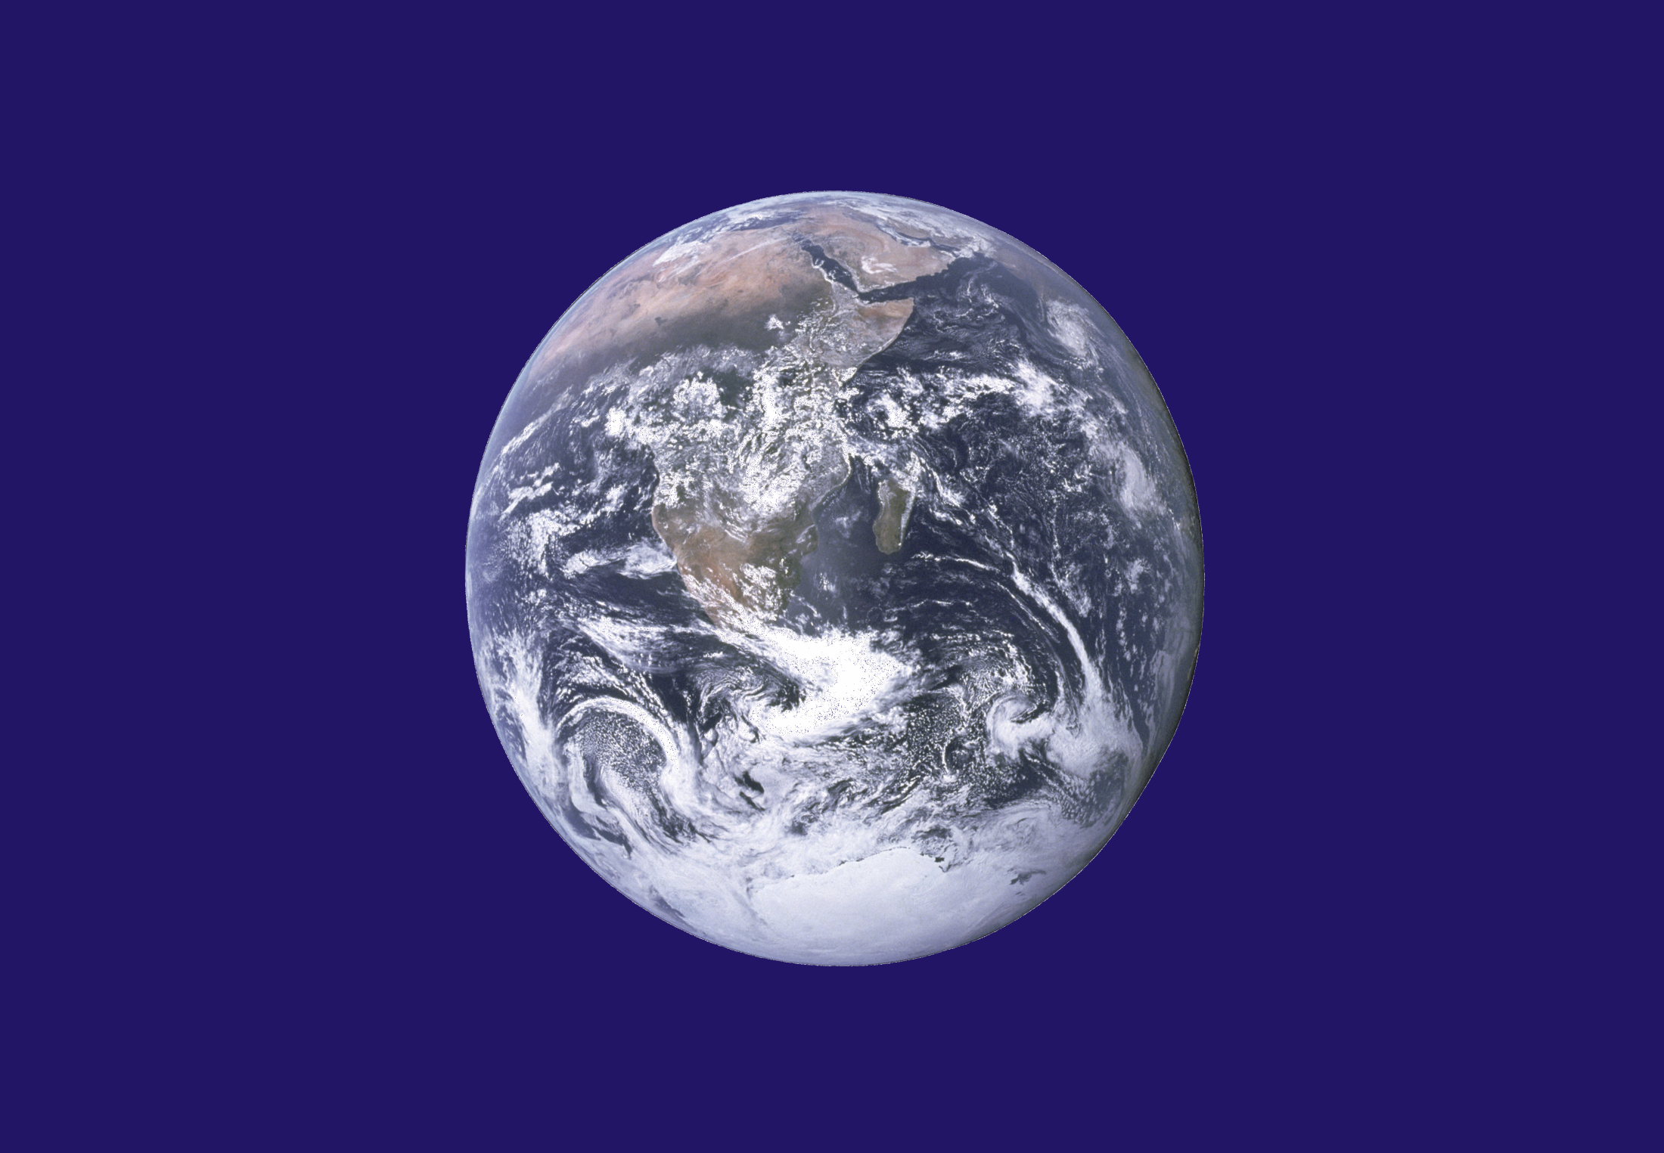

Slide 3
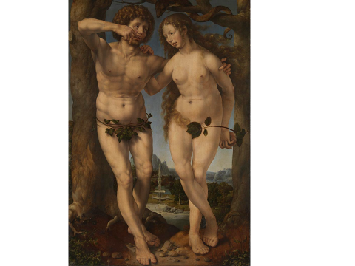

Slide 4
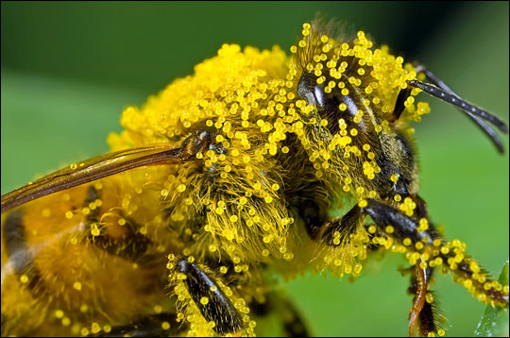

Slide 5
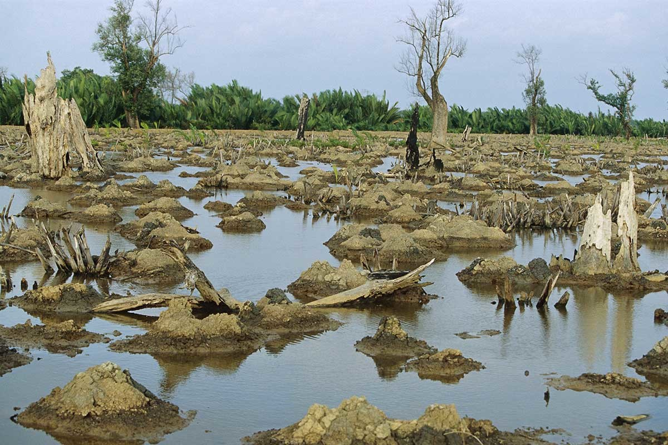
Notes:
Mango swamp destroyed by a shrimp farm – New Scientist 10 May 2016

Slide 6
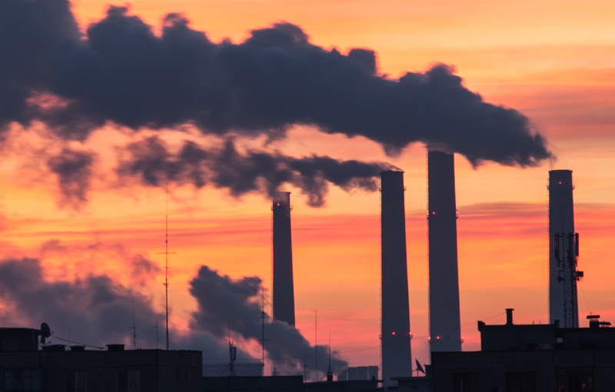

Slide 7
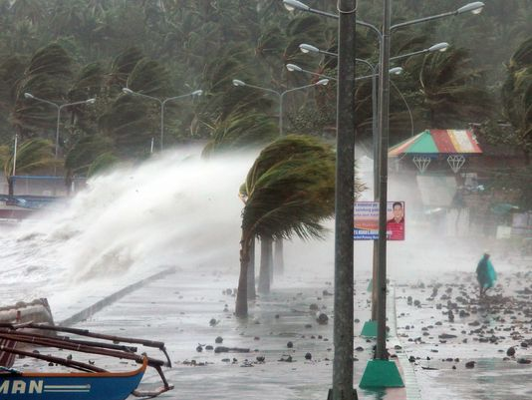

Slide 8
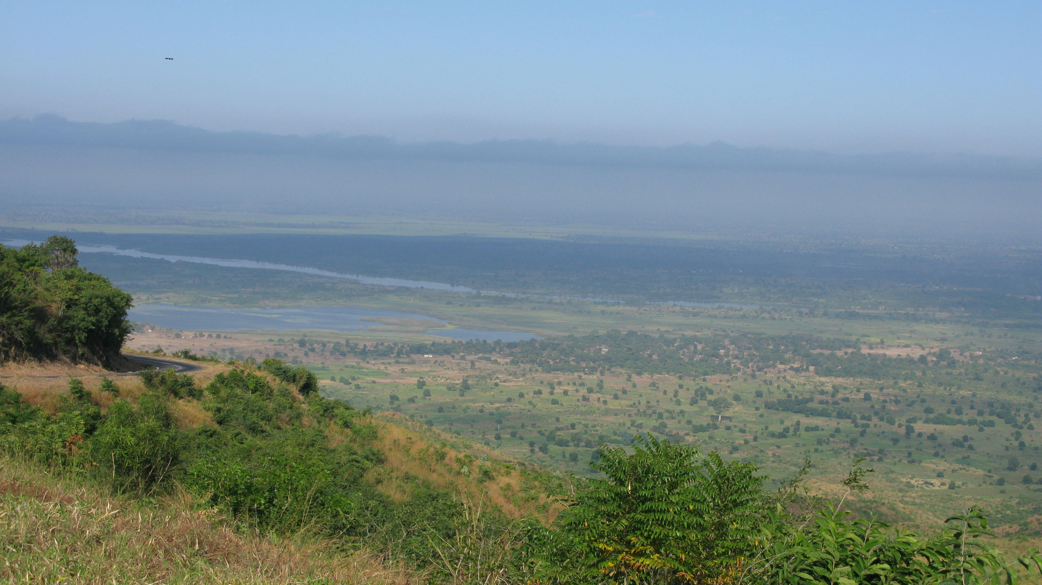

Slide 10
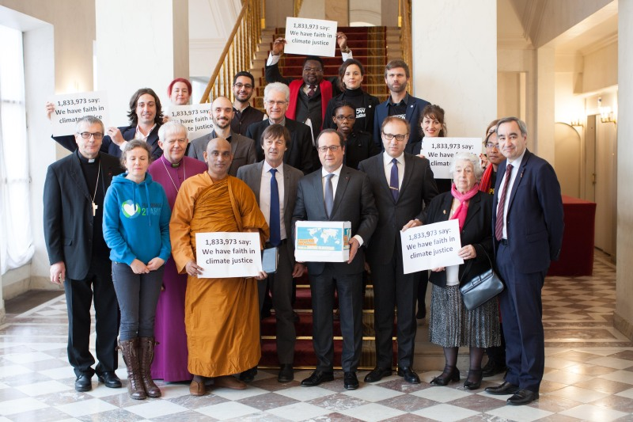

Slide 12
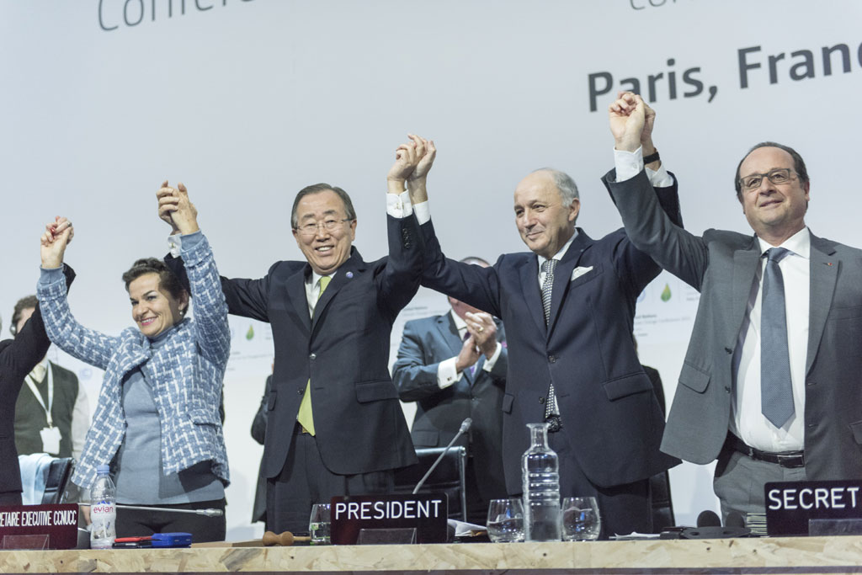

Slide 13
In Paris Governments agreed:
to work towards being carbon neutral by the end of the century.
a long term goal of keeping the increase in average temperature to well below 2⁰C above pre-industrial levels
to aim to limit the increase to 1.5⁰C since this would significantly reduce risks and the impact of climate change.
on the need for global emissions to peak as soon as possible, recognising that this will take longer for developing countries
to undertake rapid reductions thereafter in accordance with the best available science.

Slide 15
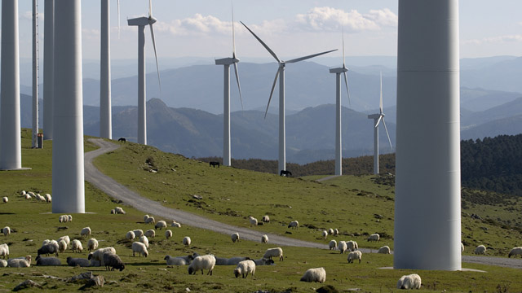

Slide 16
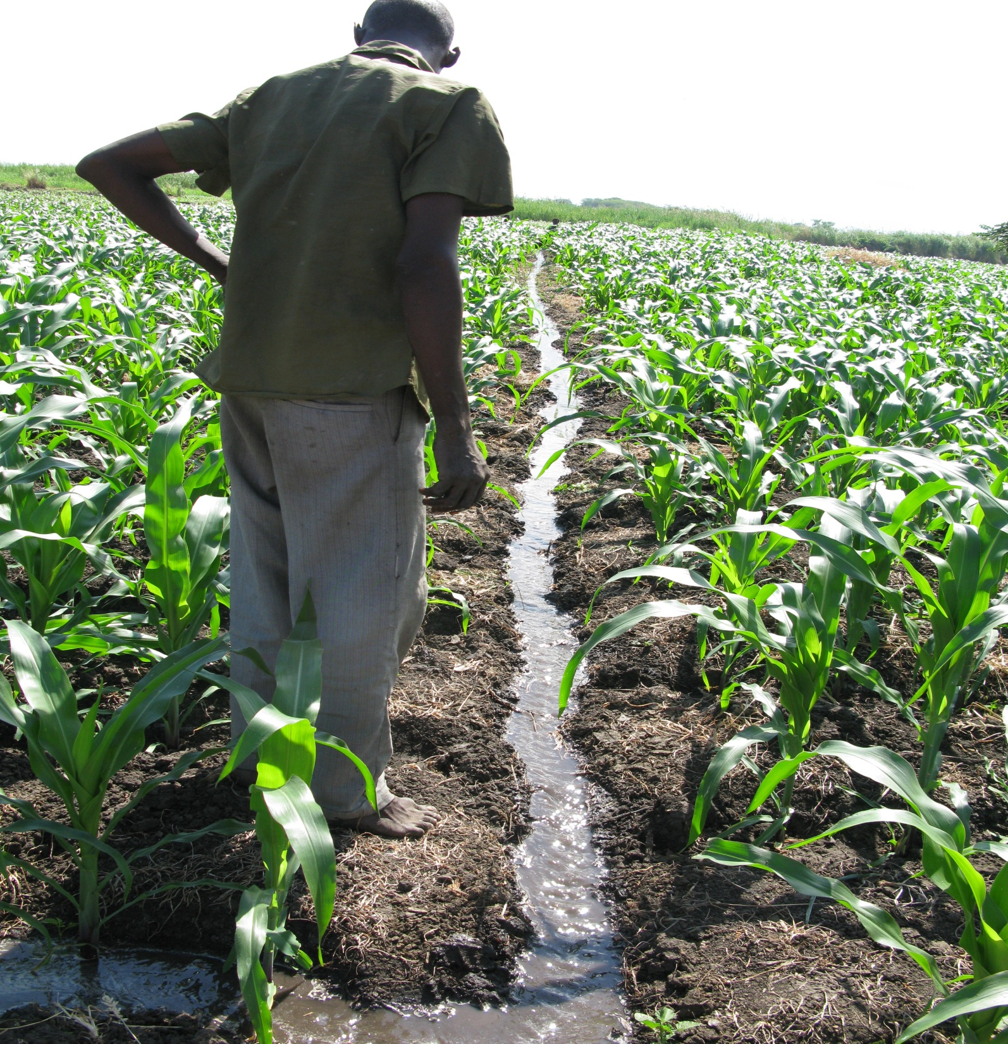

Slide 17
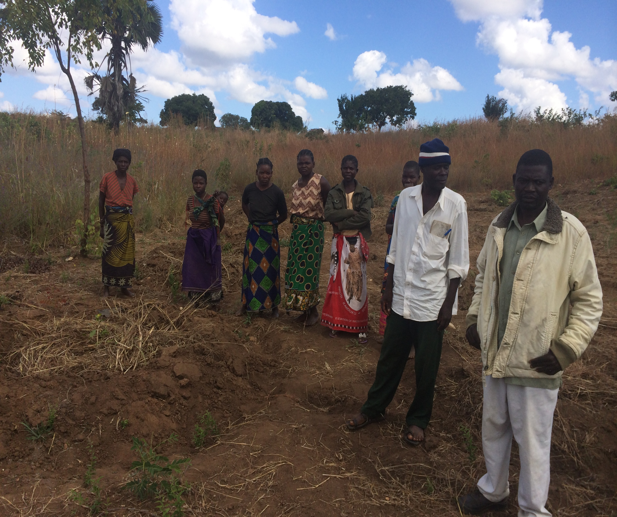

Slide 18
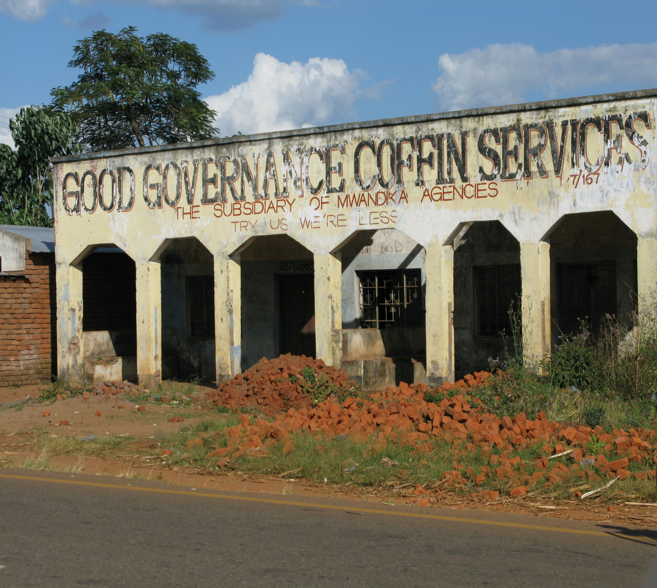

Slide 19
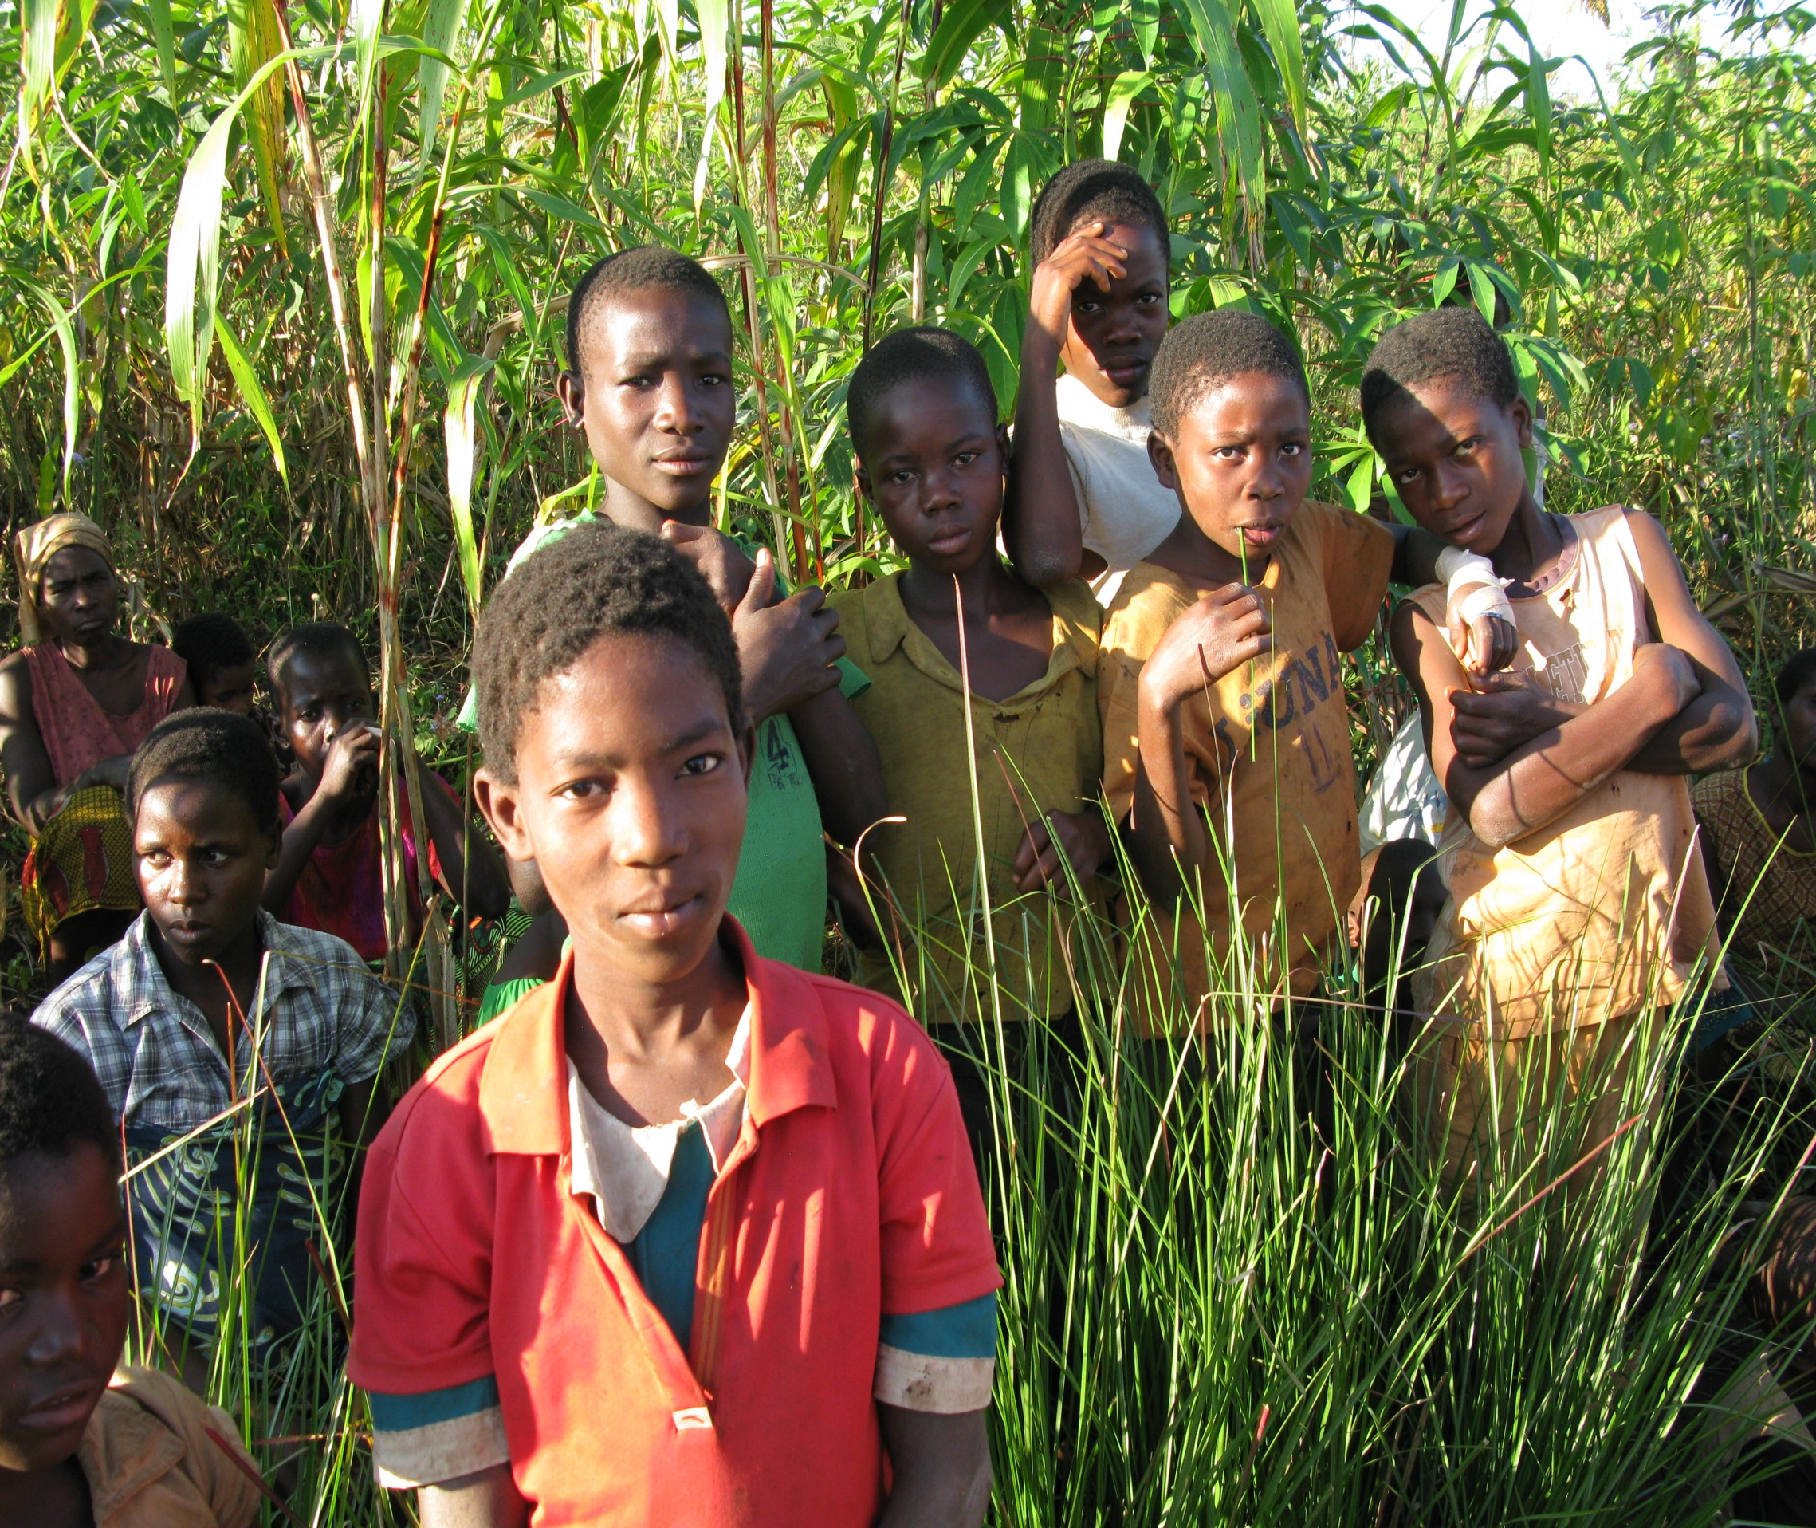

Slide 20
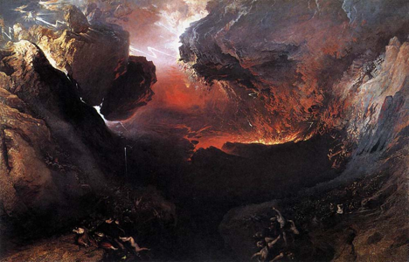
Notes:
John Martin's The Great Day of His Wrath, c1853.

Slide 22
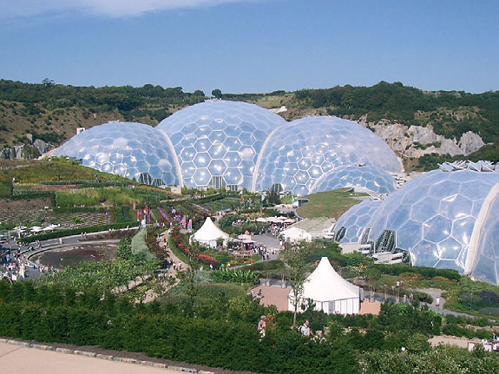

Slide 24
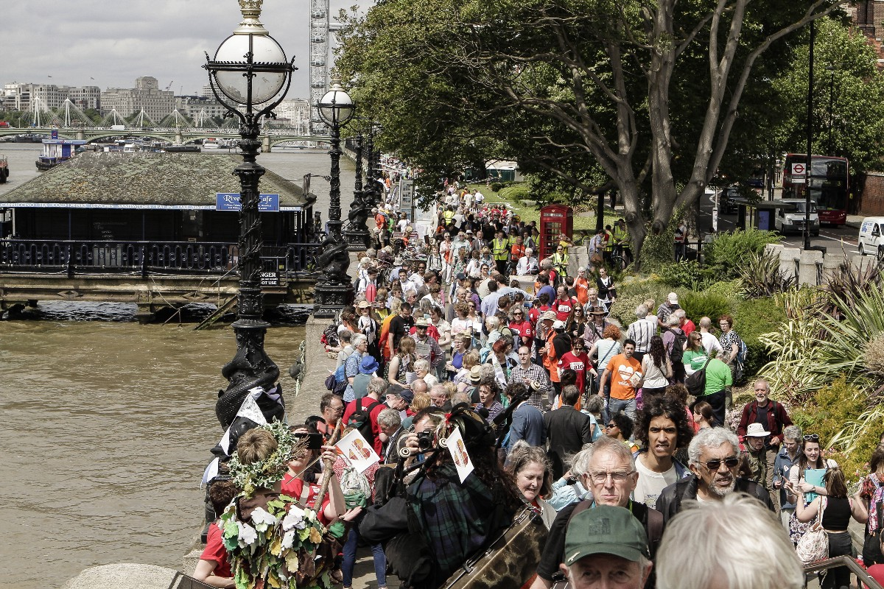

Slide 25
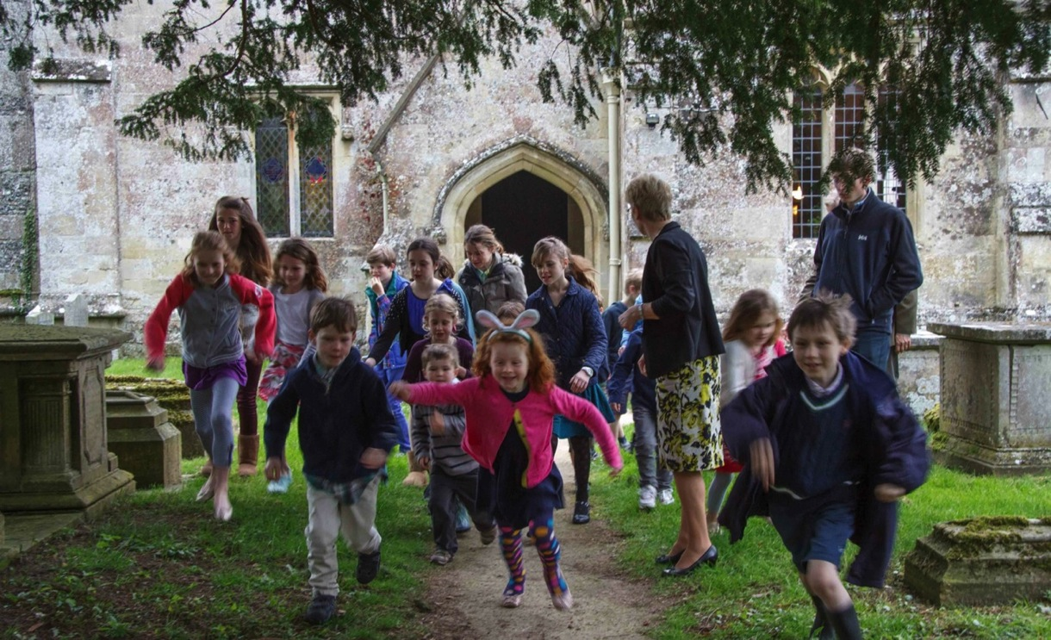

Slide 26
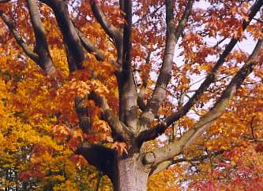

Slide 27
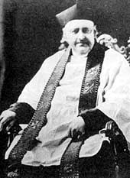

Slide 30
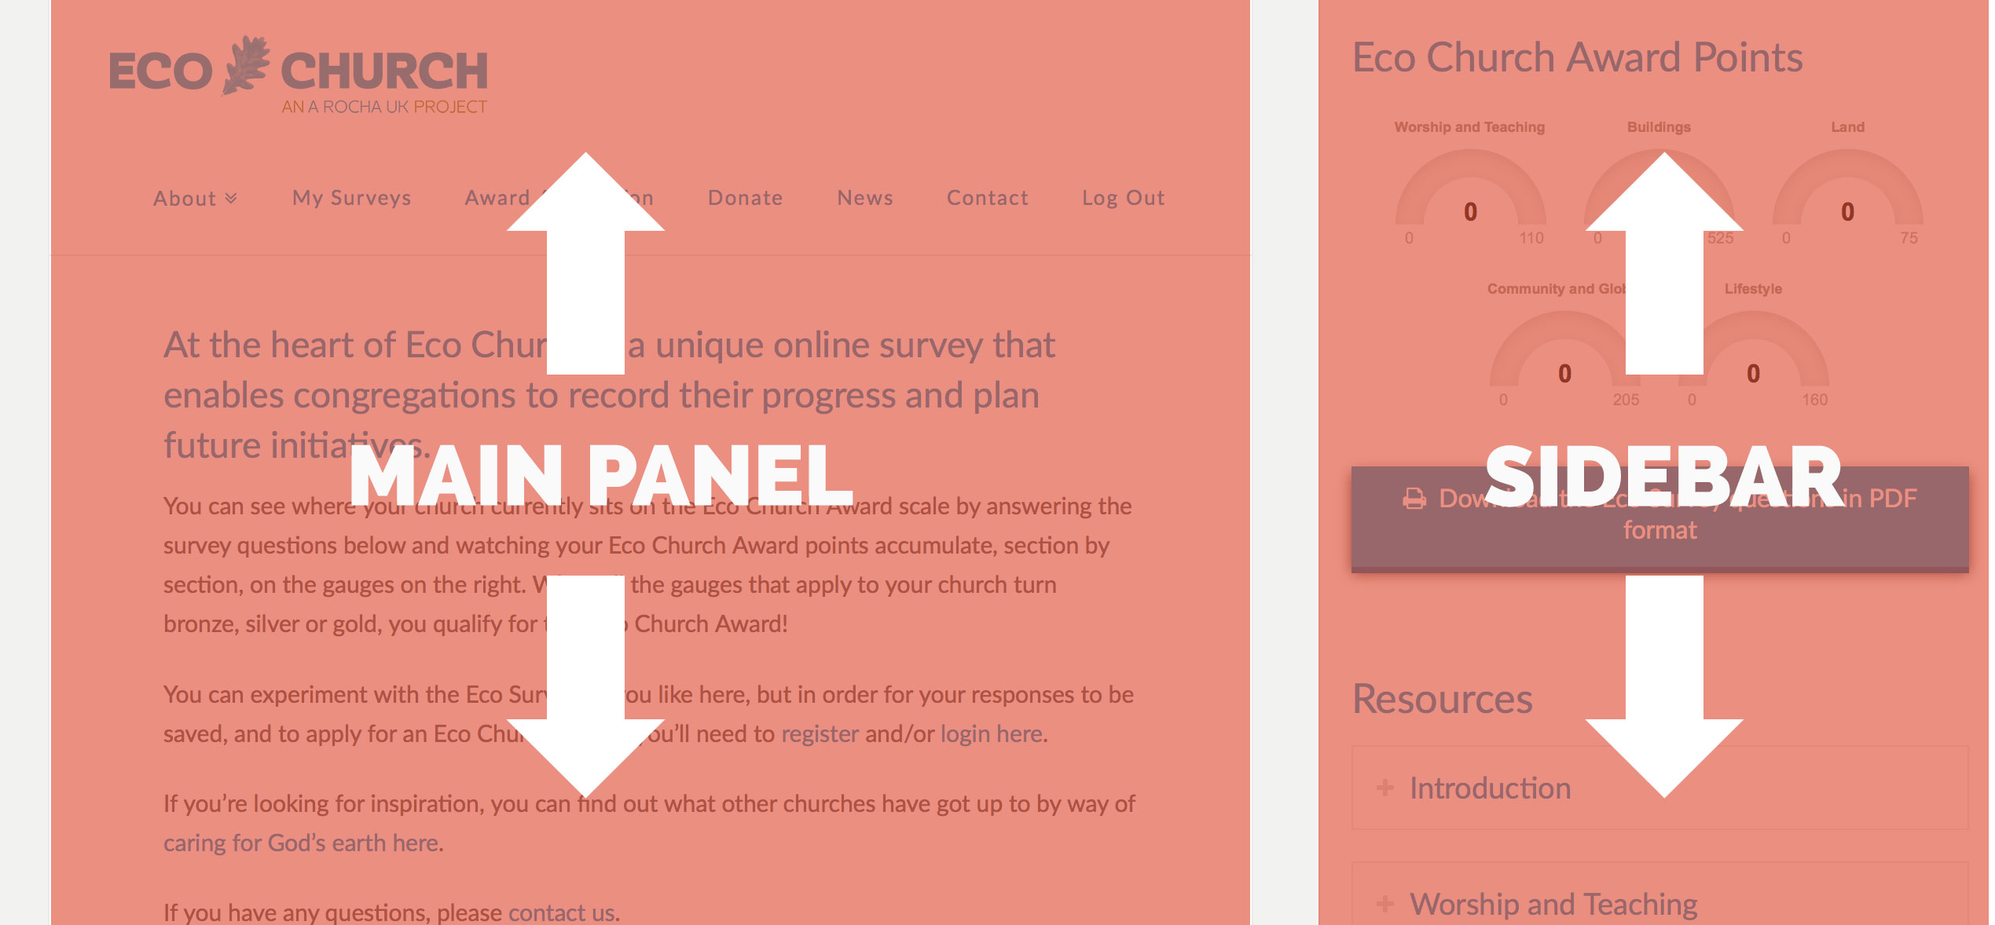

Slide 31
#GreenChurch
Church Times Green Church Awards
2017
Green Building
Biodiversity
Green Congregation
Green Champion
Green Futures

Slide 32
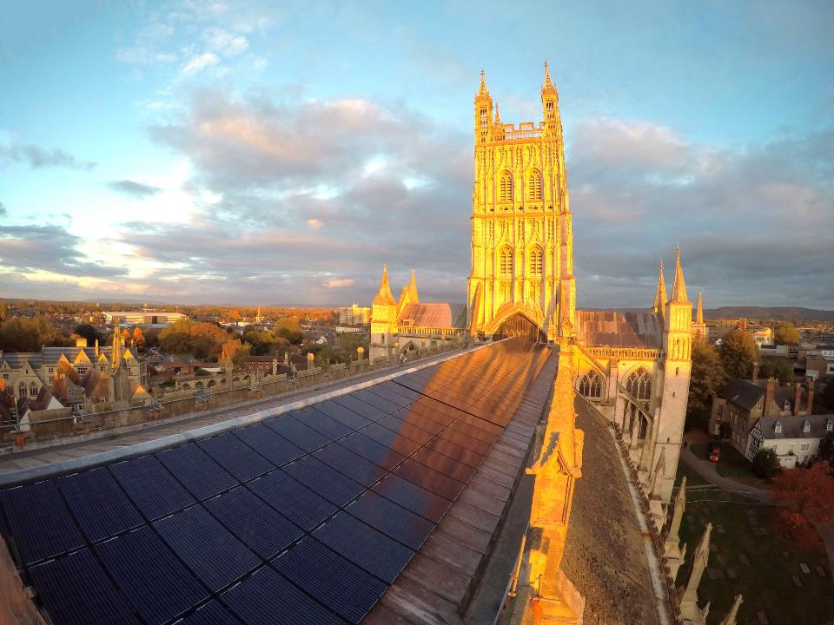
Gloucester
Cathedral

Slide 33
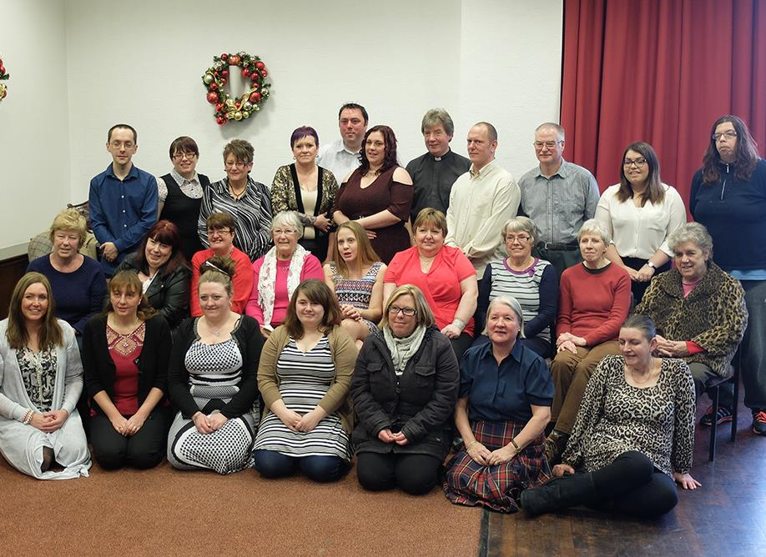
Shildon
Alive!
Guerilla Gardening Team

Slide 34
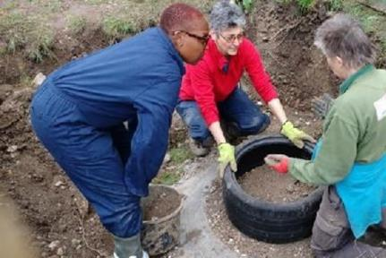
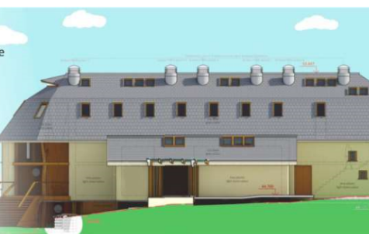
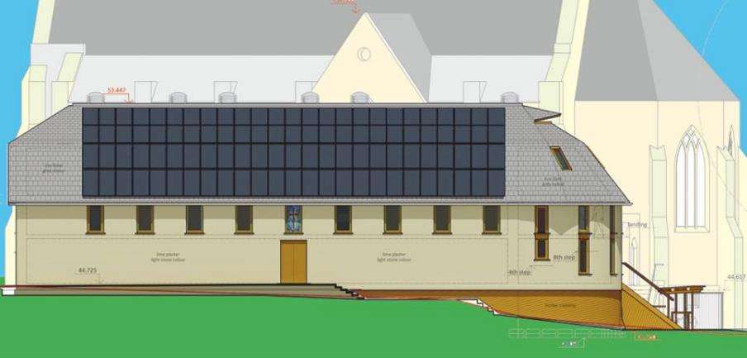
Holy Trinity,
Tulse Hill
Notes:
https://youtu.be/R7pAScKXyVc

Slide 35
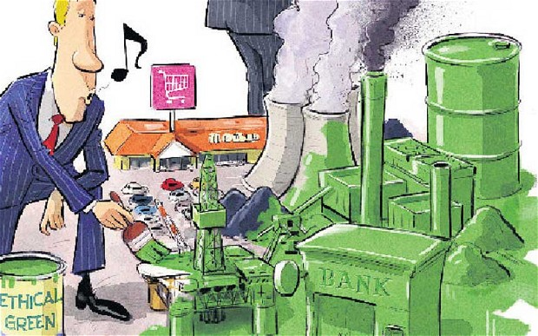

Slide 36
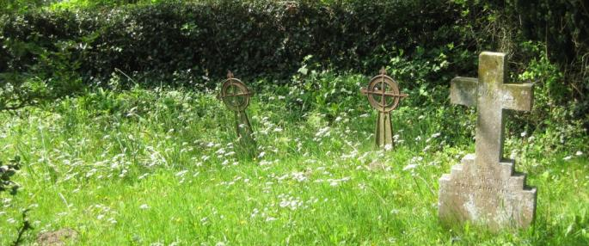

Slide 37
