Slide 1

Transforming Church. Together
Introduction and Update
Notes:
Introduction to self
- What's the most creative thing you’ve done so far this week???

Slide 2
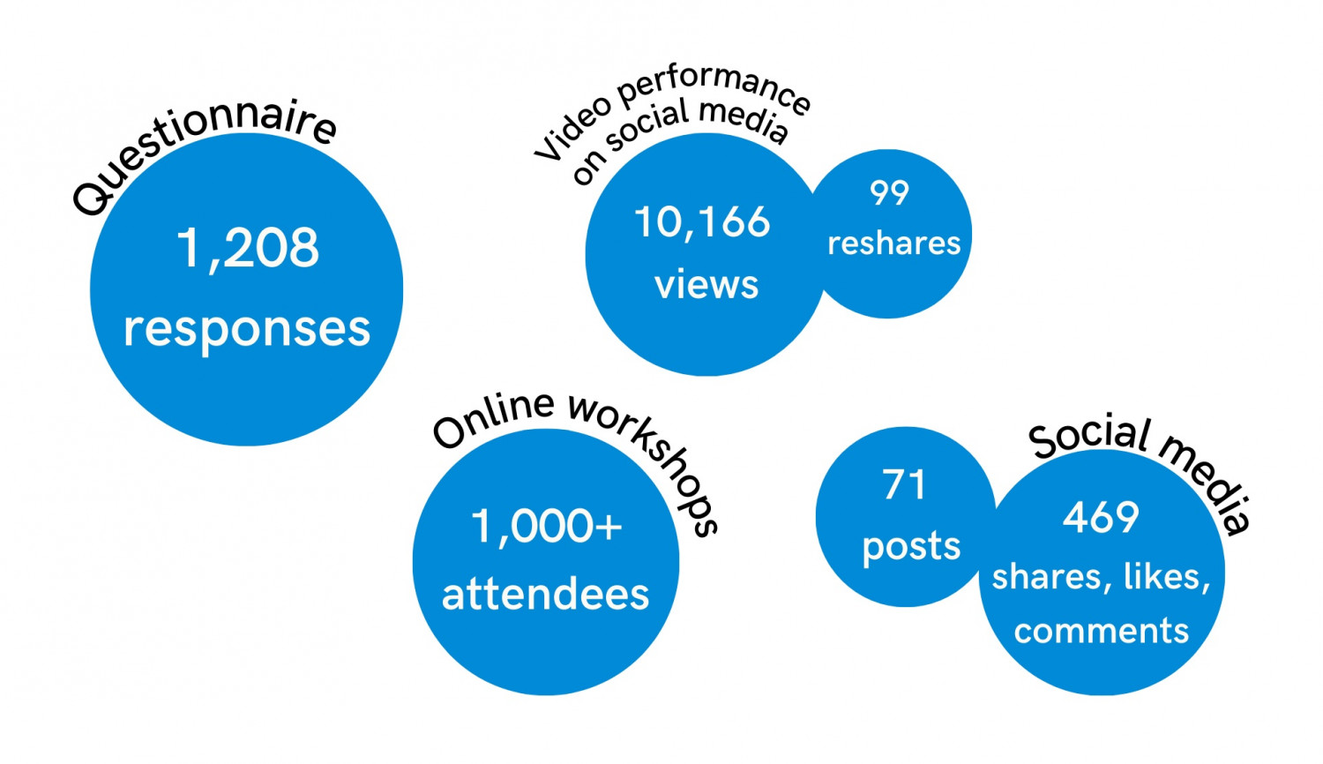
The history
The Diocesan Strategy for the next five years
Based on wide consultation,
deep prayer and discernment
Supported by investment
from the national church
2020/21
Discernment
2022
Strategy Creation
2023
Organisation
2024
Engagement
Notes:
We are the Diocese of Bristol – it's about all of us – your church is part of this
Consultation = this is based on what you asked for in 2021
Investment = £6.8m so far

Slide 3
What is it?

Slide 4
Vision, Mission, and Values
We want to see ‘humanity reconciled, creation restored’
We are sent to follow Jesus, to serve others,
and to transform communities
By being open, generous, creative, and brave
Notes:
We value openness and are loving and open to all. Our behaviour is welcoming – we want to be a safe, accessible, kind and welcoming space for everyone. We want our communities to feel embraced, their diverse needs met, and for them to benefit from a long-term relationship based on acceptance and love for people as God made them
We value generosity and receive and give sincerely. We give our time and resources to share what we know of Jesus' love. We want our communities to feel supported and cared for in the way Jesus would do, to experience God’s love through our action and an opportunity to journey into faith if they choose.
We value creativity and we cooperate with the work of the Spirit. We are faithful, rooted in faith and responsive to the Spirit. Our communities feel inspired - this is bold and joyful faith, work and worship that engages us all. We want our communities to experience a variety in projects and worship styles, celebrating tradition and innovation in connection to God.
We value bravery - we are courageous with our voices and our actions. We acknowledge and learn from our past and actively effect positive change in the world. We want our communities to feel empowered as they are listened to, supported, and partnered with in seeking transformational change. The collective voices and actions of our community will help to bring about transformational change.
There are small group study guides on the four values to download from the diocese website

Slide 5
What will we look like in 5 years?
Transformed!
Outcomes:
  To have a form of church in every community to which all can belong
  To have people who worship God in every aspect of their lives and throughout their whole lives
  To be recognised as a powerful force for gospel change
  To have a sustainable church with sustainable finances
Notes:
Transformed – not tweaked! Especially Culture – we will be thinking differently

Slide 6
Investing in Following Jesus
U18s
Pathways to faith
Flourishing ministers
Notes:
U18s – growing faith lens
Pathways to faith
a Diocesan Rhythm of Life;
training for small group leaders (experienced or new);
Workplace wayfinders
Young preachers
diocesan conferences exploring themes of discipleship and evangelism and sharing good practice from across the diocese;
offering consultancy support through the team to help parishes and mission areas develop a culture of discipleship and evangelism;
signposting resources.
Flourishing ministers
Coaching programme
Admin support (hubs)
Wellbeing and training support – leadership development

Slide 7
Investing in Serving Others
Supporting volunteers
Buildings that serve communities
Right forms of church in the right places
Notes:
Supporting volunteers
Toolkits / training / recruitment support (see later)
Buildings
Income generation / redevelopment etc
Flourishing ministers
Mission Areas / Fresh Expressions / Planting and grafting

Slide 8
Investing in Transforming Communities
Supporting Priority Communities
Carbon Net Zero
Partnerships for Gospel Change
Inclusion and Racial Justice
Notes:
PCN
Specific investment in those in the top 12.5% of the IMD – historically under invested in – less well resourced – injustice issue
CNZ
Buildings… investment to decarbonise all vicarages - £6m outside of national church investment, plus £10k per church following paid for energy audit… support of local champions
Partnerships
Partnership with other 3rd sector organisations, as well as fundraising opportunities
Inclusion / RJ
Disability, mental health, racial justice – out churches on the whole do not look like our communities… why not? Support training for congregations – targeted support for GMH and UKME clergy which are also under-represented in our institution…

Slide 9
Some examples:

Slide 10

Growing Faith Chaplains
Four initial projects
  Purton and Lydiard Millicent
  Downend
  Soundwell
  Bristol City
Flourish in Patchway
Notes:
Some early good news – successes so far

Slide 11
New Mission Areas
Chippenham focussing on
  Coordinated youth work for the town
  Cross parish admin support
  Outreach to new estates
Might this sort of thinking help your context?
Notes:
Some early good news – successes so far

Slide 12
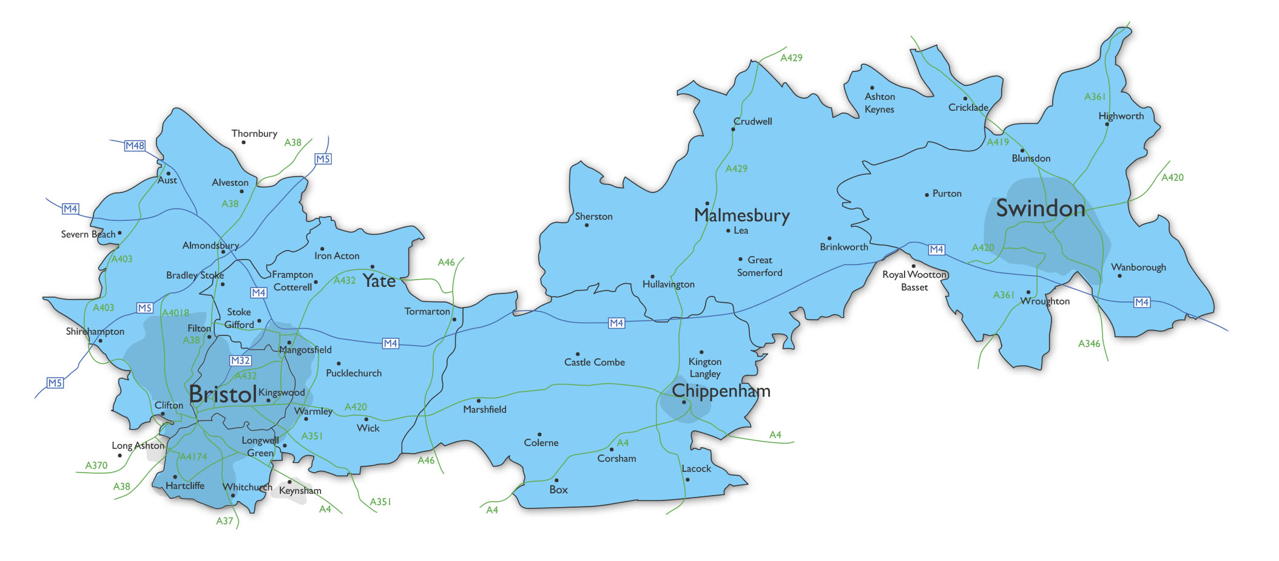
Admin centres
Providing admin support across boundaries:
  people management, safeguarding administration and practice
  health and safety, fabric and buildings
  churchyard monument admin
  room hire and enquiries
Notes:
Some early good news – successes so far

Slide 13

Clergy Coaching Network
First cohorts beginning in September
Notes:
Some early good news – successes so far

Slide 14
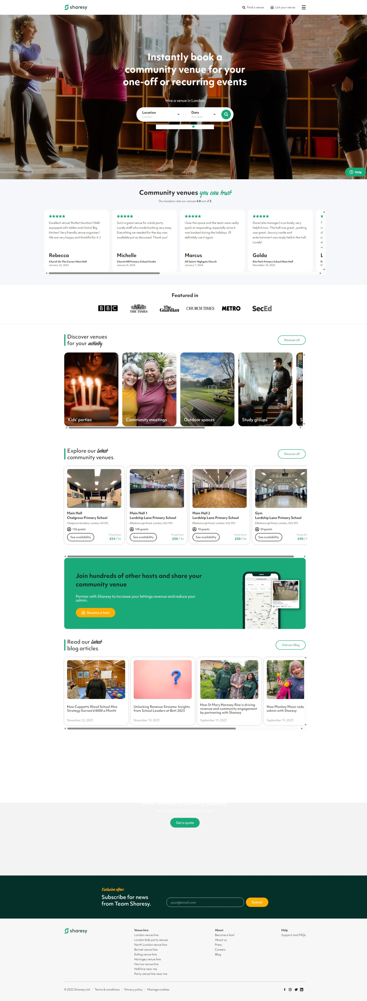
Sharesy
‘AirBnB’ for halls, schools, churches
Advertises to a wider audience
All the admin done for you
Free for the first year
Notes:
Some early good news – sucessess so far

Slide 15
Any questions?

