Slide 1
Global Environmental Perspectives
One World, One Body
Rebecca Boardman
Programmes Coordinator – Advocacy and Mission

Slide 2
Leah Gordon/USPG

Slide 3
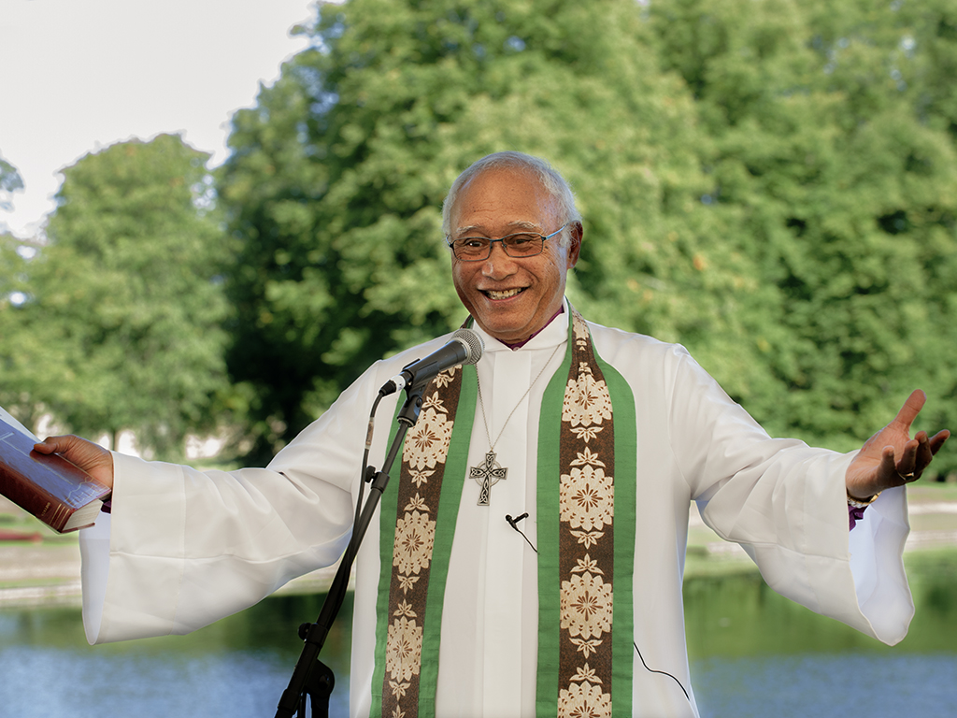
Leah Gordon/USPG

Slide 4
Leah Gordon/USPG

Slide 5
Rebecca Boardman/ E-CARE Foundation

Slide 6
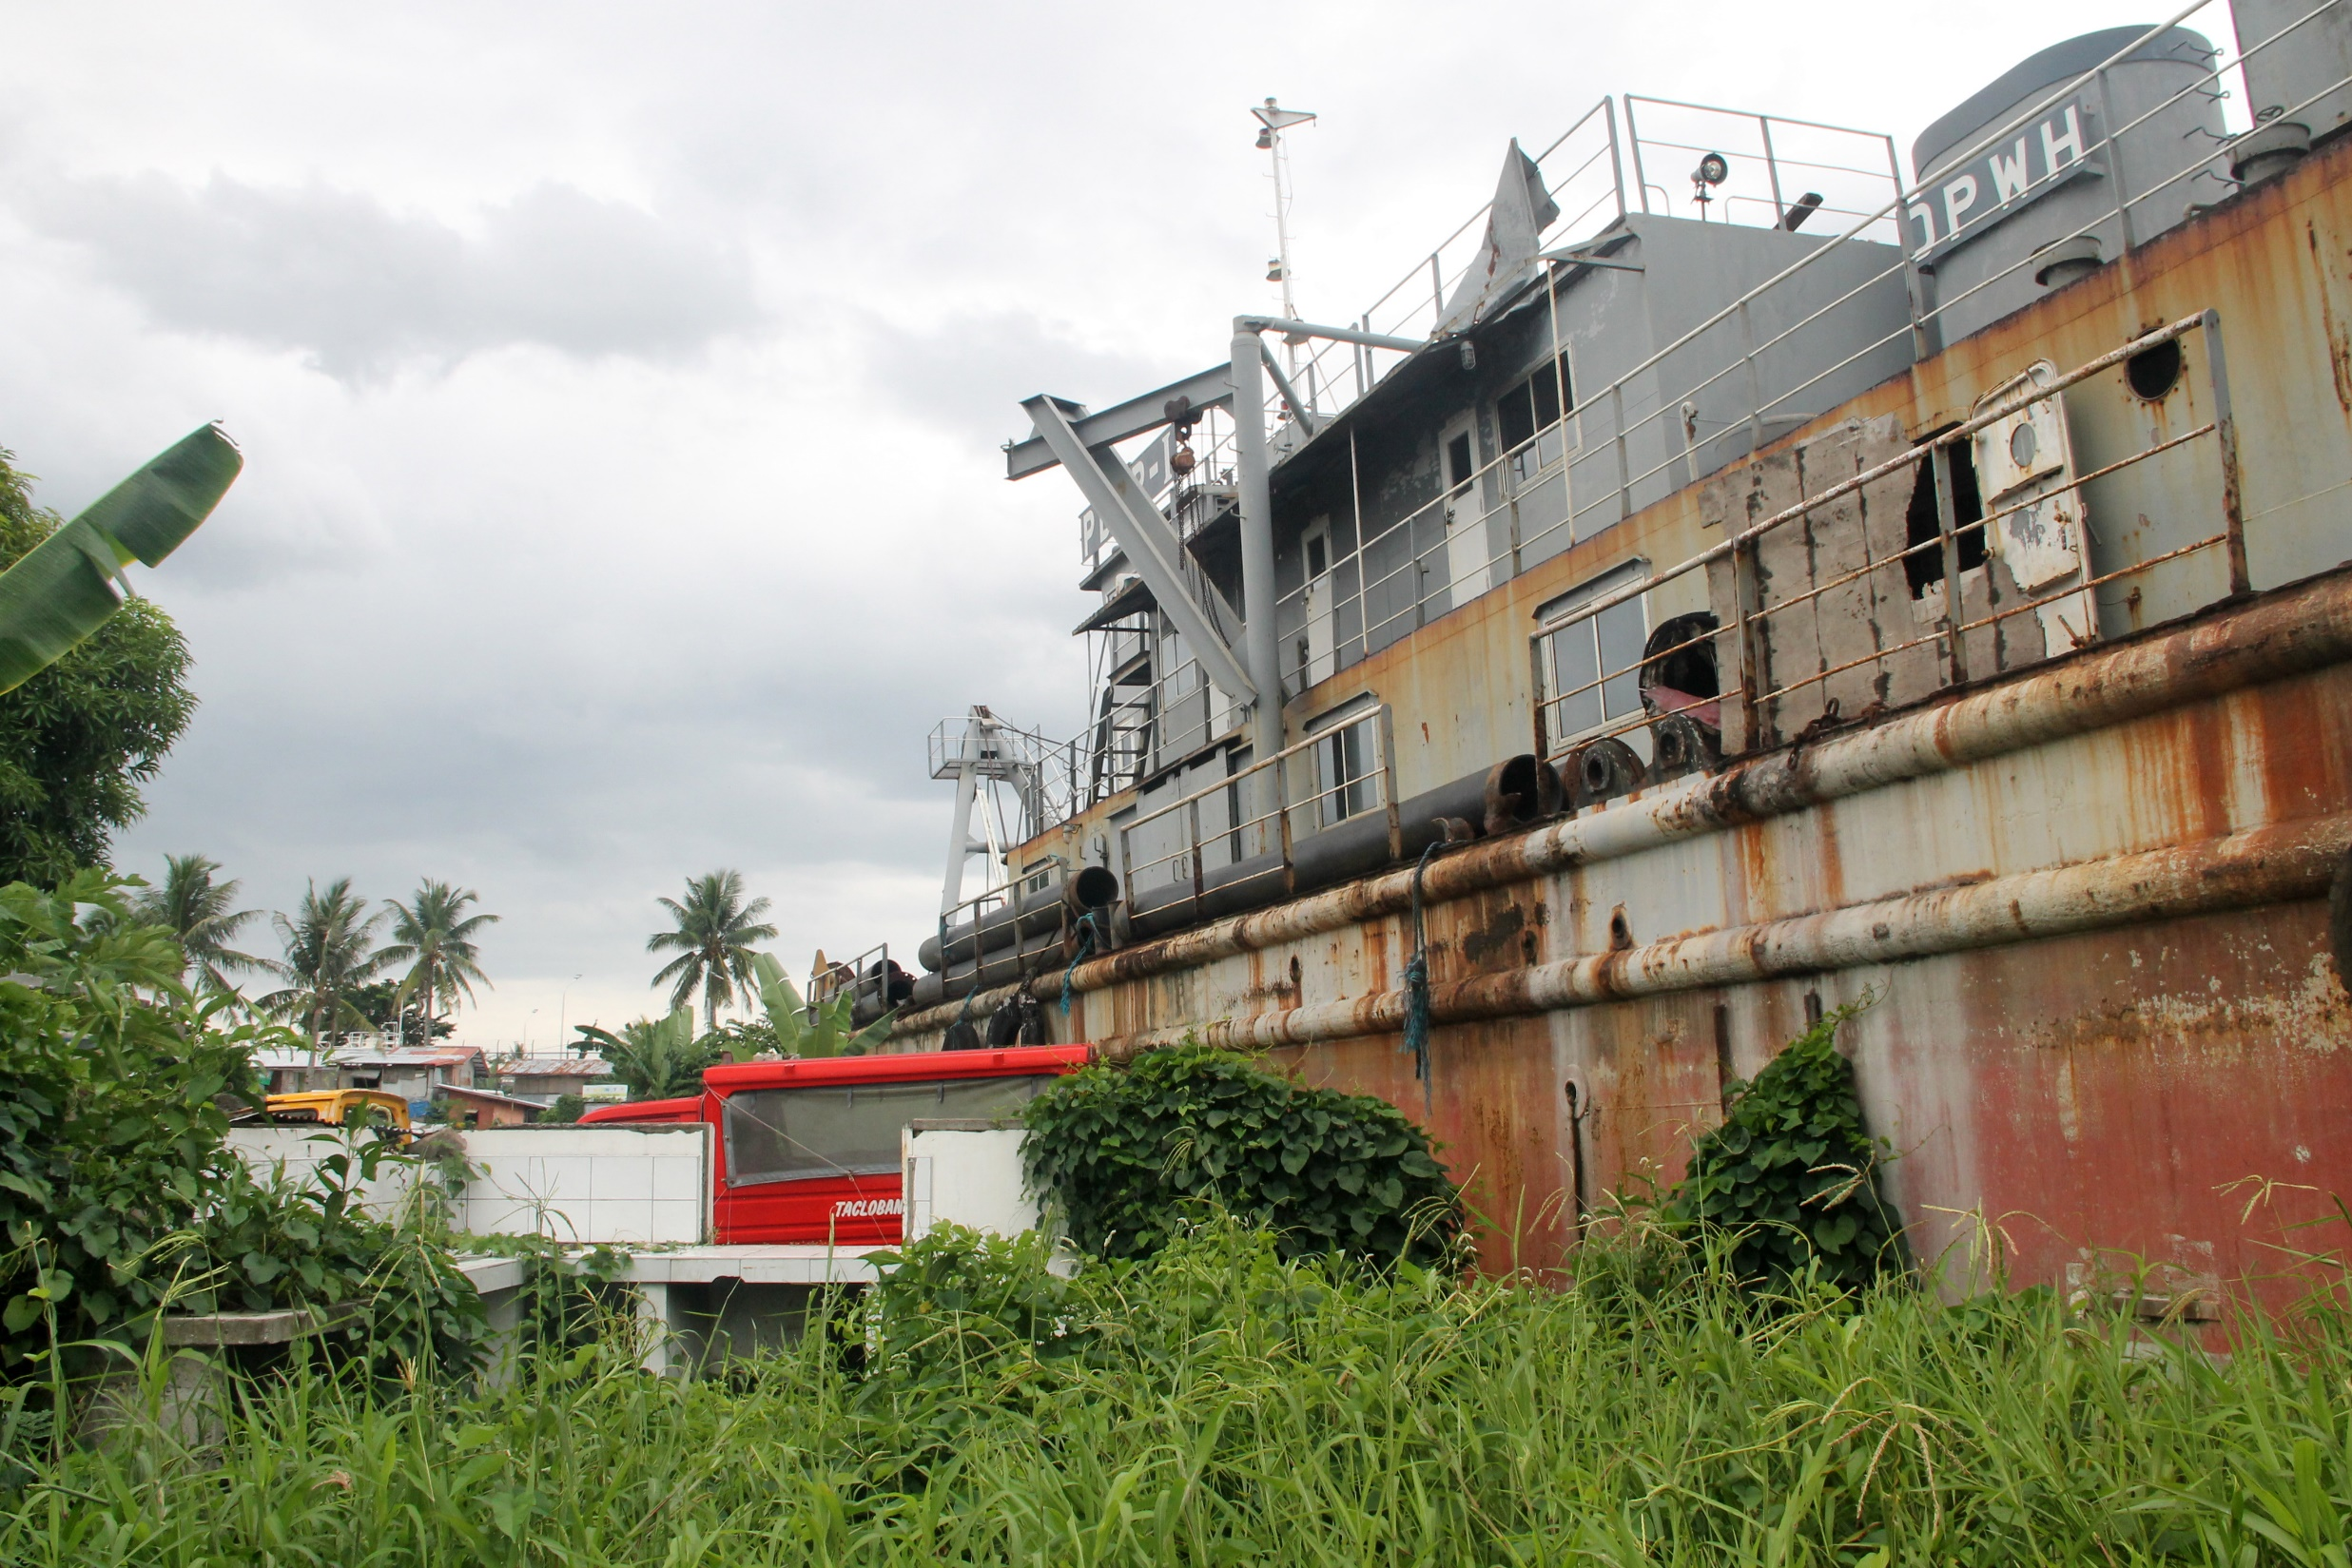
Rebecca Boardman/ E-CARE Foundation

Slide 7
Chris Dobson

Slide 8
Leah Gordon/USPG

Slide 9
©2009-2018 hapciuMadam

