Slide 1
Bidding for Success
14th May 2018
Presentation by Paul Playford
Allchurches Trust Grants Officer

Slide 2
Allchurches Trust Ltd
Established 1972
It owns the Ecclesiastical Insurance Group
Objects are to “promote the Christian religion” plus any other charitable purpose
Over the ten years 2008-2017 Allchurches Trust was able to give away a total of £99.7 million to churches and other good causes
In 2017 alone, it gave away £15.6 million
Worcester Cathedral

Slide 3
Grant Schemes
Recurring Block Grants to Anglican Dioceses and Cathedrals
Grants in response to applications
Special Projects Grants
Methodist Insurance Fund
Trinity Arts Centre, Bristol

Slide 4
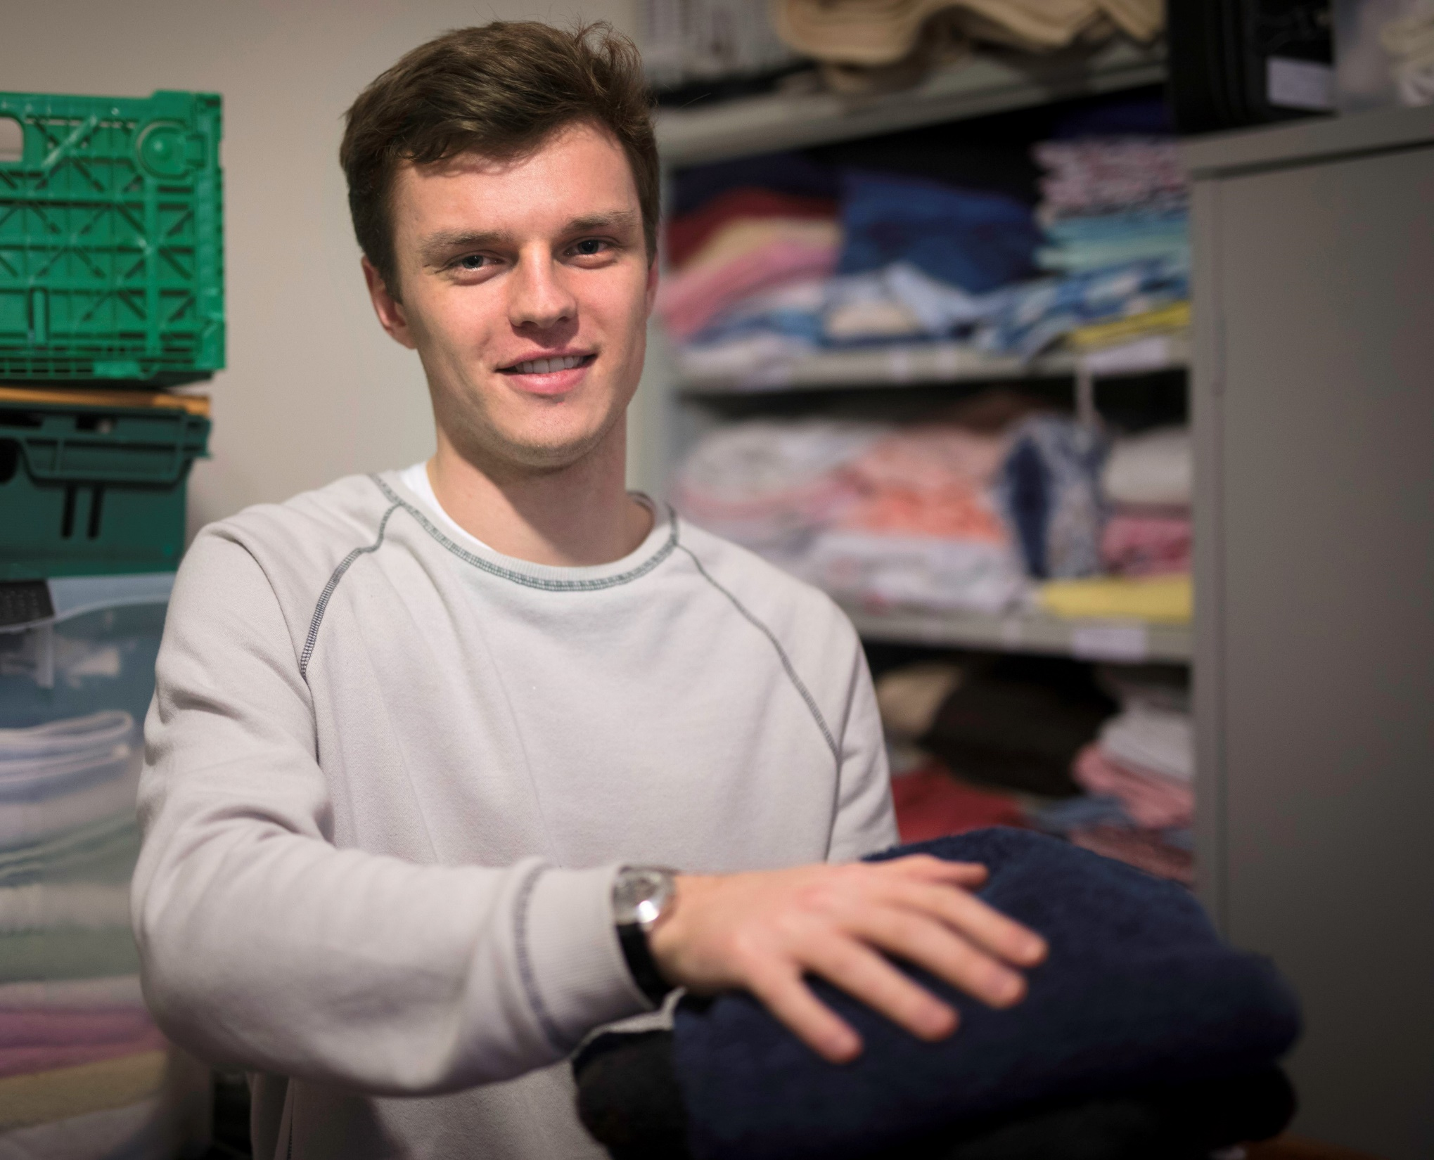
Who can apply?
Churches and cathedrals of all denominations
Charities with Christian links
Schools, colleges, hostels, care homes and other communities – for projects which have a Christian dimension
Genesis Trust, Bath
Notes:
Member denomination of Churches Together in England (or the equivalent bodies in Wales, Scotland or Ireland)
… or we look for membership of local CT groups to demonstrate that church works in ecumenical harmony with other churches

Slide 5
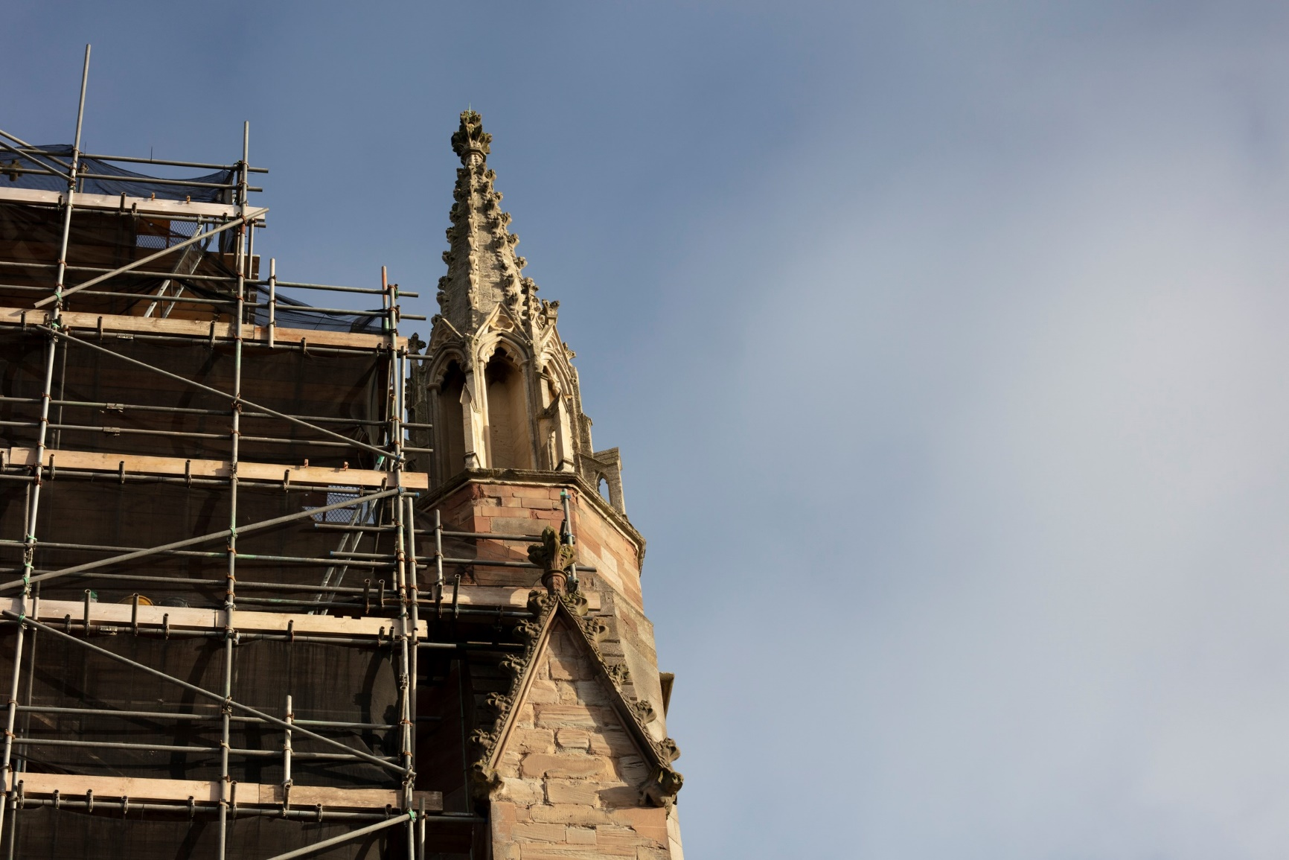
What we support
Projects which support mission and ministry
Projects which impact those in greatest need
Reordering and new works
Repairs
Worcester Cathedral
Notes:
https://www.allchurches.co.uk/what-we-fund
Also touch on what we don’t fund

Slide 6
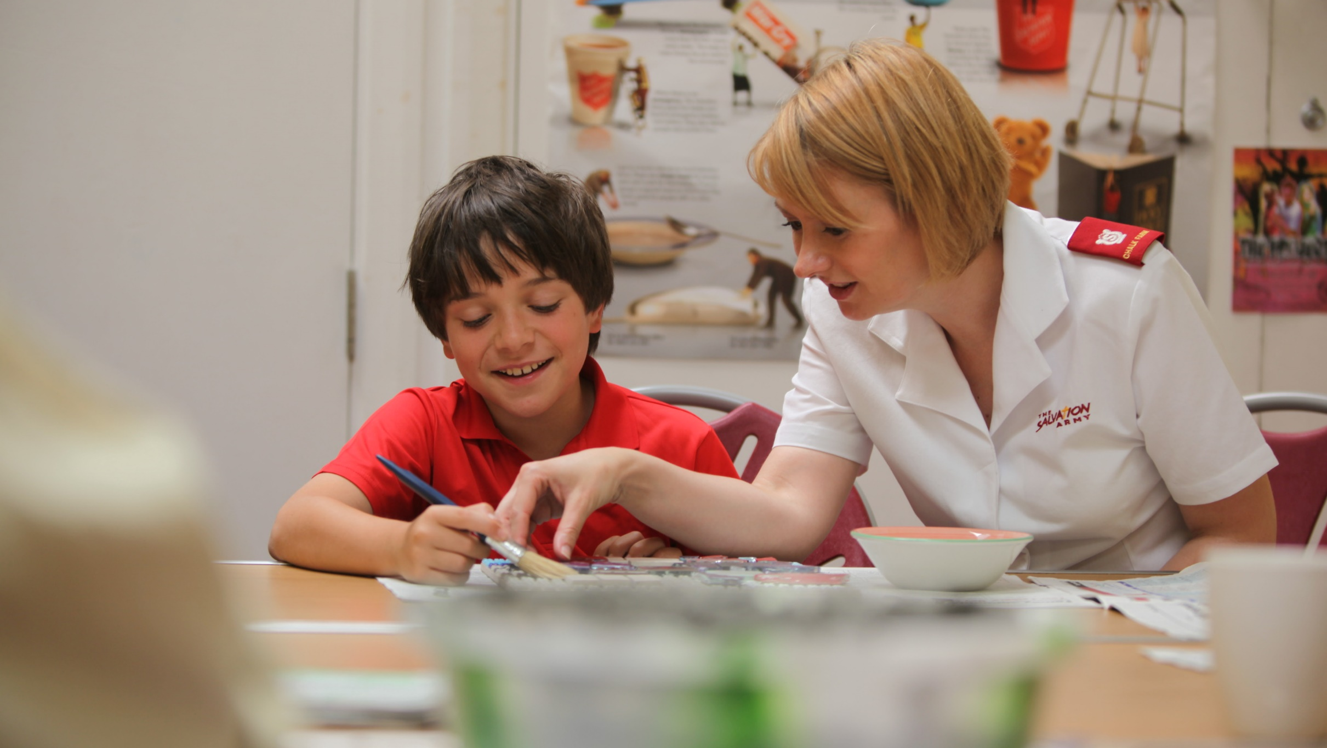
The Salvation Army, Droitwich Spa
Worcester Cathedral
Notes:
“What you are doing is saving peoples lives. When I felt there was no hope you gave me hope” – Polish single mother

Slide 7
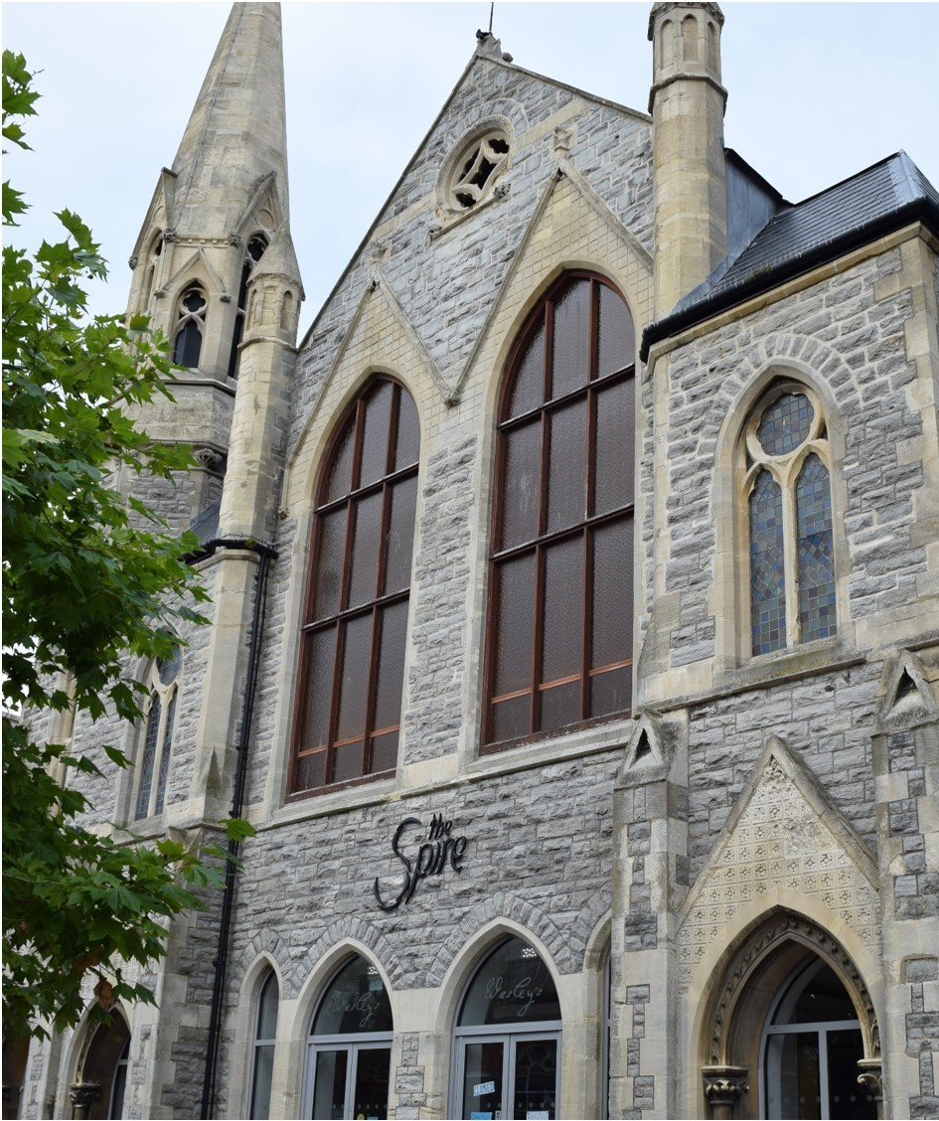
Poole Methodists, The Spire, Dorset

Slide 8
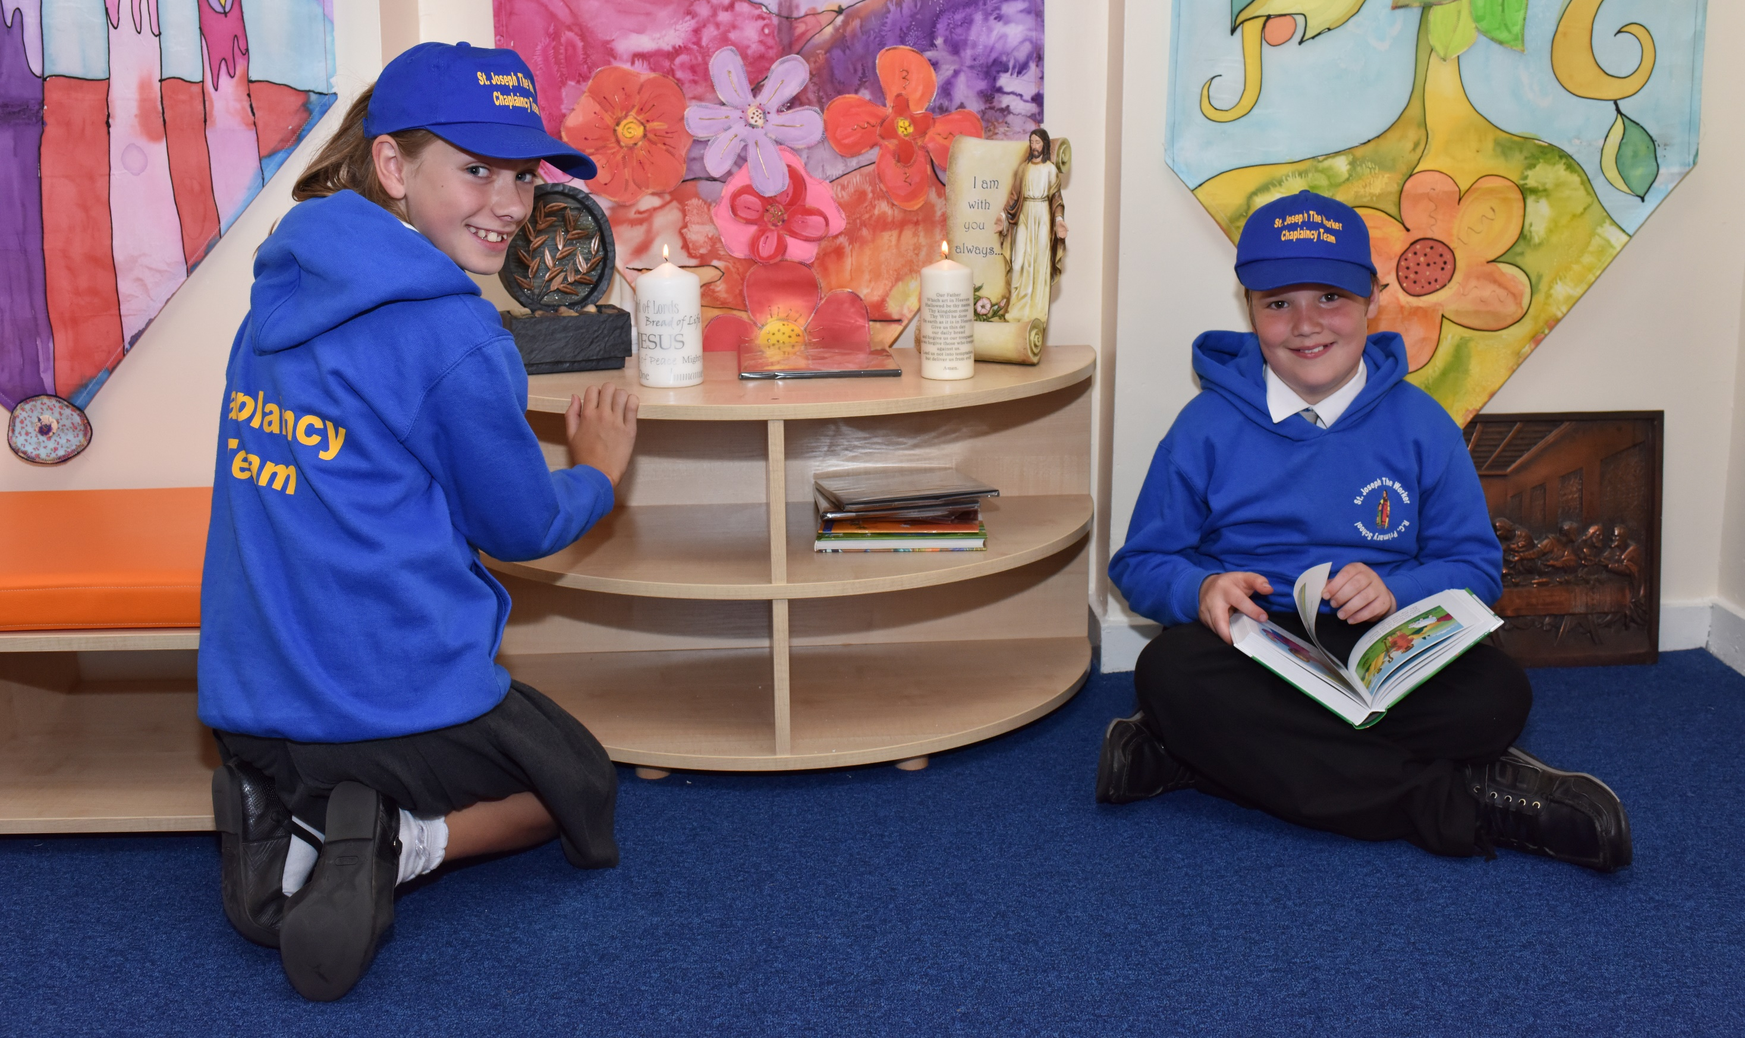
St Joseph the Worker RC Primary School, Manchester
Notes:
As well as the prayer and worship that will take place there, we have a weekly visit from a family counsellor who supports children who are experiencing challenging circumstances. She will be able to use this lovely space too.” - Dawn Ridyard, Headteacher

Slide 9
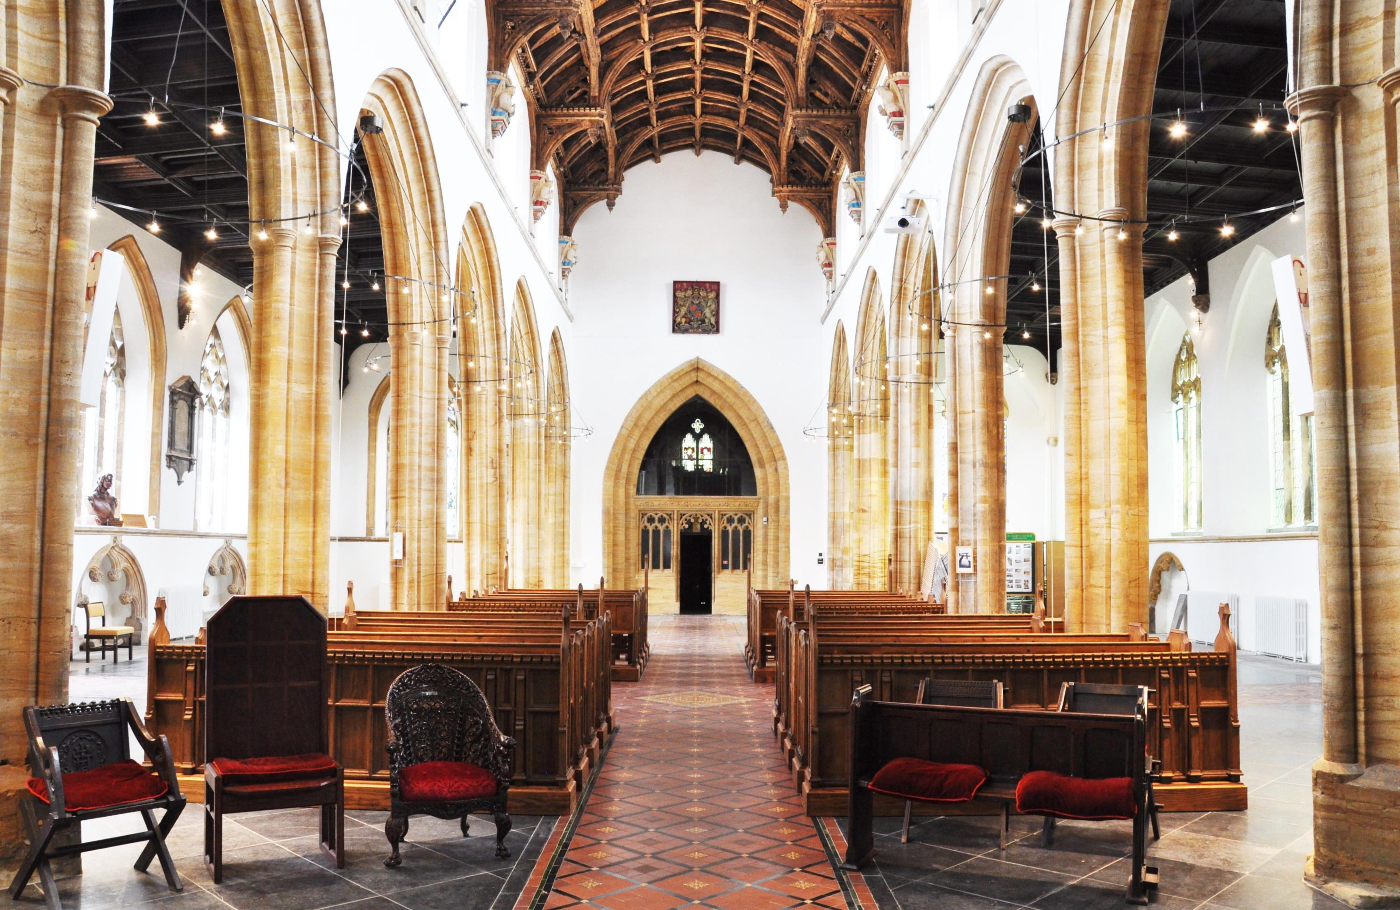
St Mary’s Church, Bridgwater

Slide 10
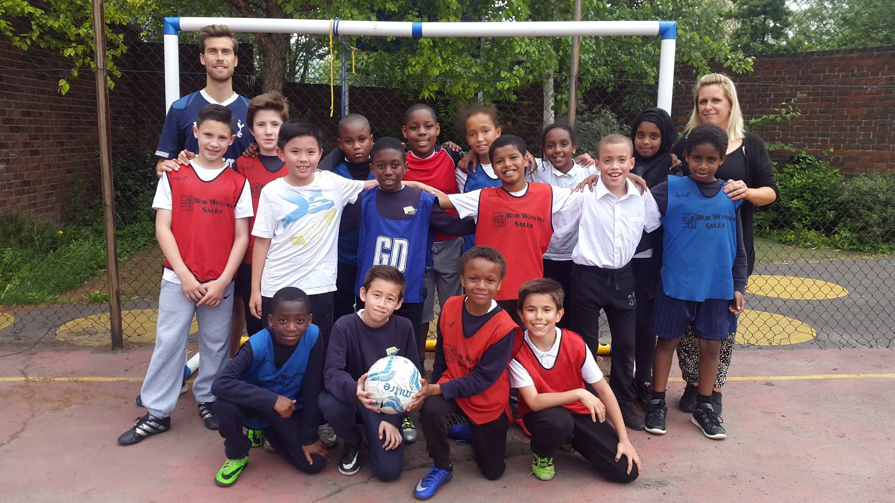
Hub Athletic, Oasis Trust, Waterloo
Notes:
“You have directly affected the lives of young people in Waterloo in a really positive way” – Sam Mepham, Hub Athletic

Slide 11
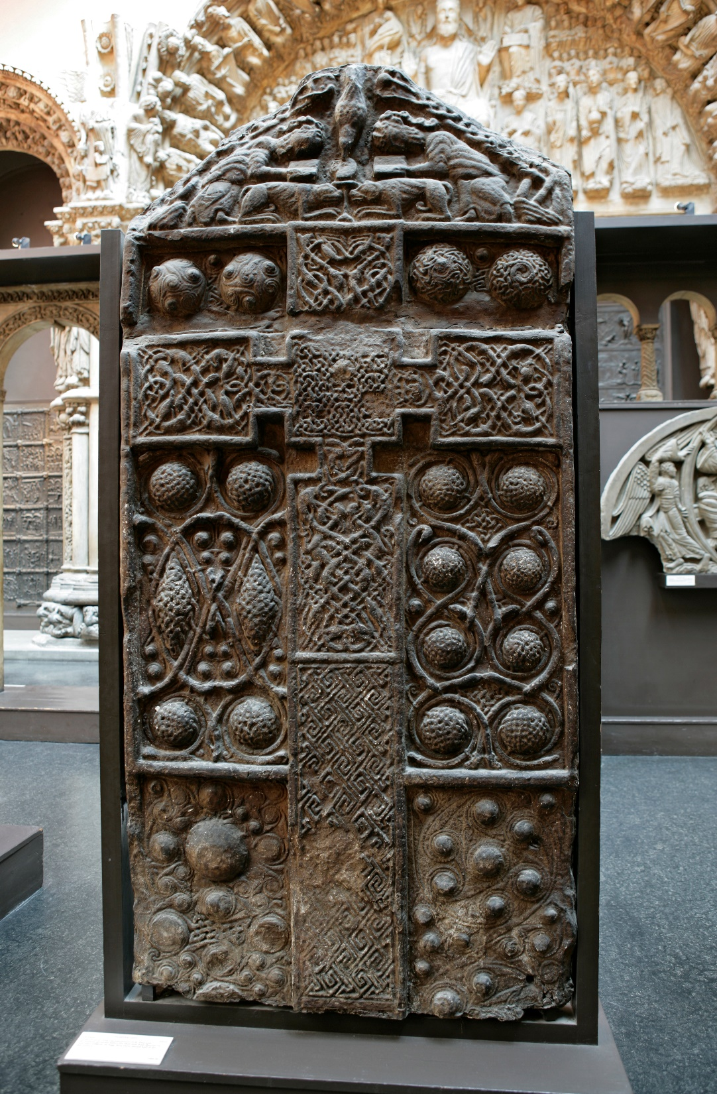
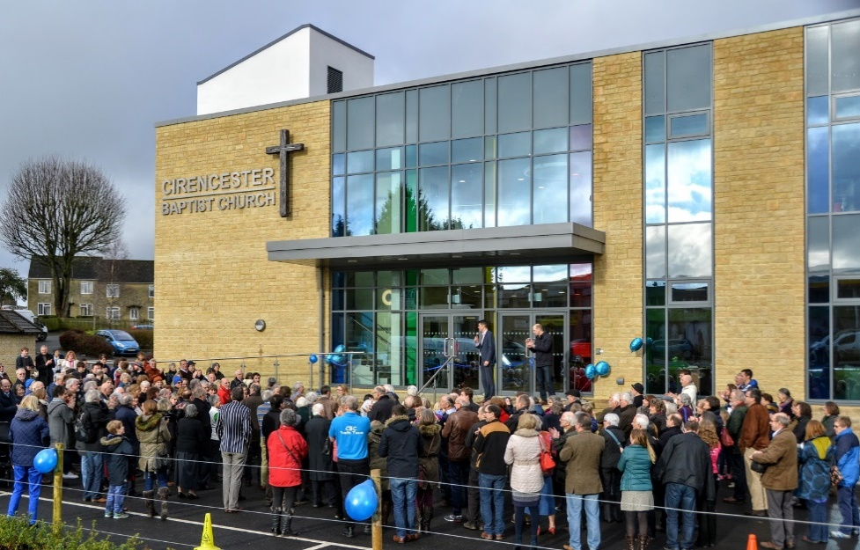
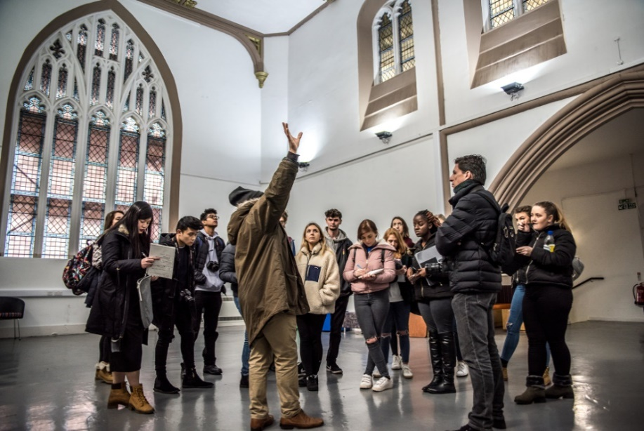
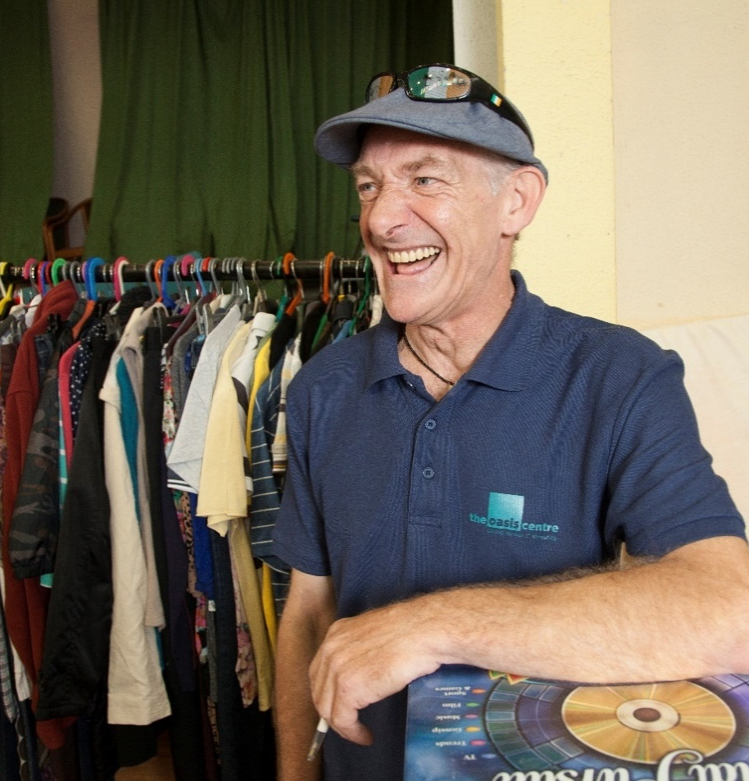
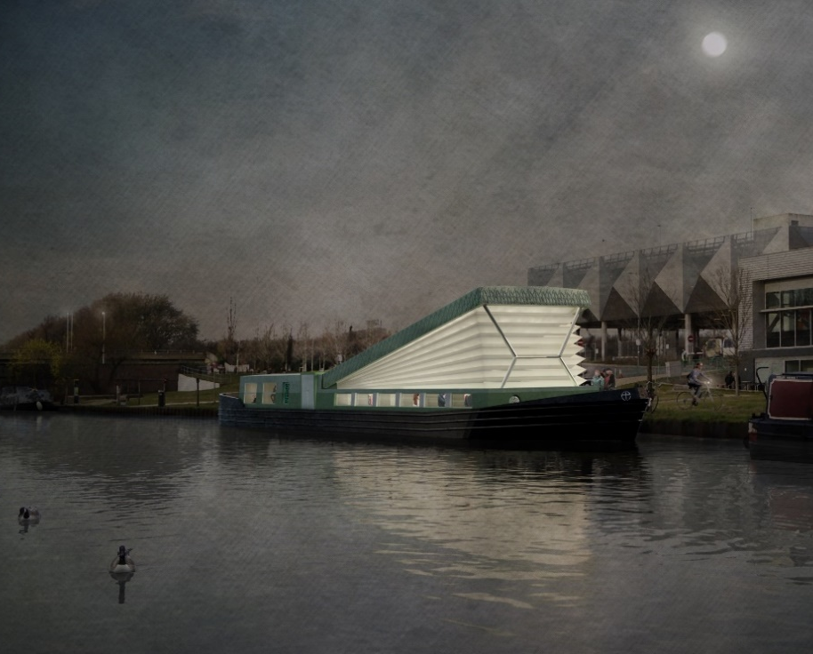
More grants
Cirencester Baptist Church – a new church building
Trinity Arts Centre – repair to Grade II* converted church centre
St Paul’s Old Ford Church – the building of a floating church
Victoria & Albert Museum – for the restoration of six Christian cast crosses
The Oasis Centre, Gorton – a purpose built centre to support the homeless

Slide 12
Get in touch
www.allchurches.co.uk
01452 875858 07584 384431
Facebook
@allchurchestrust
Twitter
@allchurchest

