Slide 1
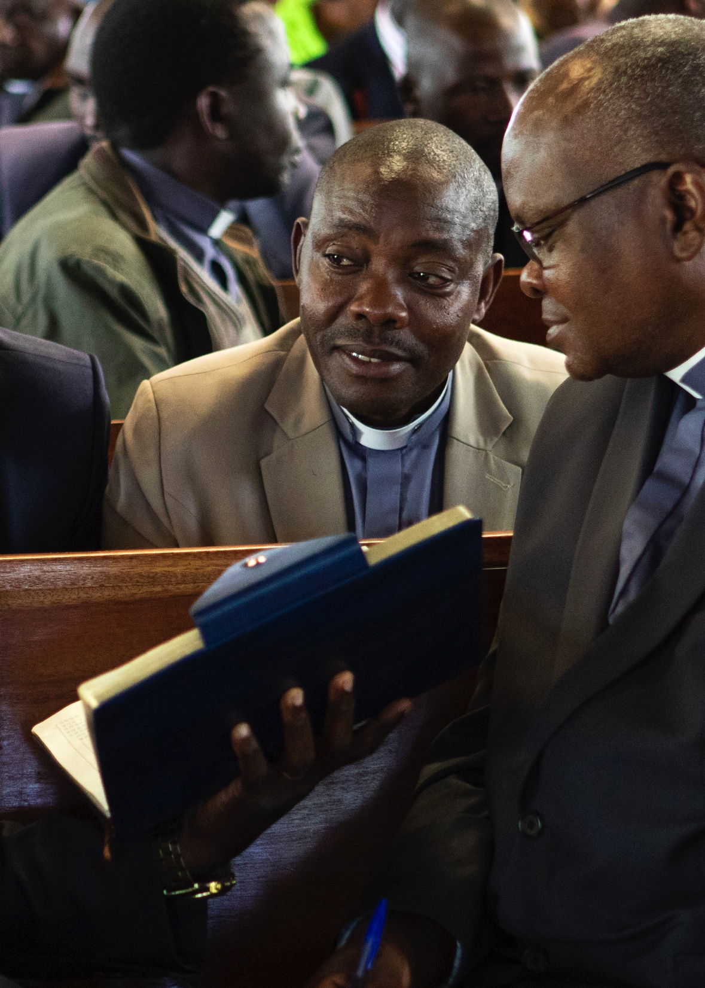
Bishops’ Appeal to help
clergy families in Uganda
“The people who so often bear the burden of care in their own communities are themselves now in desperate need of encouragement and support.”

Slide 2
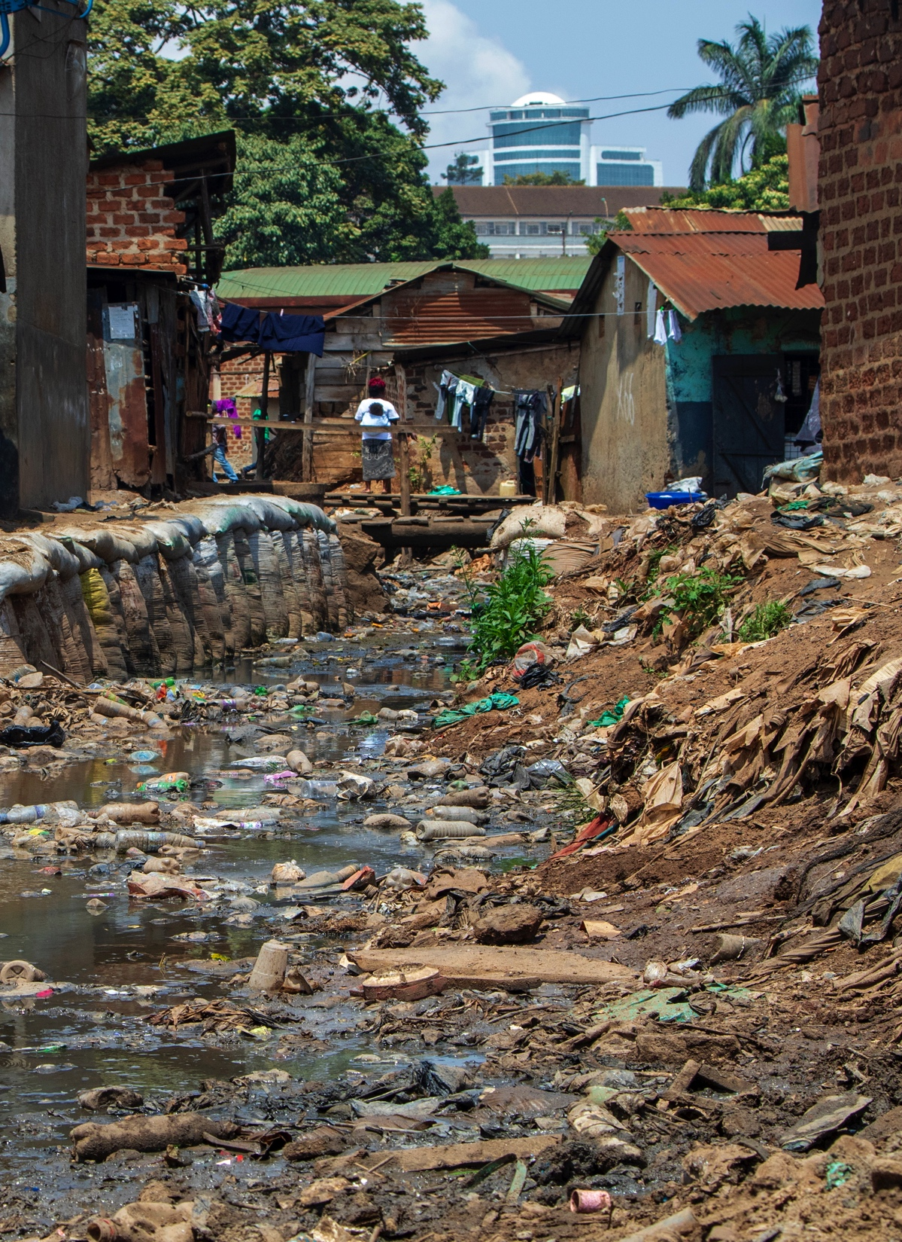
Our gifts will go a long way
10 pounds can provide maize meal and beans for a family to survive on for a week;
£20 would mean that basic essentials such as salt, sugar, soap and cooking oil could be provided along with the food.
£50 would allow a family to meet a simple medical emergency.
£200 could provide food relief for ten families.

Slide 3
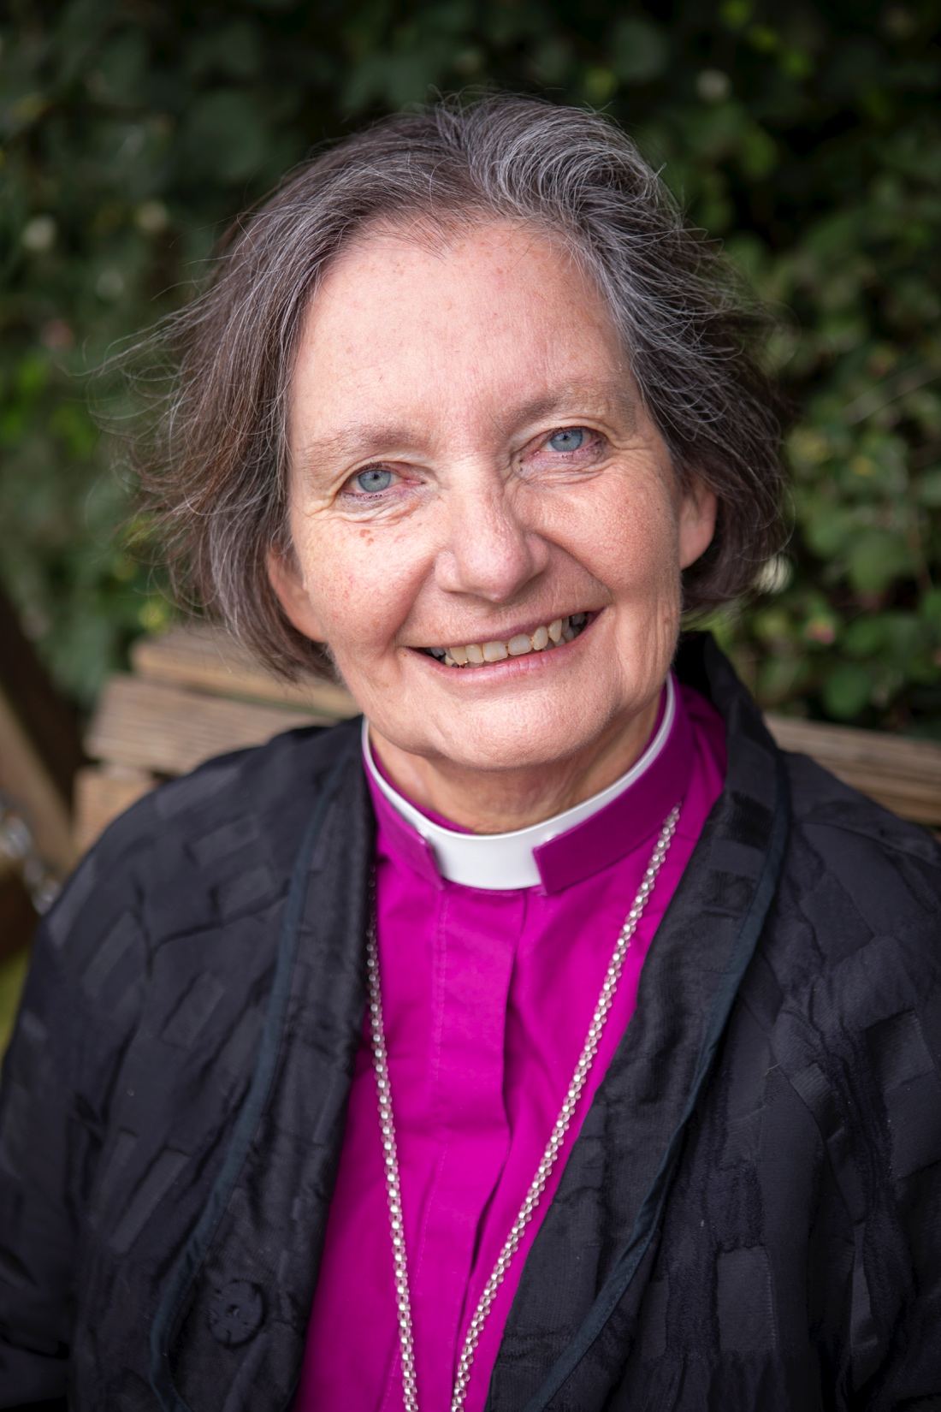
“Today I am asking you to stand with our Ugandan sisters and brothers in this time of crisis and support this appeal as generously as you can.”
To give go to:
www.bristol.anglican.org/uganda-appeal

